Slide 1
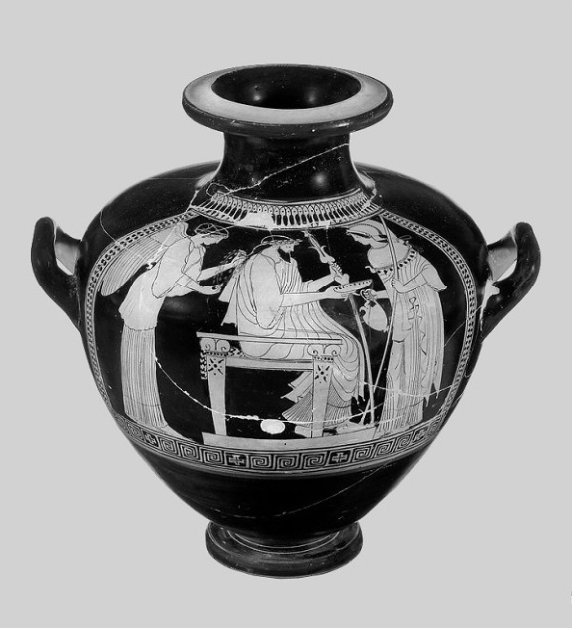

Libation

Slide 2
Zeus with
Nike or Iris and Athena hydria,
(142460 MNW)

Slide 3
Libation
A libation is liquid offering.
A libation would be poured to a god or goddess, to a hero or heroine, or the dead.
Water, wine, olive oil and honey were the most common liquids offered.
Even the gods were thought to perform libations.

Slide 4
Zeus with
Nike or Iris and Athena hydria,
(142460 MNW)

Slide 5
Libation
Libations often marked the beginning or end of something – for example:
Before and after a meal or a symposium party.
In the morning and at evening time.
At the beginning and end of a journey.
When a soldier leaves for war and when he returns.

Slide 6
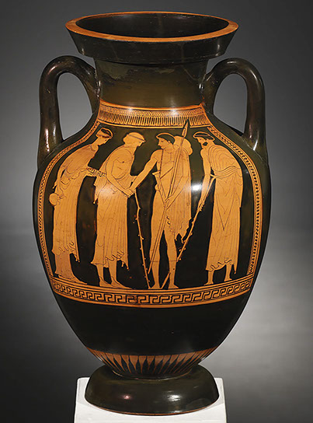
This amphora shows a soldier leaving home. The woman on the far left holds a jug and bowl ready for making a libation.
Private collection, c. J-D Cahn.
See Well-Wishers on www.panoply.org.uk

Slide 7
Private collection, c. J-D Cahn.
See Well-Wishers on www.panoply.org.uk

Slide 8
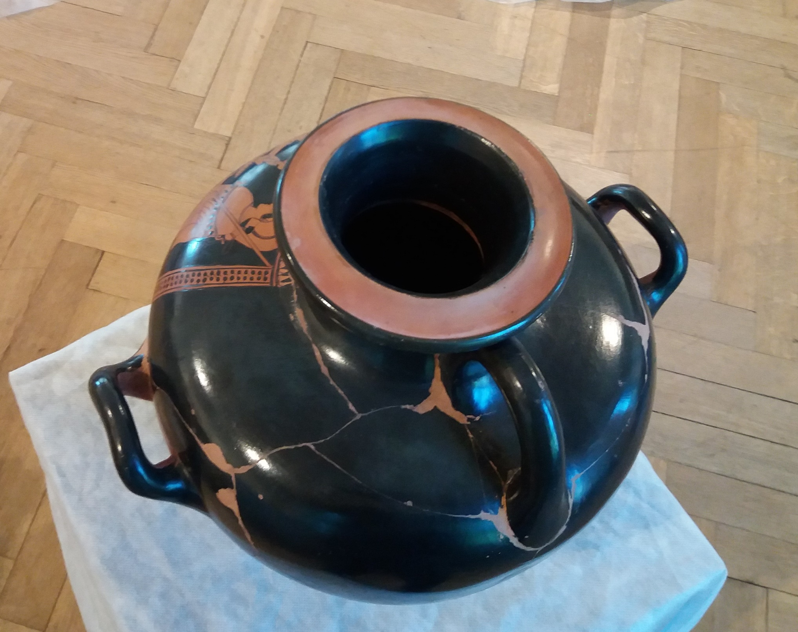

Slide 9
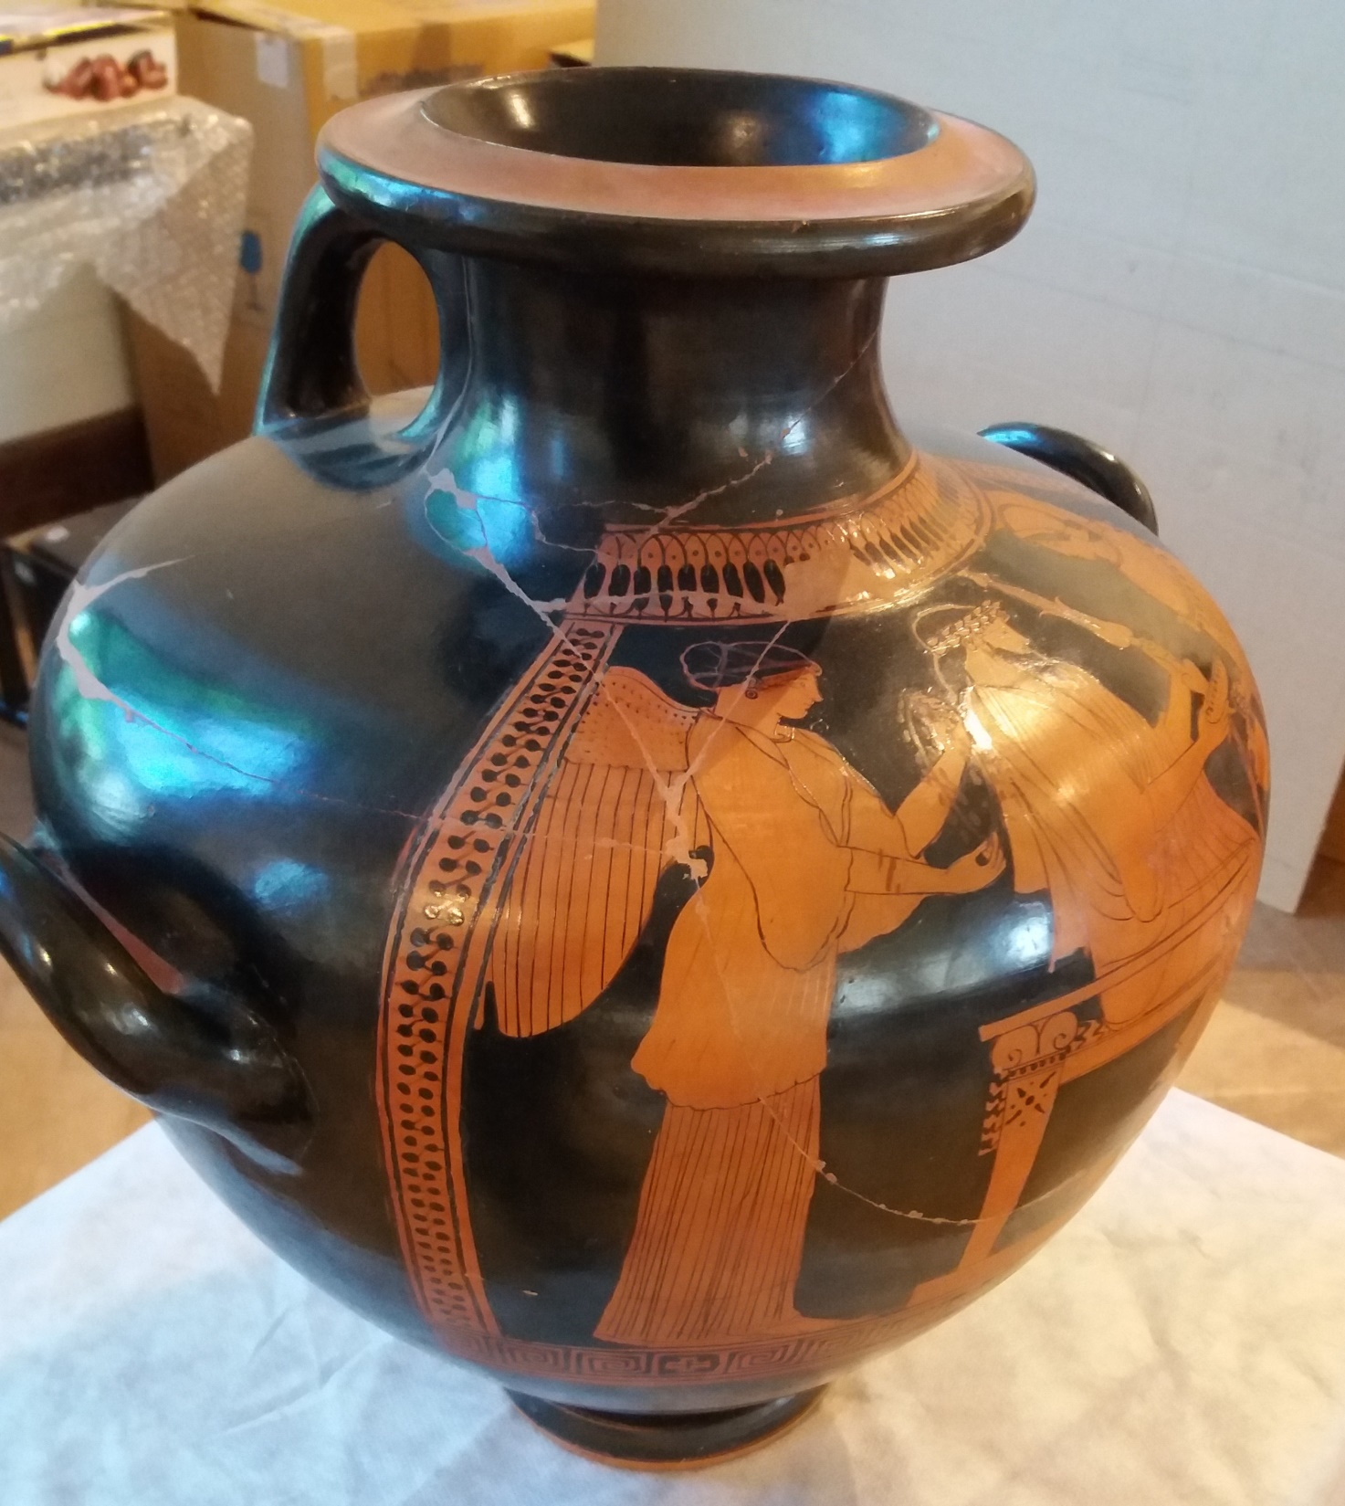

Slide 10
Zeus with
Nike or Iris and Athena hydria,
(142460 MNW)

Slide 11
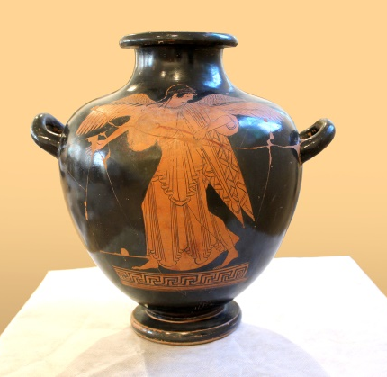
A hydria featuring Iris, c.450BCE
National Museum in Warsaw, 142289

Slide 12
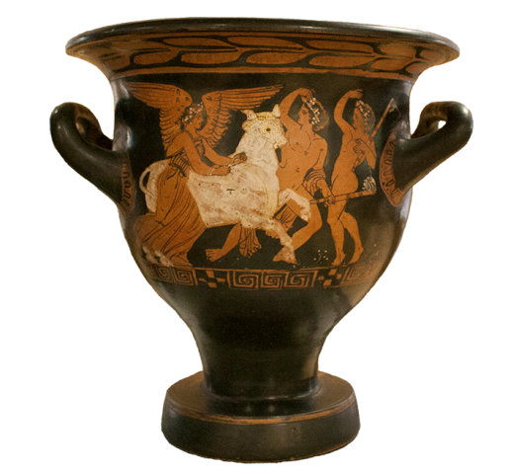
A bell krater featuring Nike, c.375BCE
UCD Classical Museum, 197

Slide 13
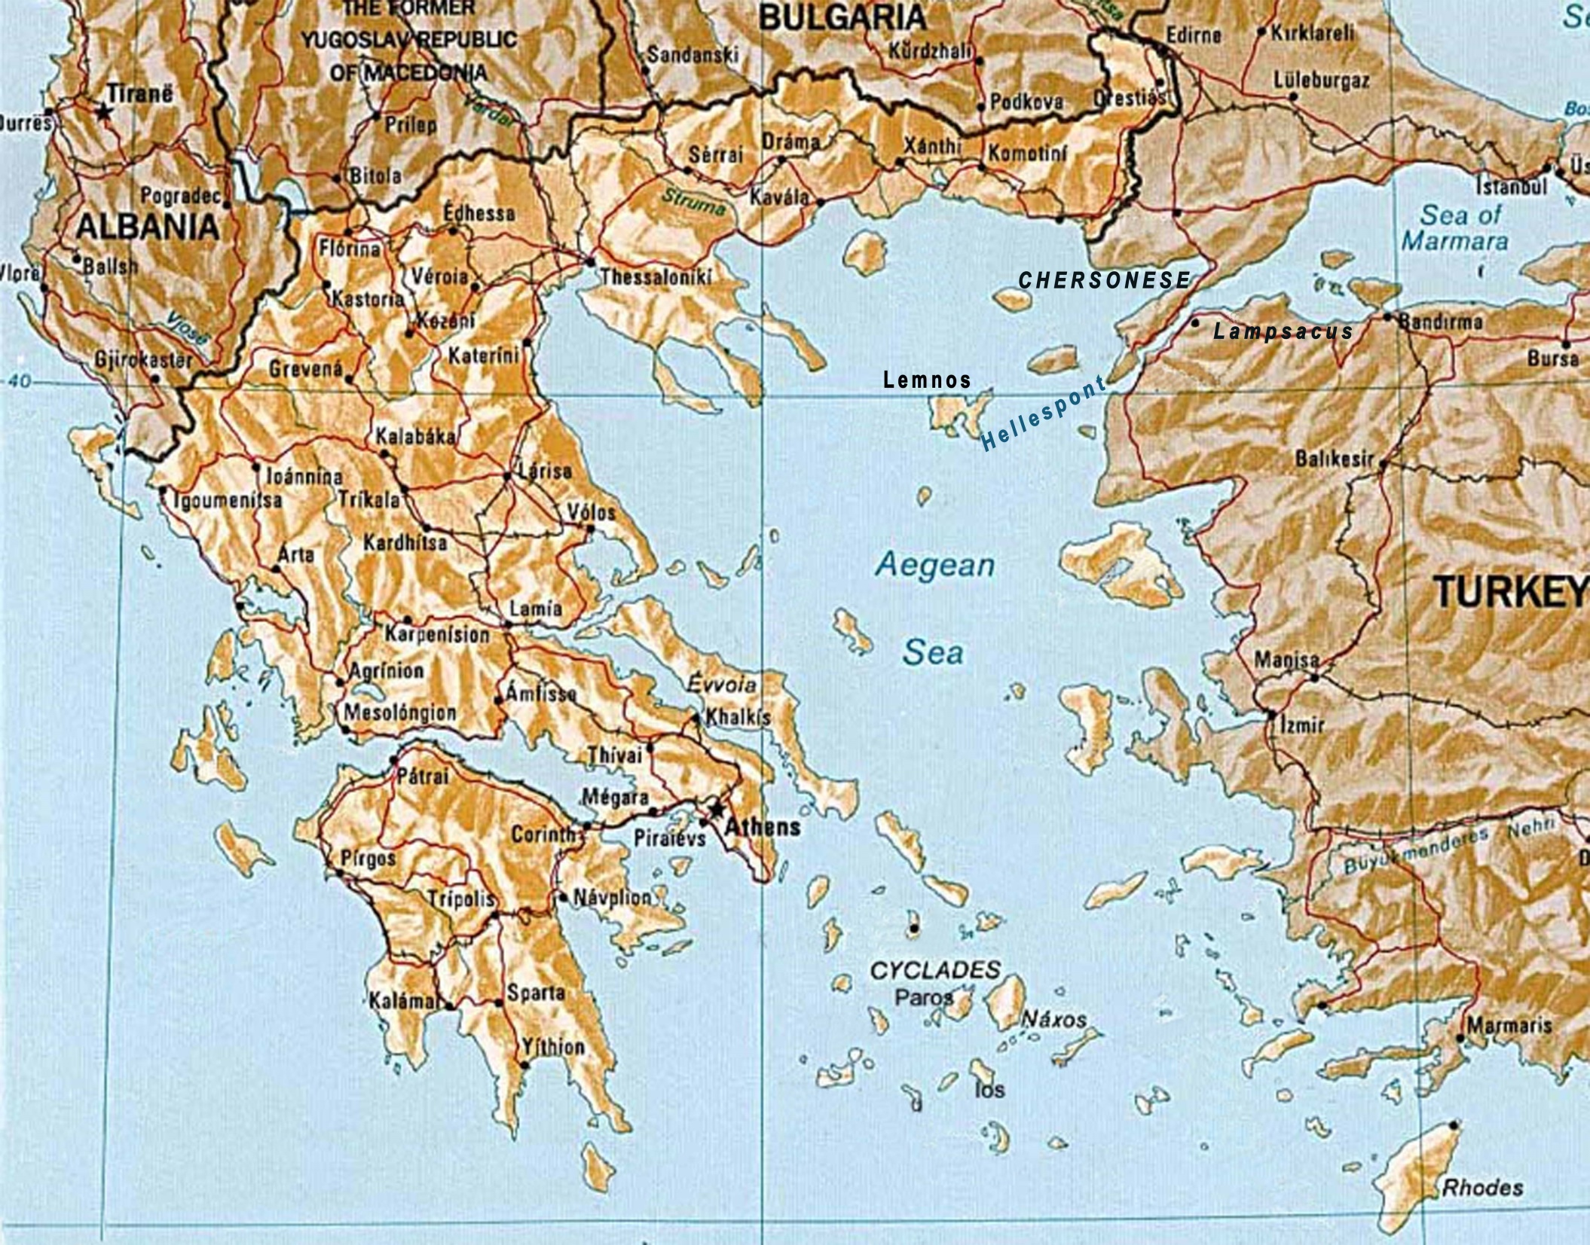

Slide 14
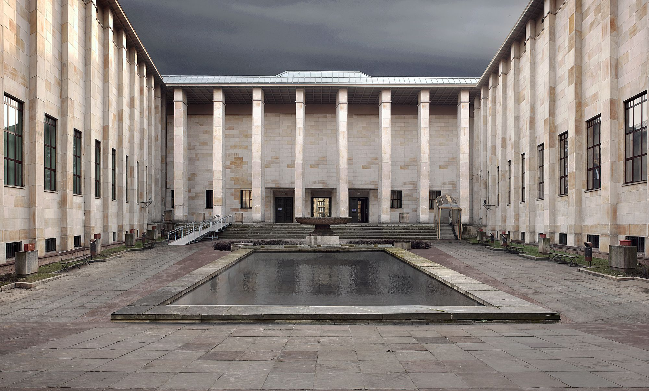
National Museum in Warsaw

Slide 15
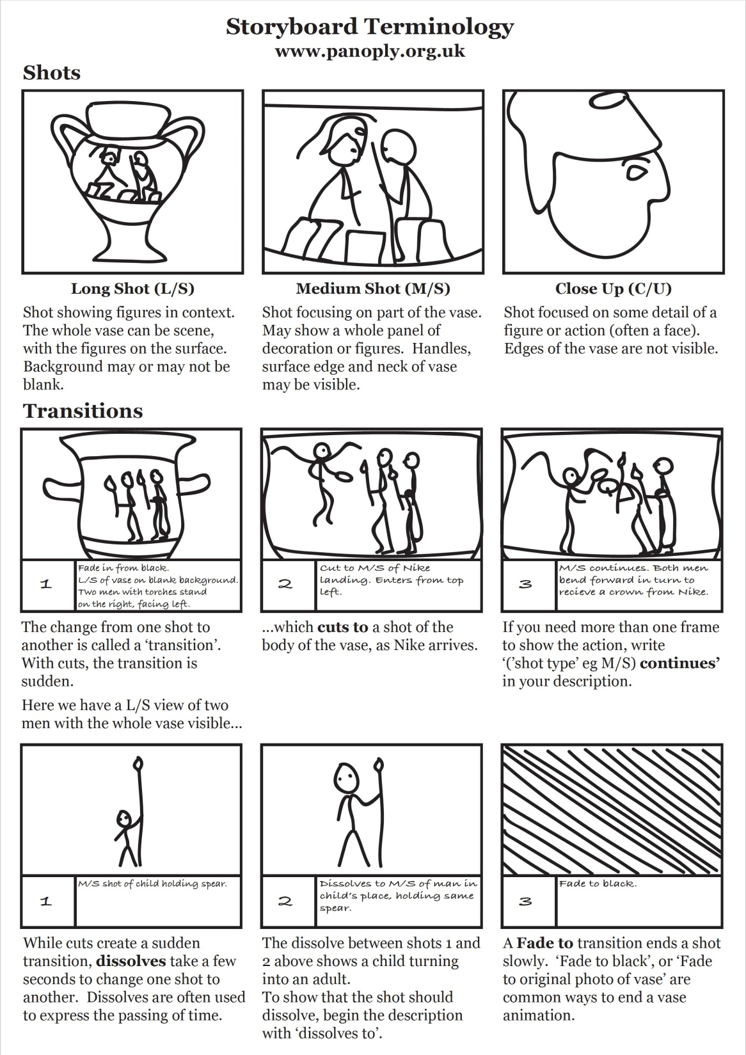

Slide 16
This resource was created by the
Panoply Vase Animation Project
as part of the European Research Council (ERC) funded project:
Our Mythical Childhood... The Reception of Children's and Young Adults' Culture in Response to Regional and Global Challenges
(Grant Agreement 681202; ERC Consolidator Grant led by Katarzyna Marciniak)

