Slide 1
Iris - Rainbow Goddess

Slide 2
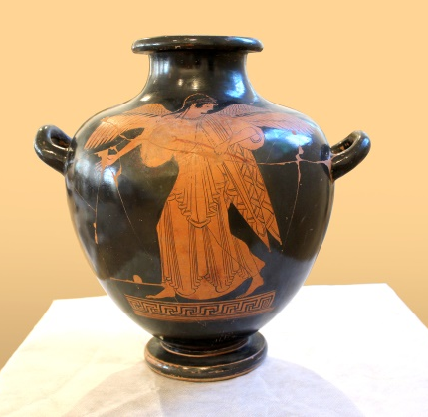
Iris, hydria,
(MNW 142289)

Slide 3
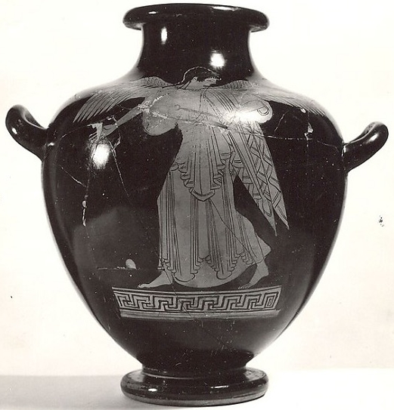
Iris, hydria
(142289 MNW)

Slide 4
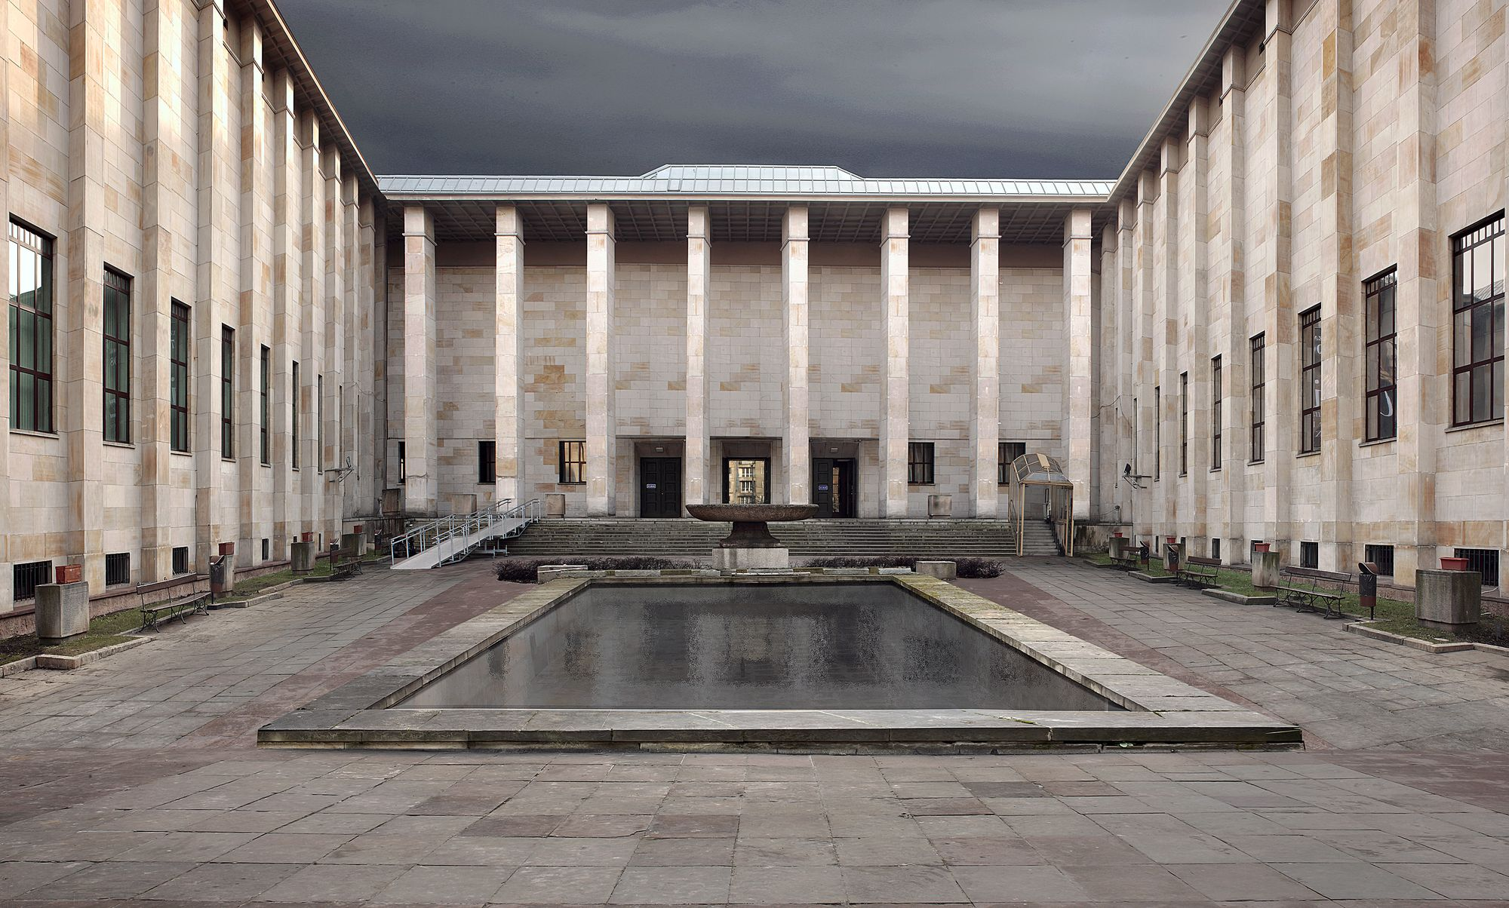
National Museum in Warsaw

Slide 5
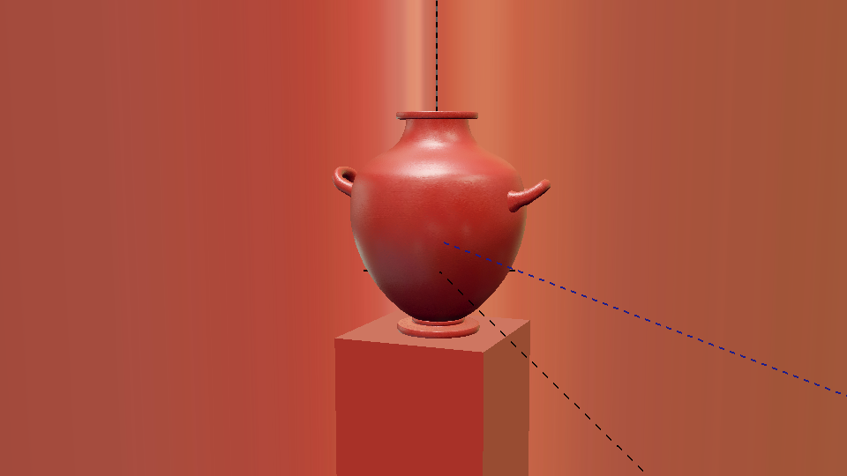

Slide 6
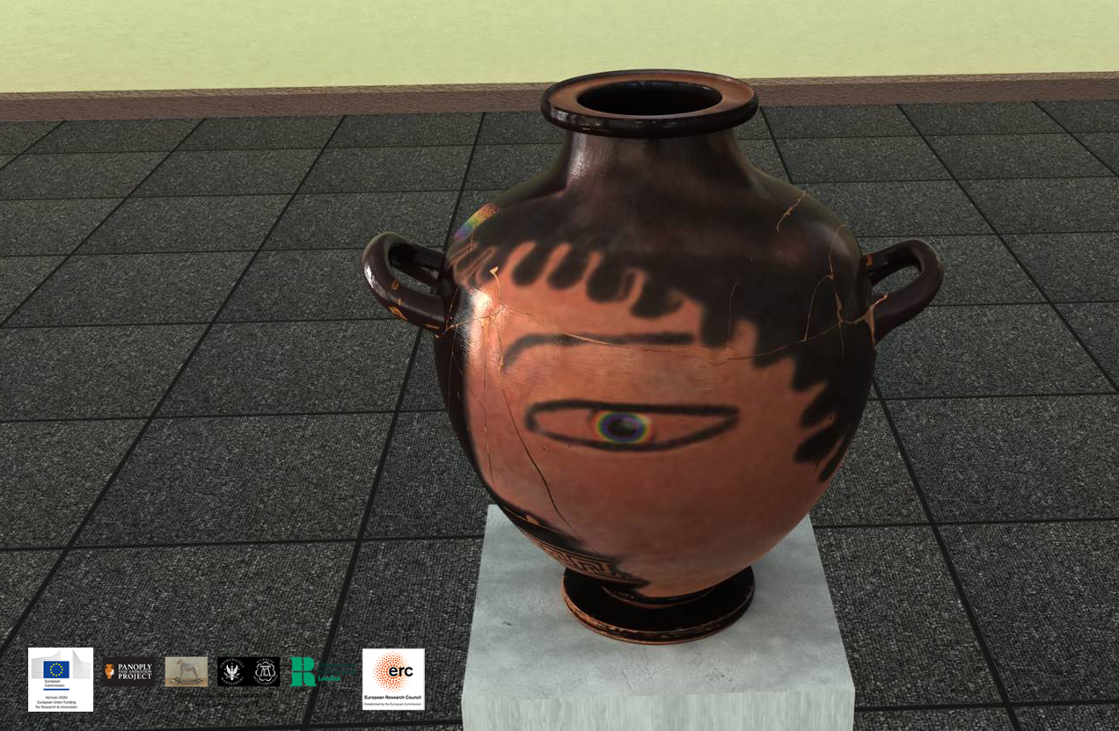

Slide 7
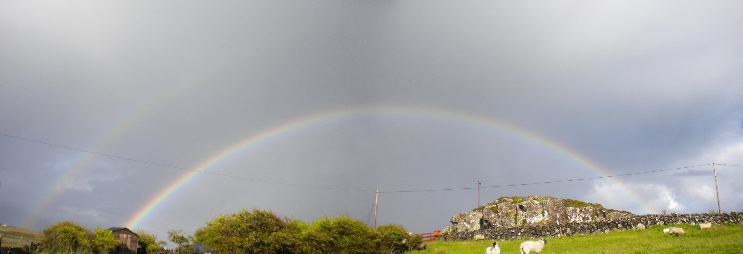

Slide 8
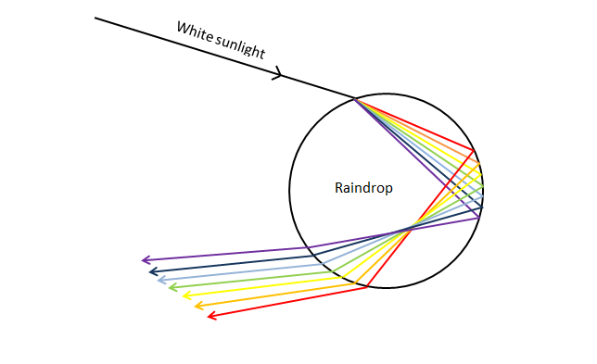
Image from the Met Service Blog
http://blog.metservice.com/atmospheric-optics

Slide 9
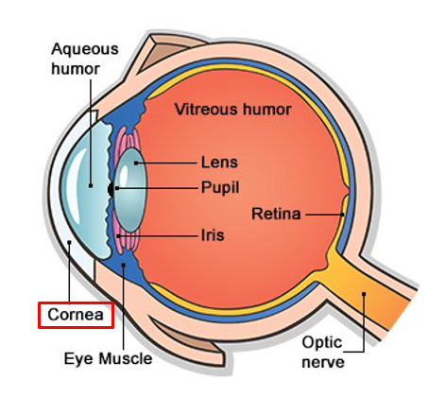

Slide 10
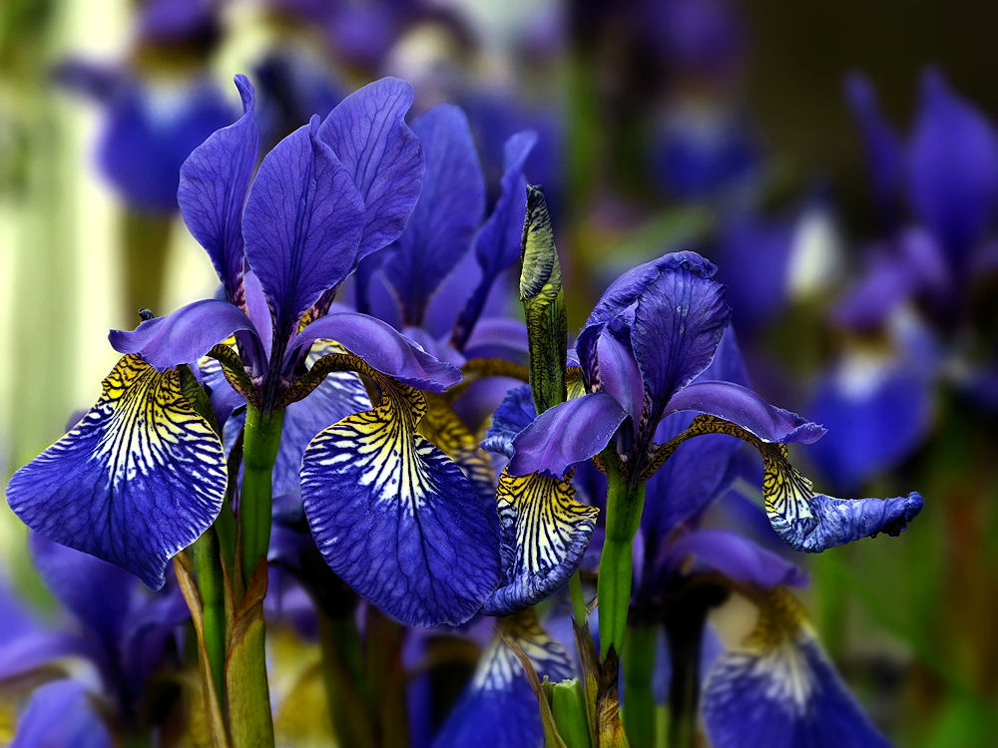

Slide 11
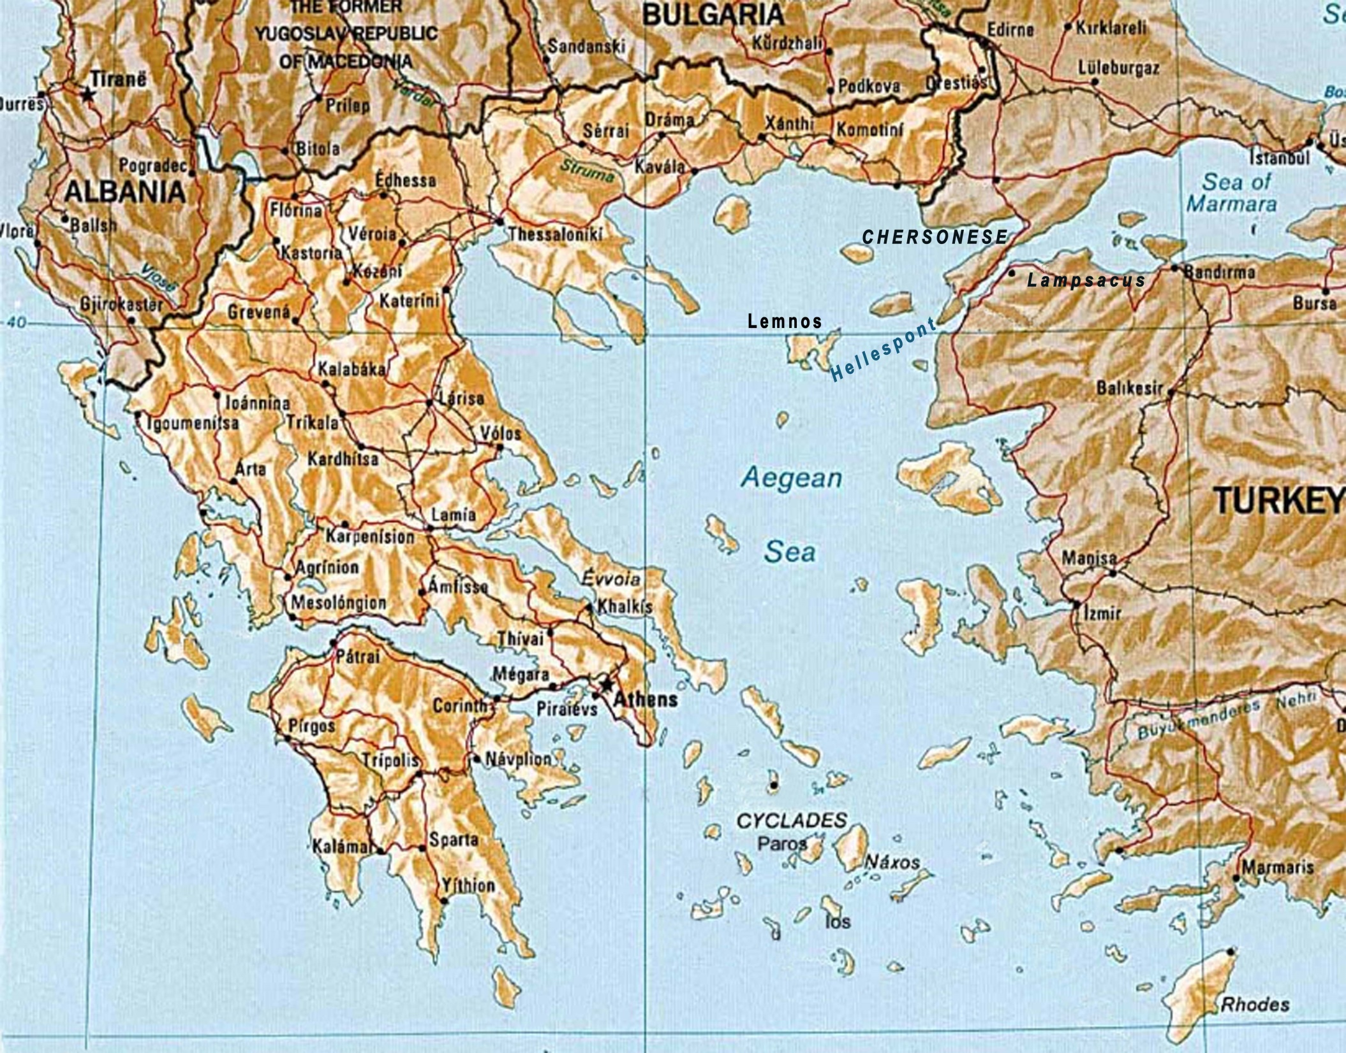

Slide 13
This resource was created by the
Panoply Vase Animation Project
as part of the European Research Council (ERC) funded project:
Our Mythical Childhood... The Reception of Children's and Young Adults' Culture in Response to Regional and Global Challenges
(Grant Agreement 681202; ERC Consolidator Grant led by Katarzyna Marciniak)

