Slide 1
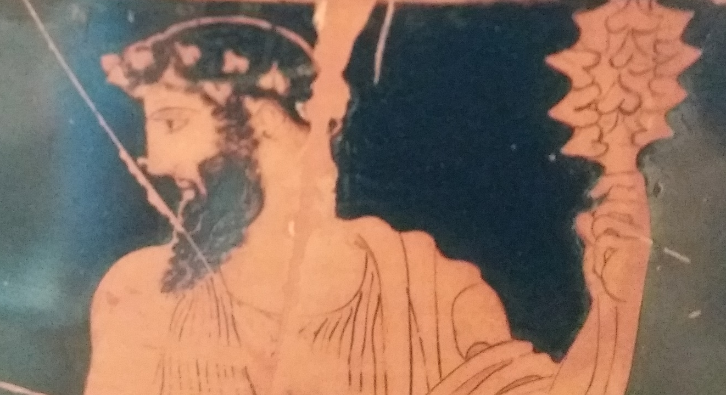

Dionysus

Slide 2
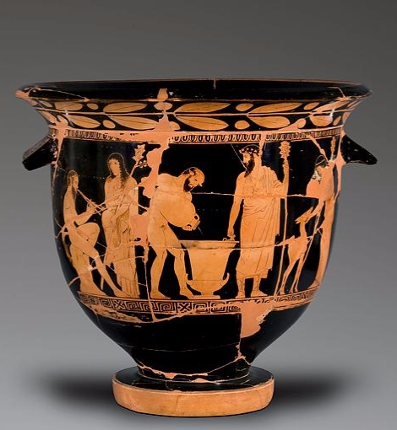
Dionysus
and followers,
bell krater
National Museum in Warsaw, 142355 MNW

Slide 3

The god Dionysus was always associated with things out of the ordinary – wild places, wine, masks and impersonation.
He was followed by mythical satyrs and by women known as ‘maenads’.
When drama developed, plays were performed for Dionysus as an offering.

Slide 4
A satyr plays the aulos. A maenad – female follower of Dionysus - listens.
A satyr pours wine into a krater to be mixed with water and served
Dionysus watches the wine being poured
A maenad
pets a deer

Slide 5
Festival of Dionysus: Dionysia
There were many festivals of Dionysus, or ‘Dionysia’ across the Greek world. Most is known about the ‘City Dionysia’ in Athens.
The City Dionysia was held when the city became busy after Winter at the end of what we call March.
When the festival began, people gathered to watch a procession. Phalli, bread loaves, and bowls were carried in the procession through the city to the sacred area by the theatre. Free, non-Athenian men who lived in Athens joined the procession dressed in red.

Slide 6
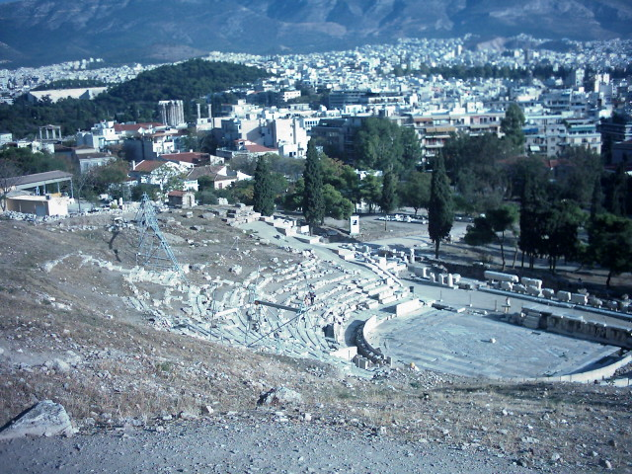
Theatre of Dionysus in Athens. Temple of Zeus in the background.

Slide 7
The theatrical performances began on the day after the procession.
3 playwrights would enter the tragedy competition.
Each competitor entered 3 tragedies and a satyr-play.
5 comic playwrights would enter the comedy competition. They entered 1 comedy each.

Slide 8
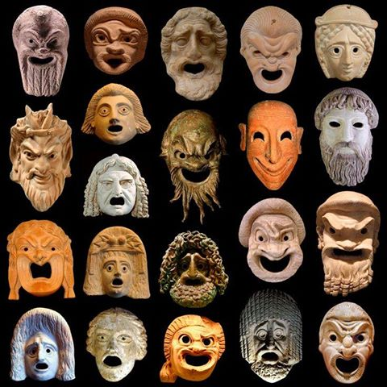
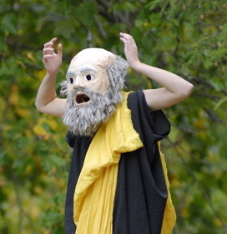
The performers in the plays wore masks.
Socrates, in Aristophanes’ Clouds.
Image from Didaskalia: Journal for Ancient Performance

Slide 9
Each play included a group of singers and dancers known as the Chorus, and a small number of actors – 2 at first, later 3.
10 men were chosen to act as the judges for the plays.
The festival would also include a group singing competition, one for men and one for boys. Every tribe in the city entered teams.

Slide 10
Satyr-plays
Satyrs are mythical creatures, much like men, but with long tails and animal ears. They are wild and rude and often doing things that people aren’t supposed to do. They love music and dance and they often accompany Dionysus.
Satyr-plays had the same sort of plan as tragedies and they included similar mythical topics.
Satyr-plays were different from tragedies in being much sillier and having men dressed as satyrs acting as the Chorus.
They were normally set in wild places.

Slide 11
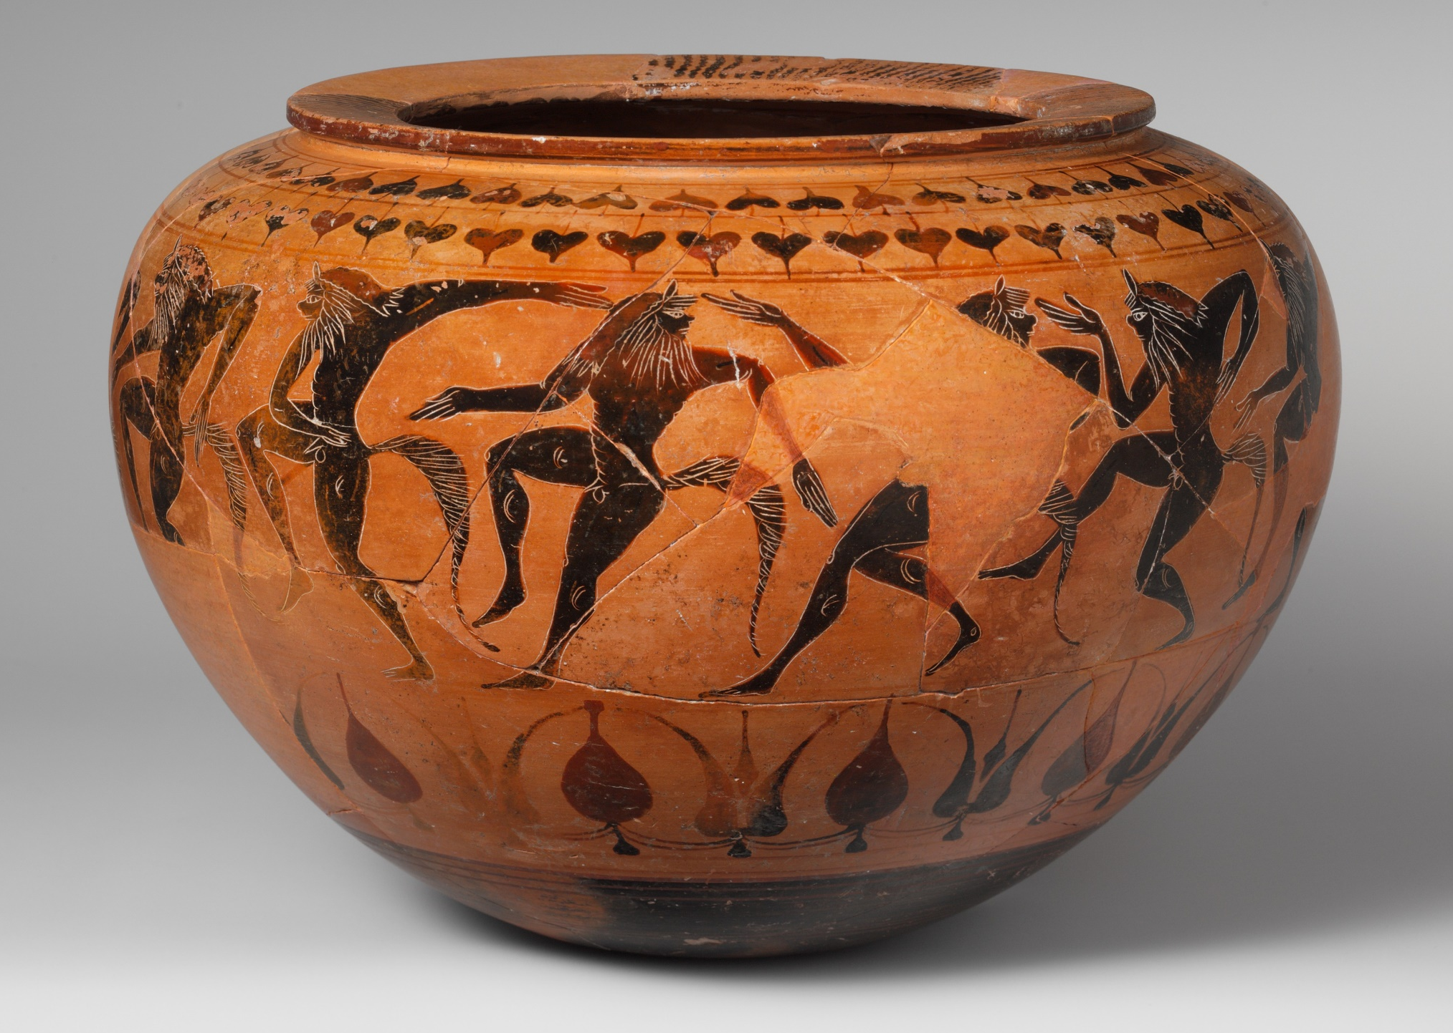
Metropolitan Museum
1971.259
Satyrs are often shown performing their wild satyr-dance

Slide 12
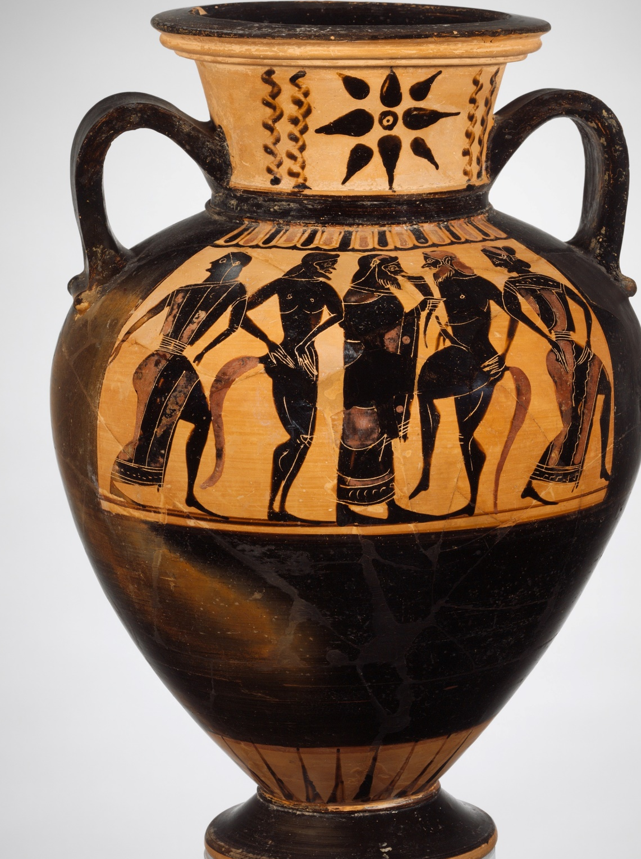
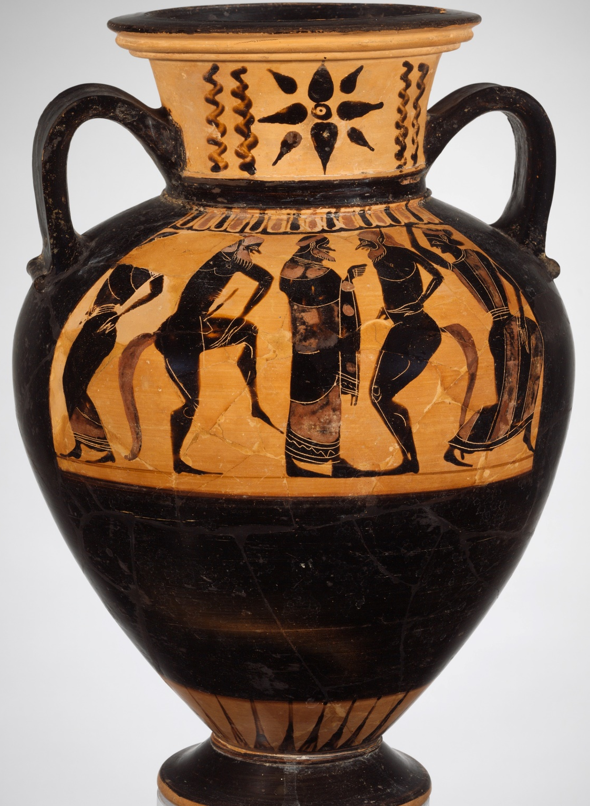
Satyrs & maenads dance around Dionysus
Two sides of one vase, Metropolitan Museum 1991.254

Slide 13
National Museum in Warsaw, 142355 MNW

Slide 14
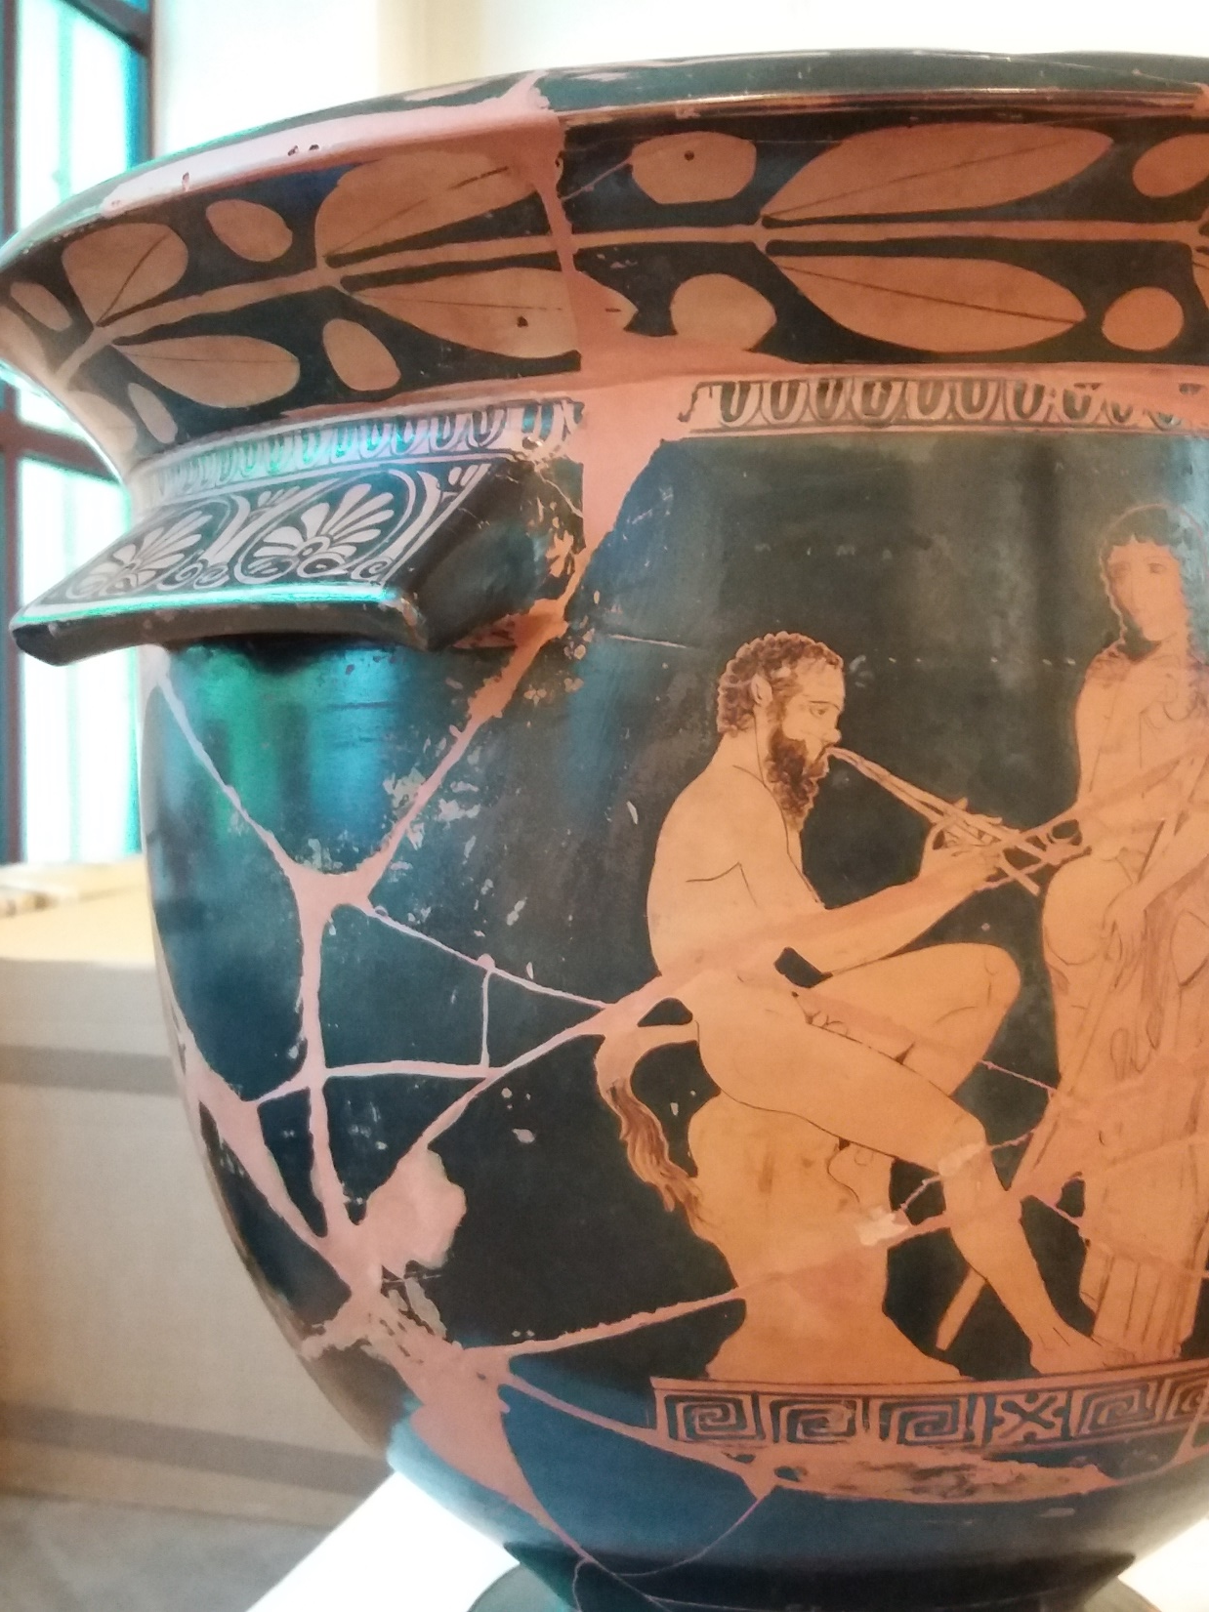

Slide 15
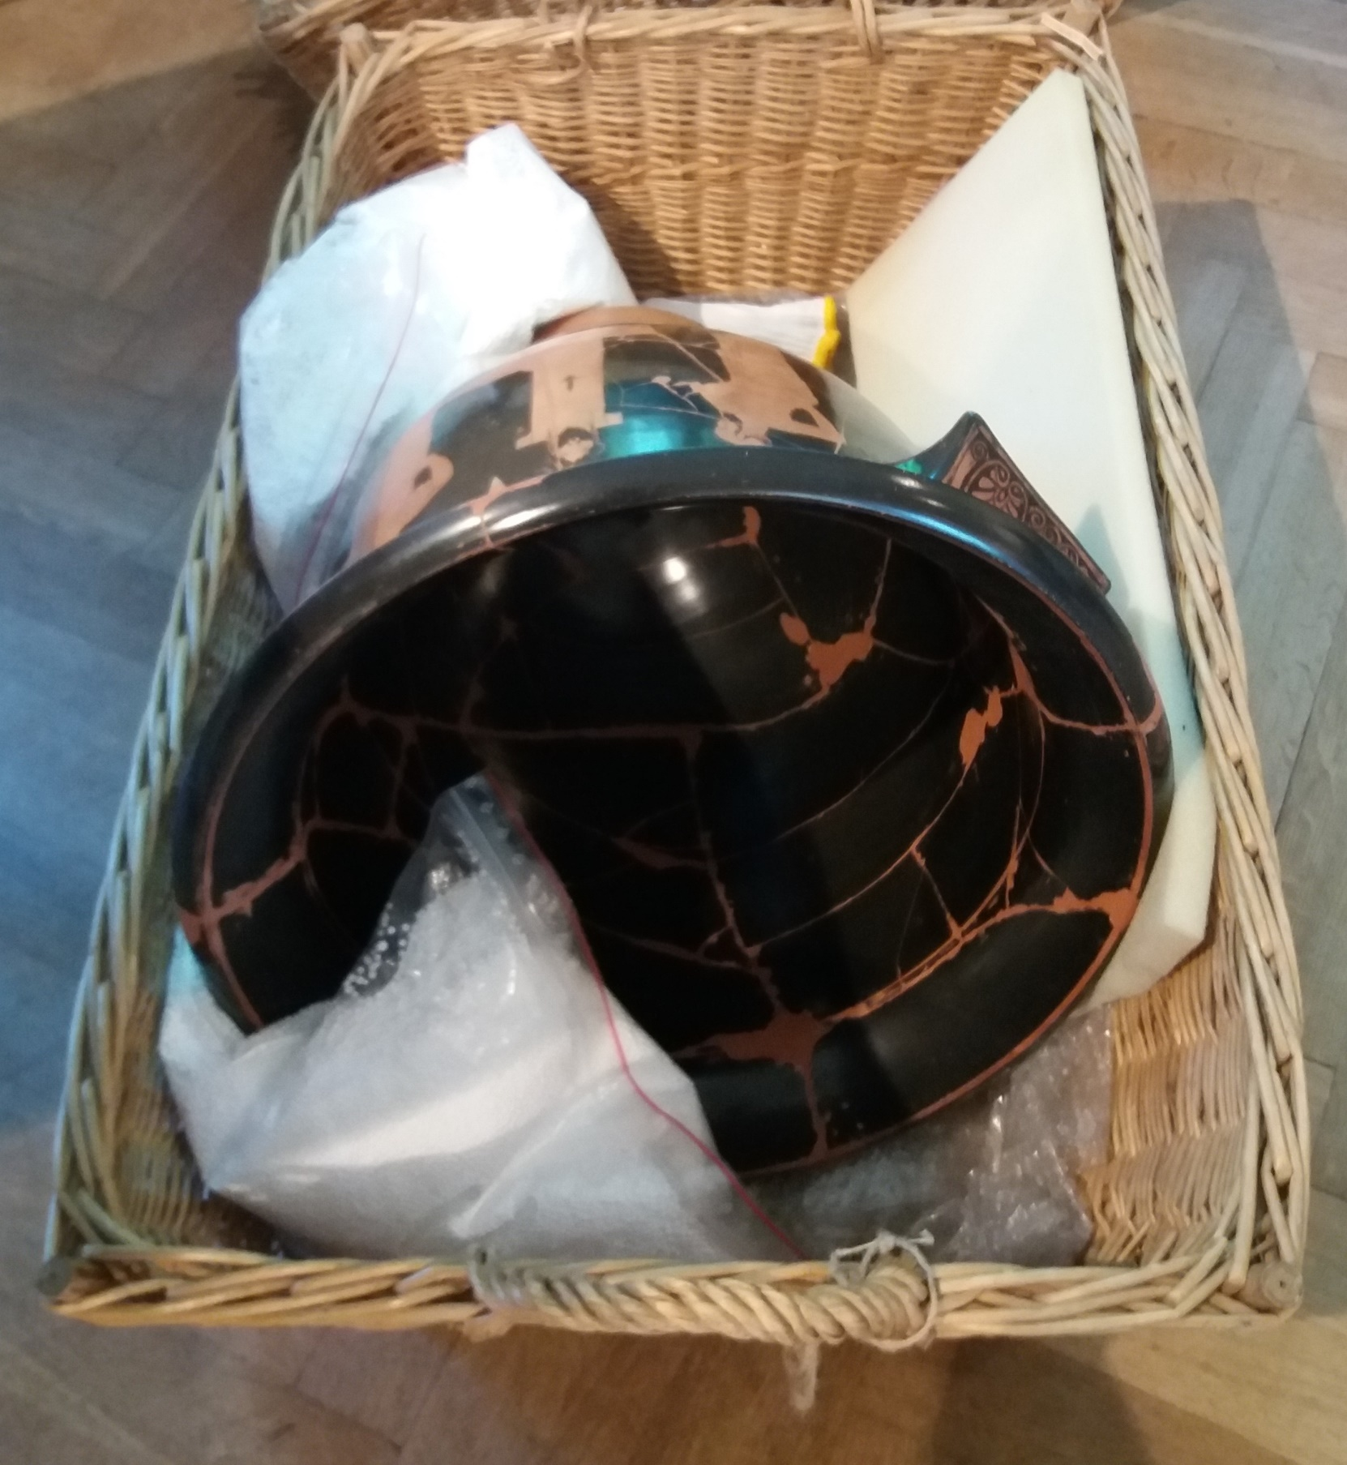

Slide 16


Slide 17
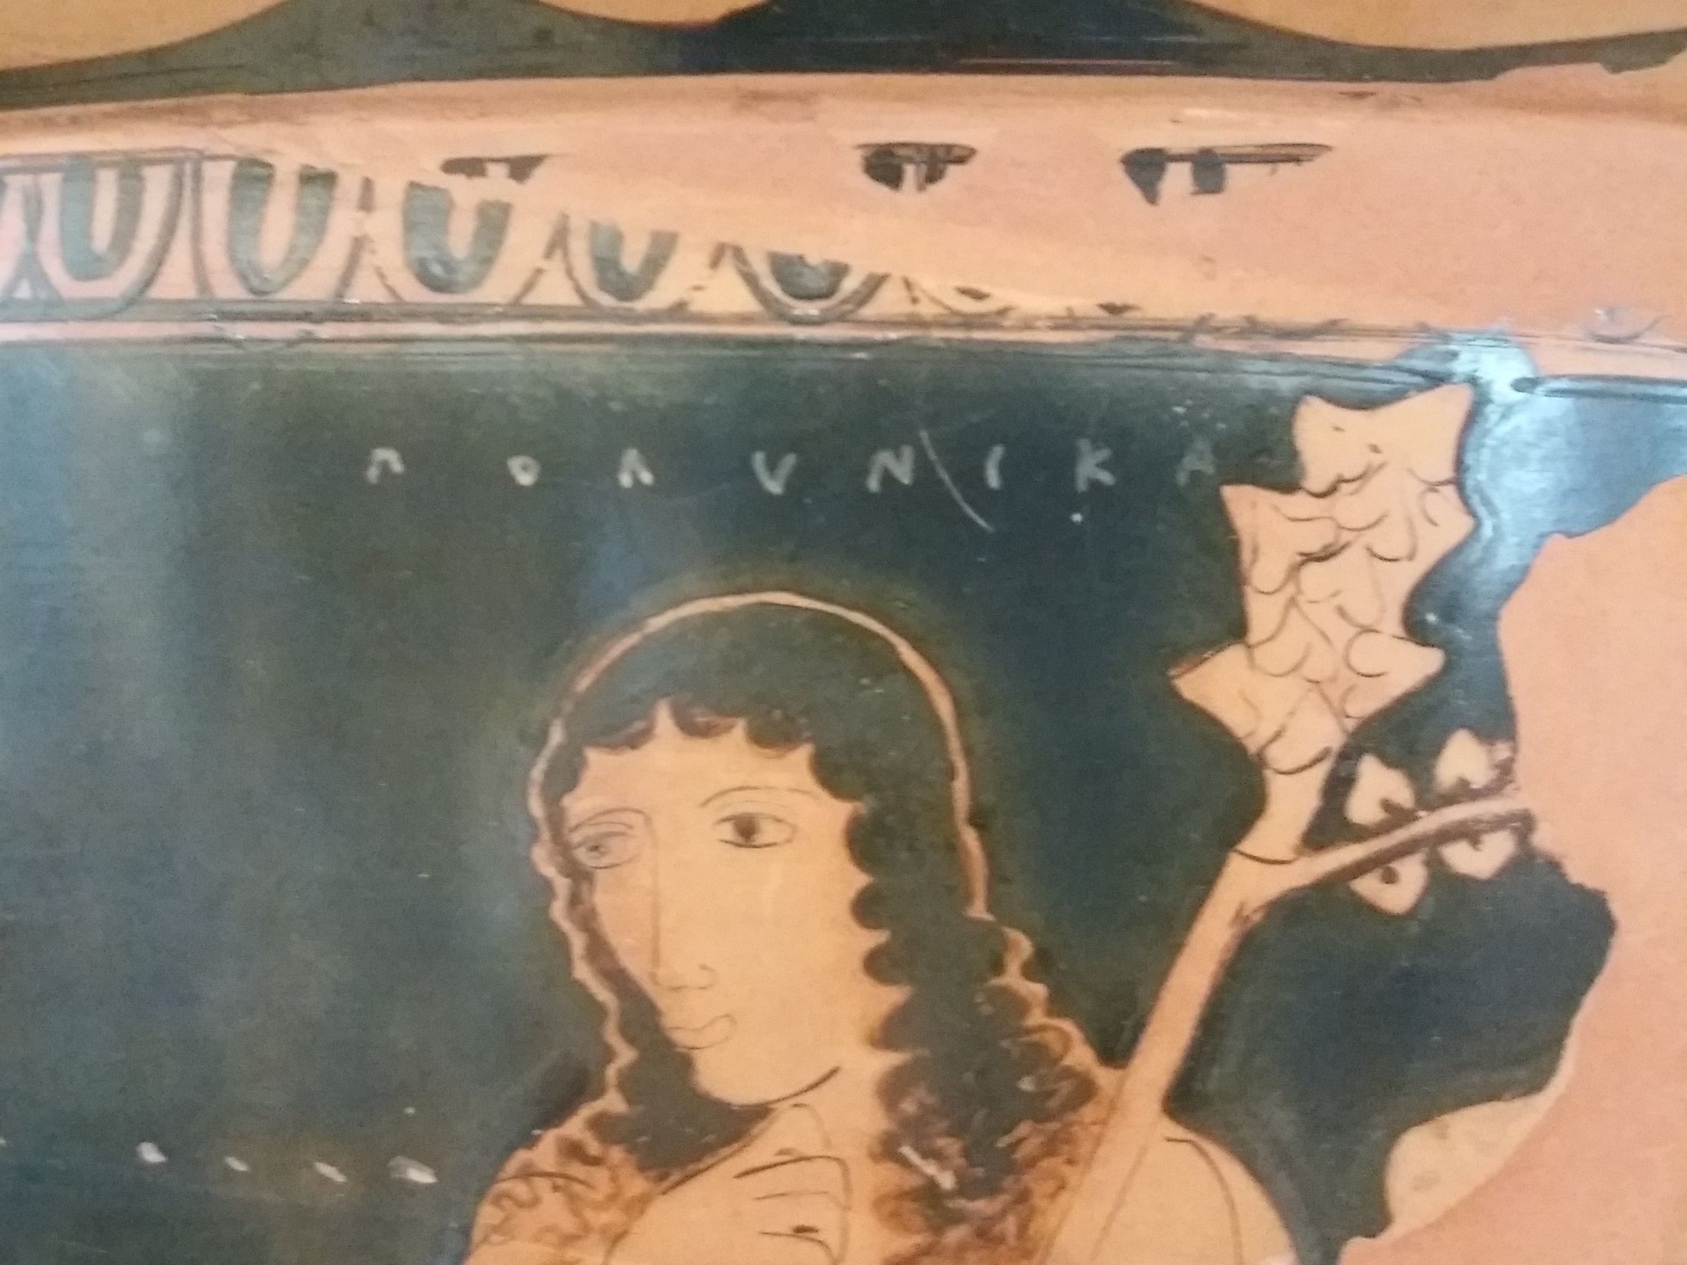

Slide 18
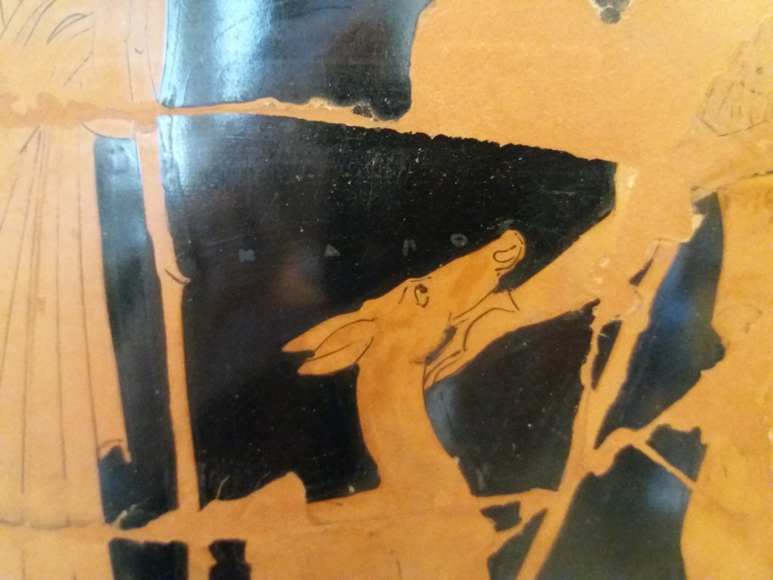

Slide 19
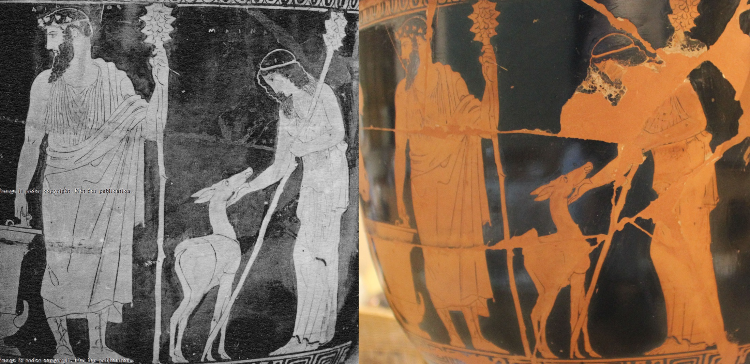
An old photo of the vase revealed what the deer’s tail should look like. The vase sustained damage; most likely when the National Museum in Warsaw was occupied by the Nazis during World War 2.

Slide 21
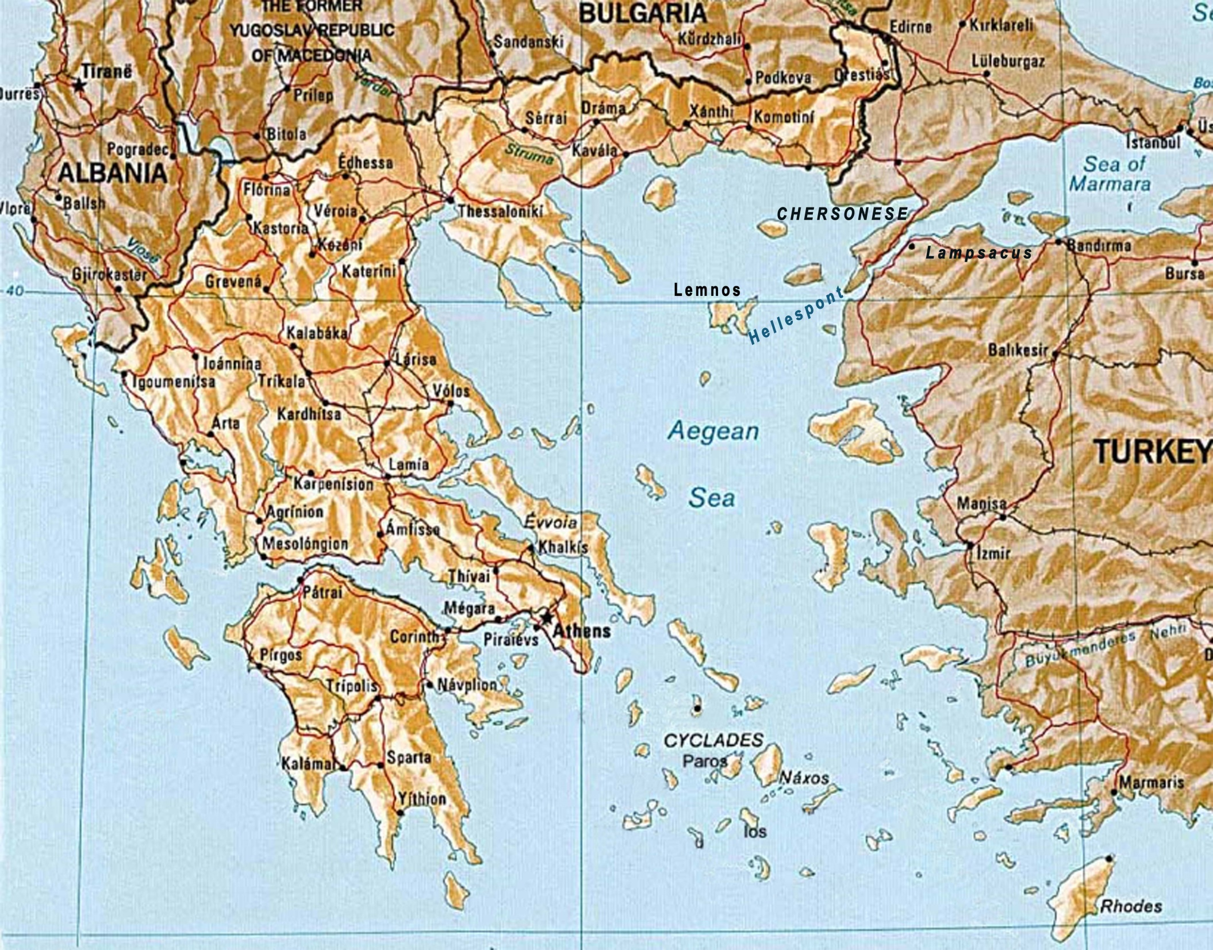

Slide 22
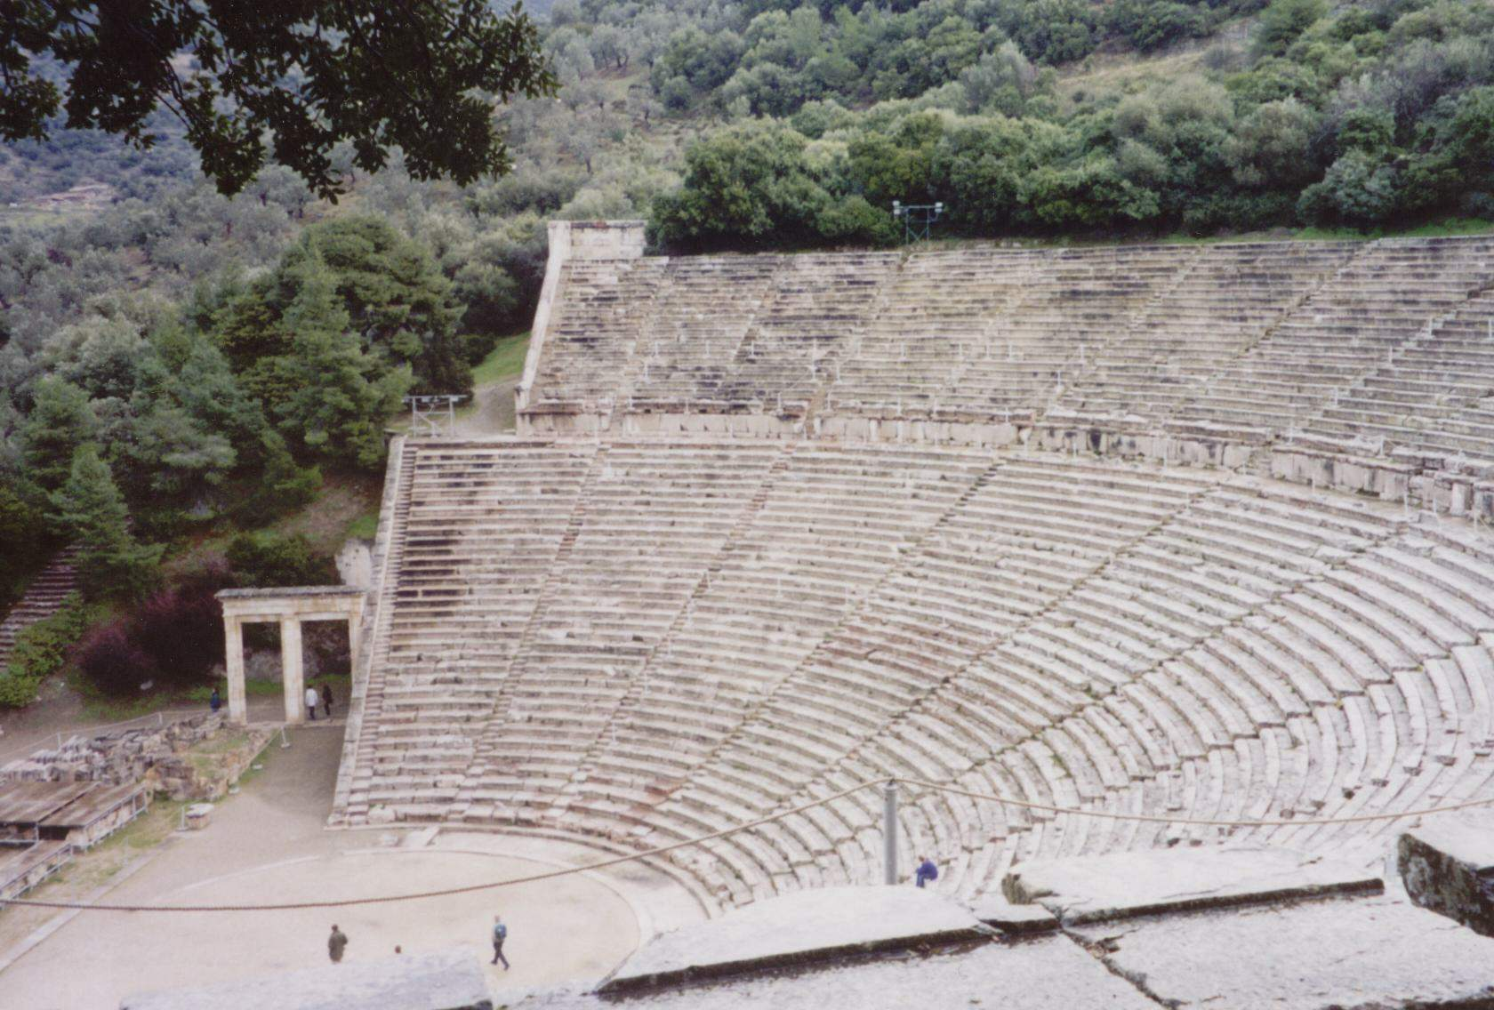
Theatre of Dionysus, Epidaurus.

Slide 23
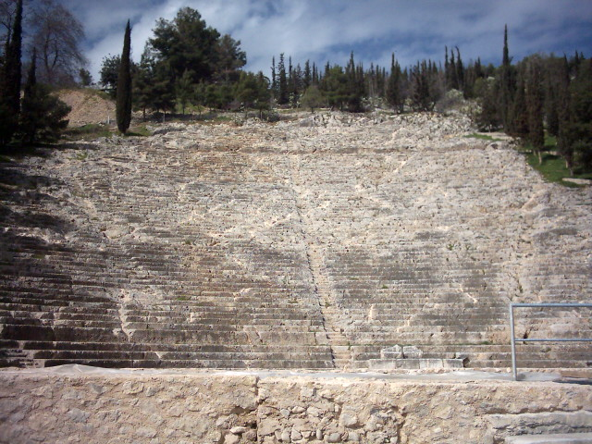
Theatre of Dionysus, Argos.

Slide 24
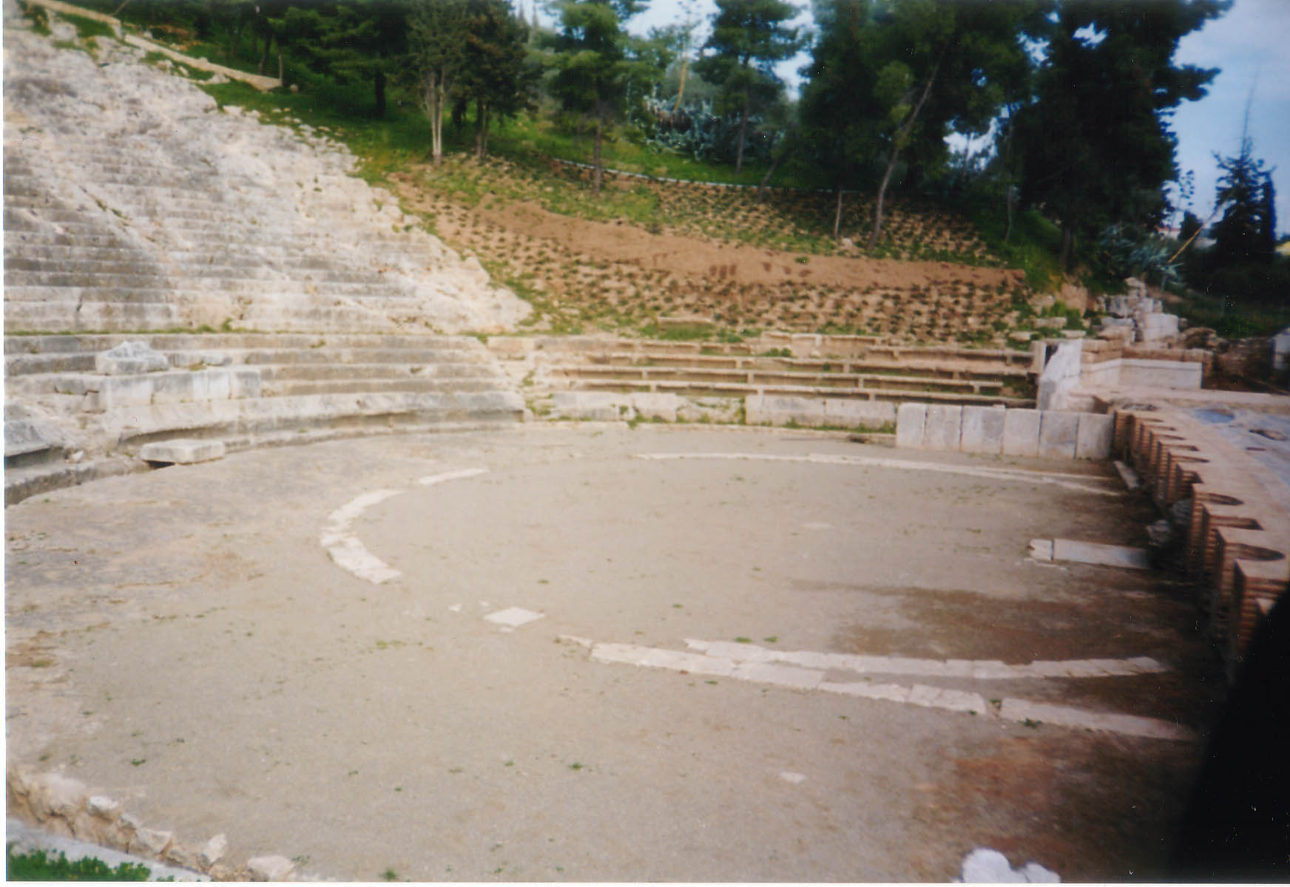
Chorus dancing lines on the floor of the theatre at Argos.

Slide 25
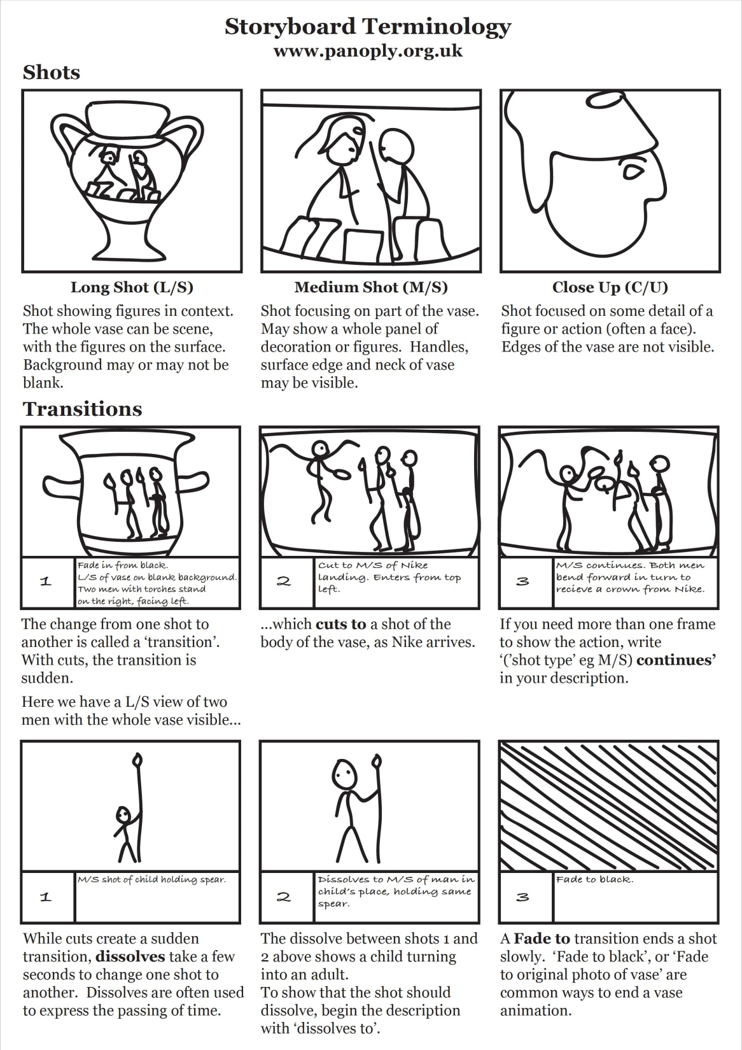

Slide 26
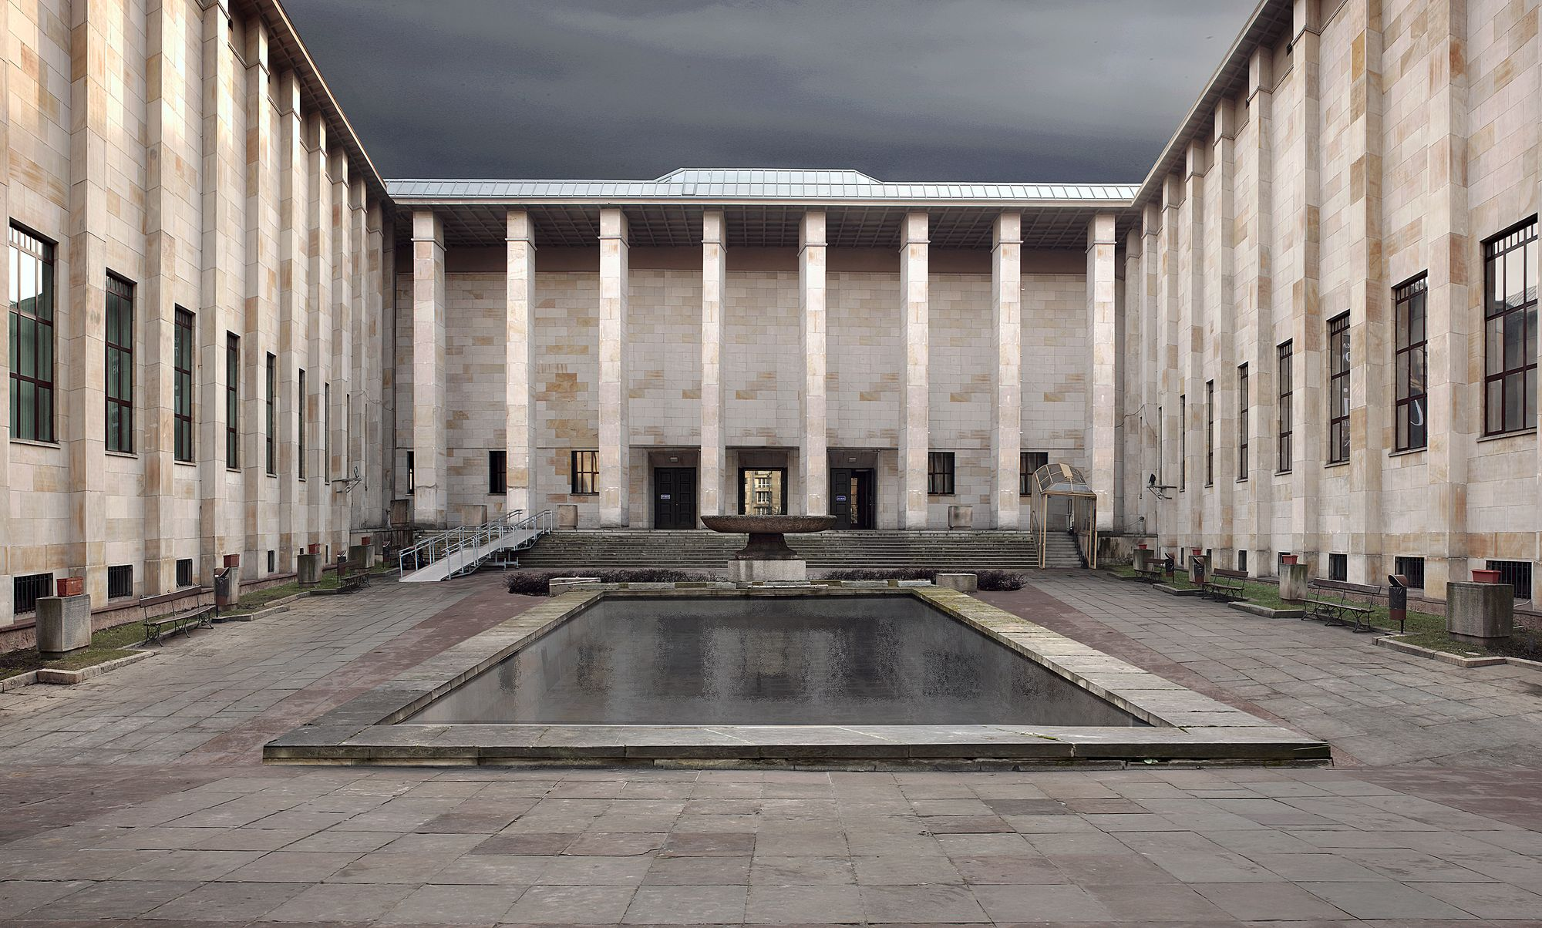
National Museum in Warsaw

Slide 27
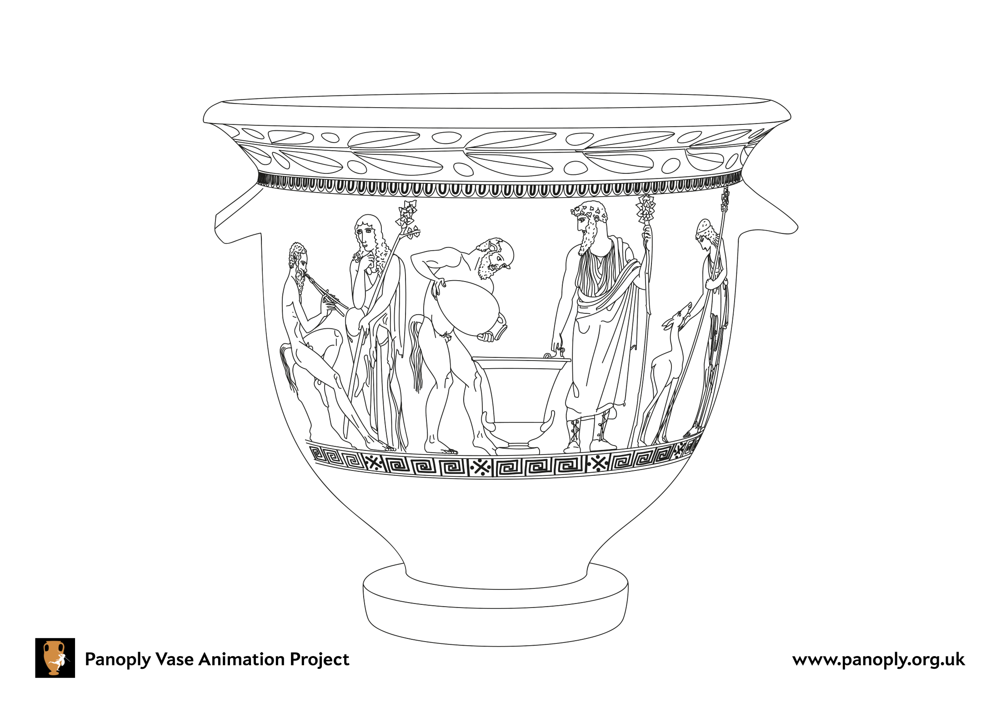

Slide 28
This resource was created by the
Panoply Vase Animation Project
as part of the European Research Council (ERC) funded project:
Our Mythical Childhood... The Reception of Children's and Young Adults' Culture in Response to Regional and Global Challenges
(Grant Agreement 681202; ERC Consolidator Grant led by Katarzyna Marciniak)

