Slide 1

The Ancient Greek
Gods and Goddesses
This PowerPoint was developed to accompany
Teaching Ancient Greece. Lesson Plans, Vase Animations, and Resources edited by Sonya Nevin.
Teaching Ancient Greece is an Open Access publication available for free download from the University of Warsaw Press.
This PowerPoint can also be used independently of
Teaching Ancient Greece.
Ancient Greek Gods and Goddesses
Sonya Nevin
http://panoply.org.uk

Slide 2

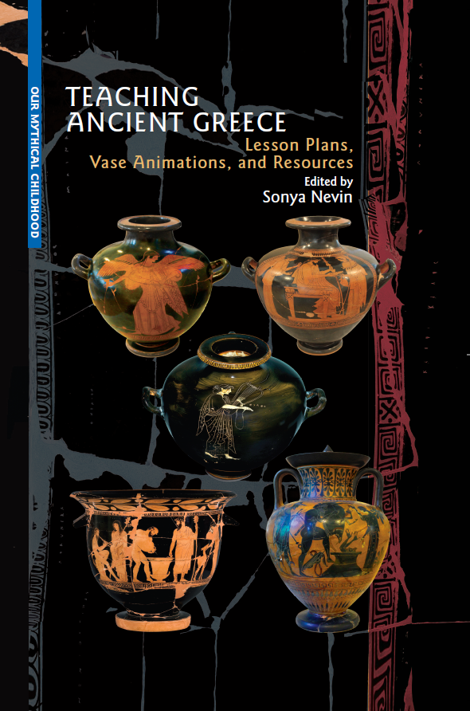
This PowerPoint was made by
Dr Sonya Nevin of the Panoply Vase Animation Project, for the ERC-funded project Our Mythical Childhood: http://www.omc.obta.al.uw.edu.pl/
Feel free to use this PowerPoint for educational purposes, including editing it.
Please do not post it online. If you would like to share it, please share its url.
The PowerPoint can be downloaded from:
https://panoply.org.uk/further-resources

Slide 3
The ancient Greeks had many gods. These are the most senior gods, known as Olympians. They live on Mount Olympus.
Zeus
Hera
Poseidon
Demeter
Aphrodite
Athena
Artemis
Apollo
Ares
Hephaestus
Dionysus
Hermes

Slide 4
There were many other gods!
Do you recognise any of their names?
Gaia
Hestia (sometimes counted as an Olympian)
Hades
Nike
Iris
Asclepius
Selene
Helios
Themis
Nemesis
Hebe
Eileithyia
Eros
Thetis
Triton
Persephone
Leto
Pan
Herakles
Hekate
and more…

Slide 5
There were other immortals, such as:
Nymphs – living in rivers and pools
Dryads – living in trees
Nereids – living in the sea
Heroes – such as Castor and Polydeuces (often known by his Roman name, Pollux) – humans or half-humans half-gods who became powerful after their mortal death

Slide 6
Let’s meet some of the gods and goddesses and see how the ancient Greeks represented them on their pottery.
The vases you will see were made by ancient Greeks between around 550BCE – 400BCE.

Slide 7
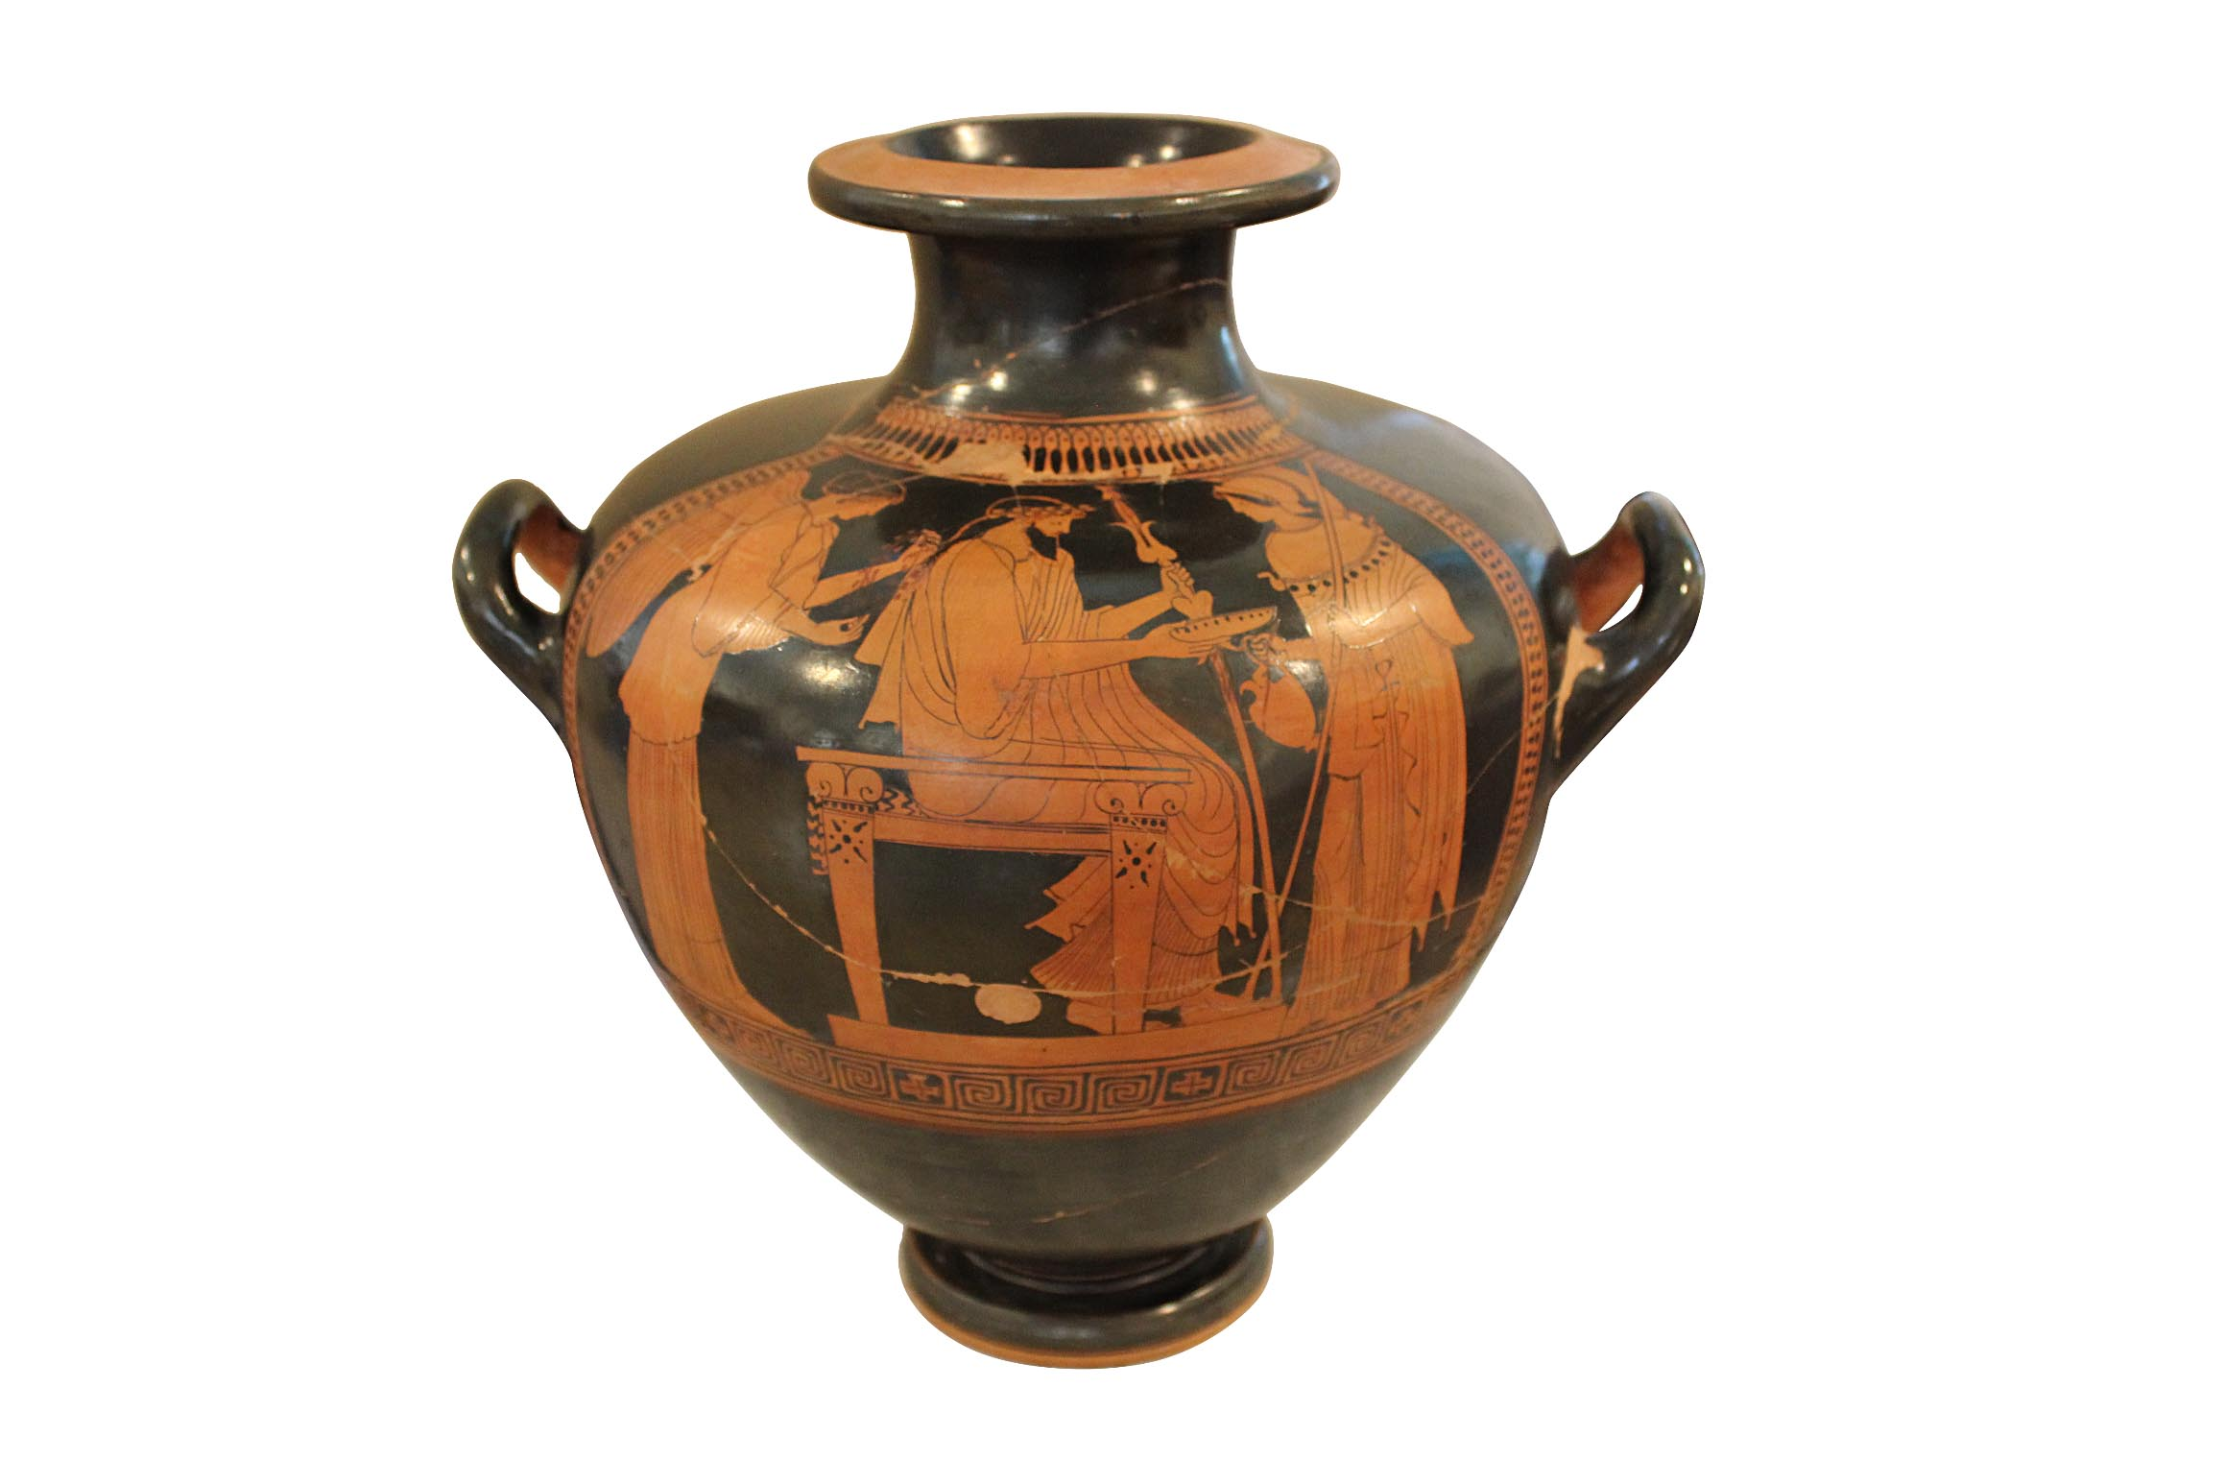
Zeus
Zeus, son of Cronus and Rhea
is the most powerful god.
He is King of the Gods,
ruling with his wife, Hera.
Zeus is father
to many gods
and heroes.
He rules the skies
and oversees
justice.
We can recognise Zeus by his beard and the thunderbolt that he holds.
He is often shown seated, as he is here.
National Museum in Warsaw, Poland, 142460 MNW.
See this scene animated

Slide 9
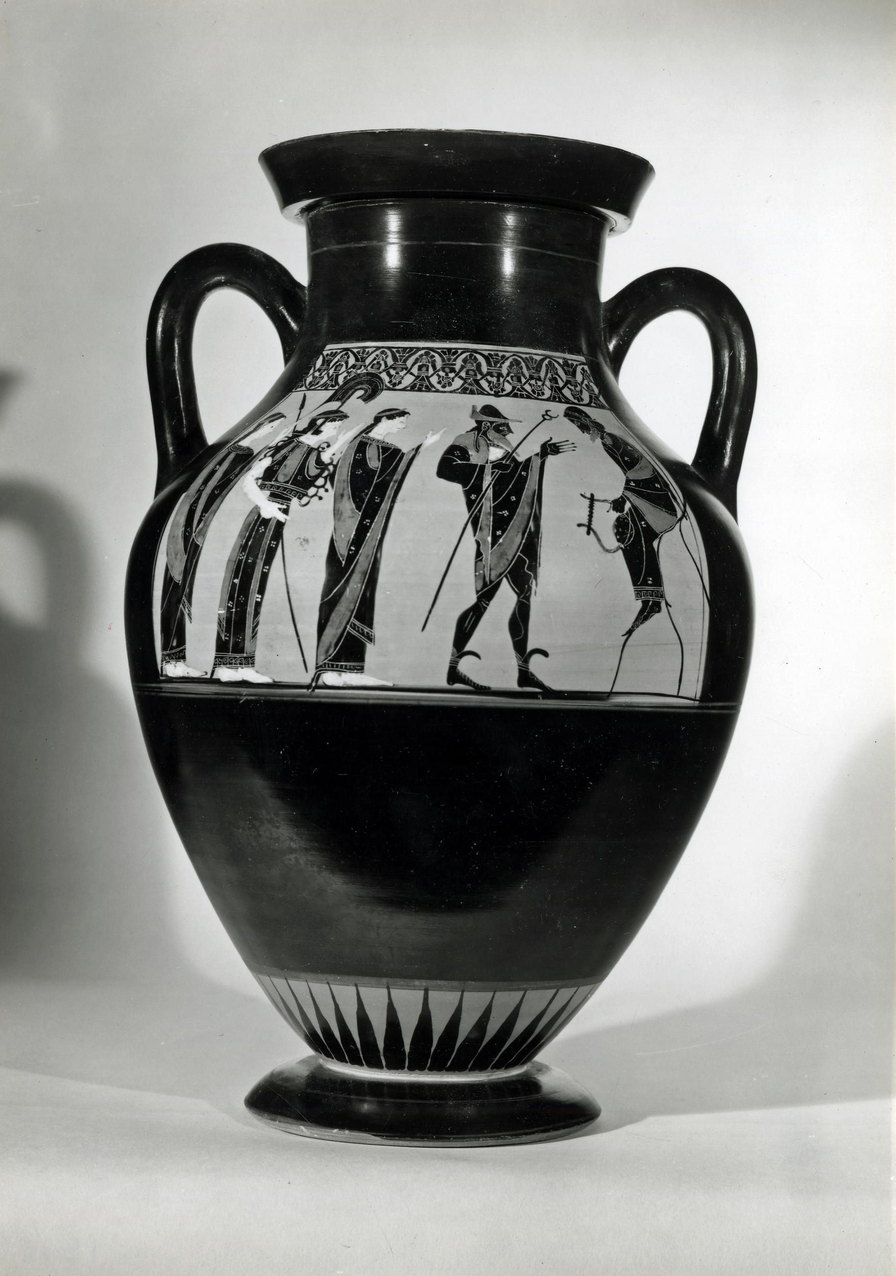
Hera
Hera, daughter of Cronus and Rhea is the Queen of the Gods.
She is married to Zeus.
Hera is associated with royalty and she oversees marriage.
She is the mother of her children with Zeus: Ares, Hebe, and Eileithyia, and she is the mother of the monster Typhon and the god Hephaestus.
Here, Hera is in the centre, taking part in the Judgement of Paris, with Athena and Aphrodite.
We can often identify her by a crown or a peacock, although she doesn’t always have them.
British Museum 1836,0224.122

Slide 10
Left to right, Aphrodite, Athena, Hera, Hermes, Prince Paris of Troy.

Slide 11
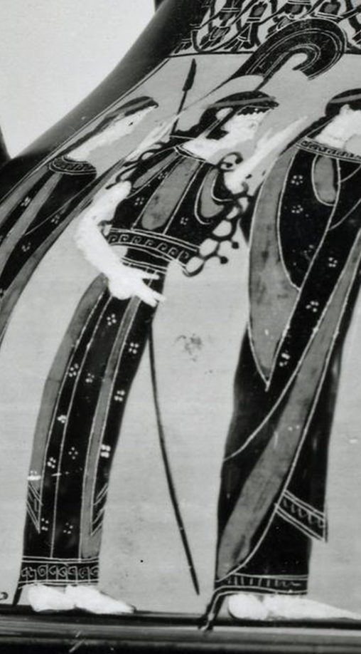
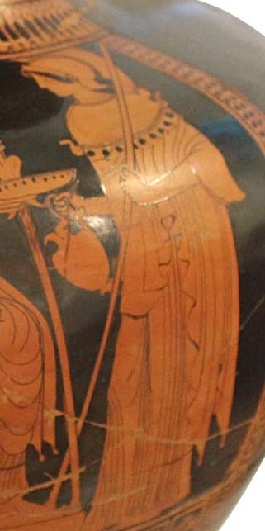
Athena
We have seen Athena already, with her father, Zeus, and with her stepmother, Hera.
Athena is the goddess of wisdom, craft,
and war.
She was chosen as the protector of many cities.
We can recognise Athena through her helmet, spear, dress, and special cloak called
an aegis.
The owl is another
sign of Athena.

Slide 12
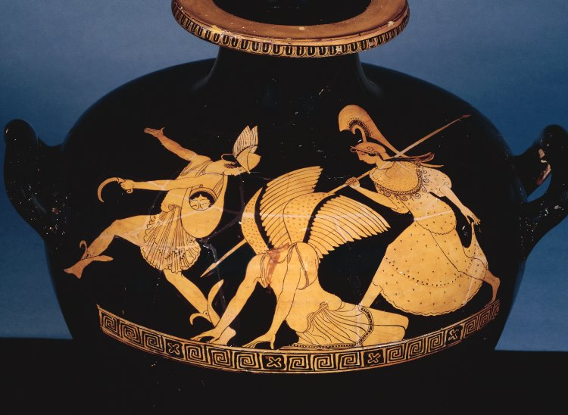
Here we see Athena accompany Perseus as he slays the gorgon, Medusa.
Helmet, spear, dress, aegis. British Museum, 1873,0820.352

Slide 13
Homeric Hymn 11: To Athena
Of Pallas Athena, guardian of the city,
I begin to sing.
Dread is she, and with Ares she loves deeds of war, the sack of cities, shouting and battle.
It is she who saves the people as they go out to war and come back.
Hail, goddess, and give us good fortune with happiness!

Slide 14
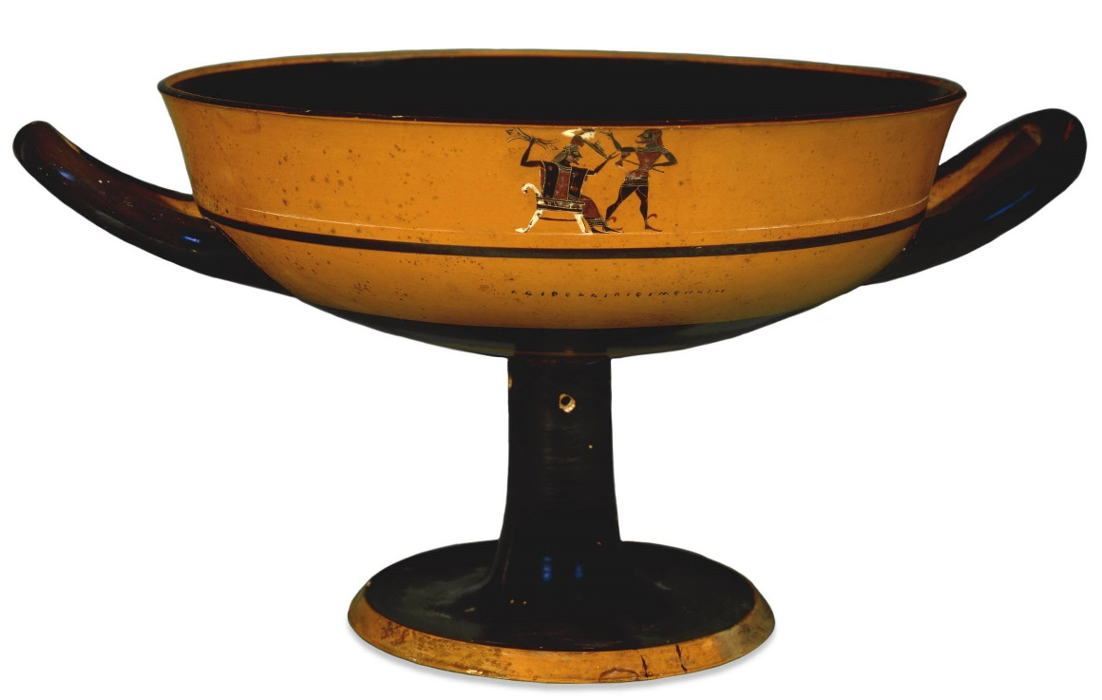
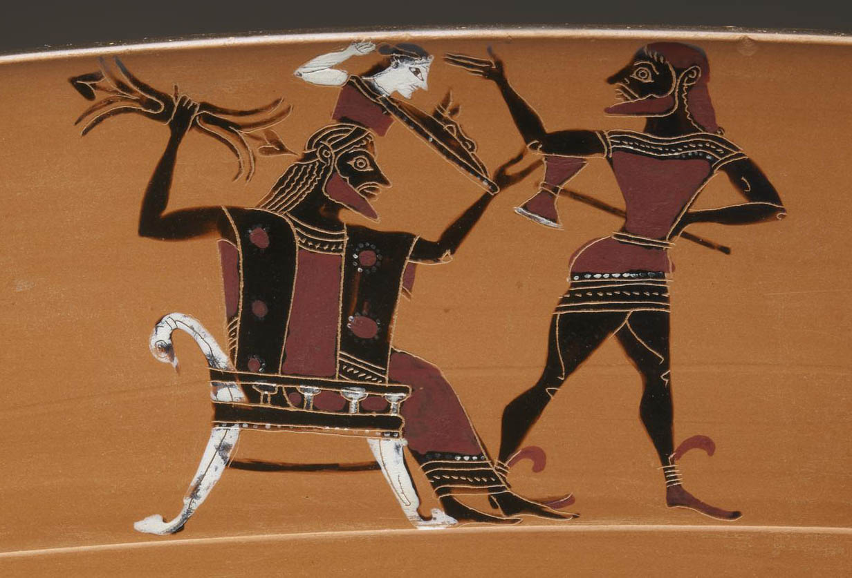
Hephaestus
Hephaestus was the son of Hera. He is the god of blacksmiths and other craftsmen, and he is himself a skilled blacksmith.
Hephaestus creates beautiful and useful things for the gods and sometimes even for lucky mortals.
Often, as here, we can recognise Hephaestus by him holding an axe. On this occasion he has used the axe to split open Zeus’ head to enable the birth of Athena. She springs out fully armed.
British Museum, 1867,0508.962

Slide 15
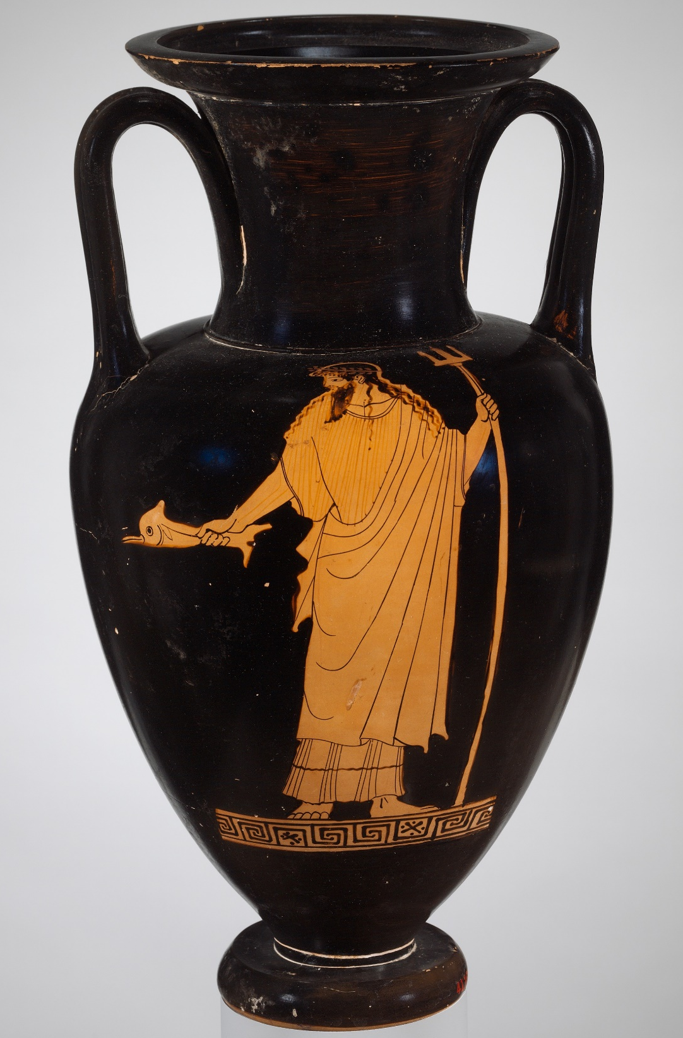
Poseidon
Poseidon is the son of
Cronus and Rhea.
He is the great god of the sea, ruling over oceans, seas, and all the water-dwelling immortals.
Poseidon is also in charge of earthquakes.
He is lord of all the horses.
Poseidon can be recognised by his beard, combined with his trident spear (three prongs).
He is often shown with dolphin or fish.
Metropolitan Museum of Art,
Rogers Fund, 1941. 41.162.17

Slide 16
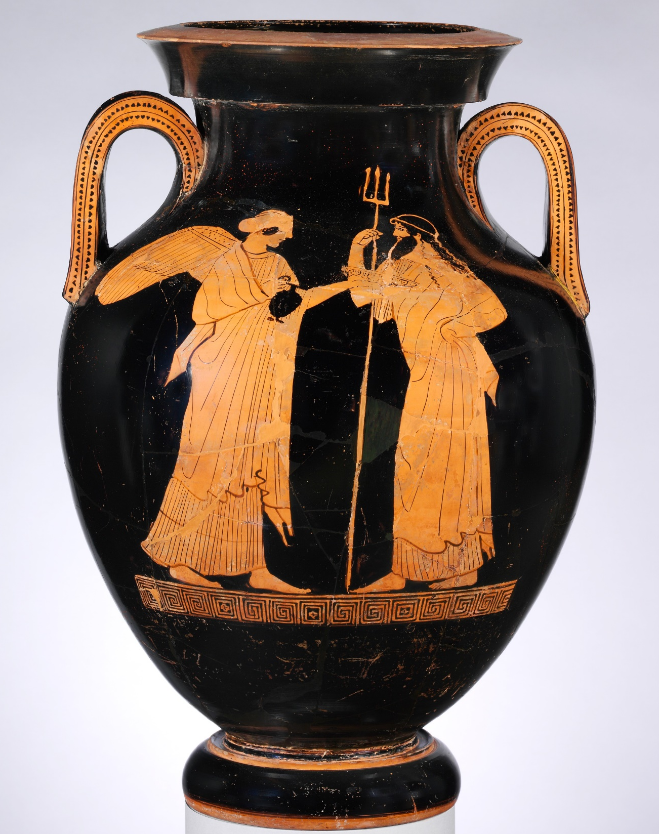
Poseidon, right, standing with Nike.
We recognise him by his beard and long trident.
Metropolitan Museum of Art,
Rogers Fund, 1906. 06.1021.151

Slide 17
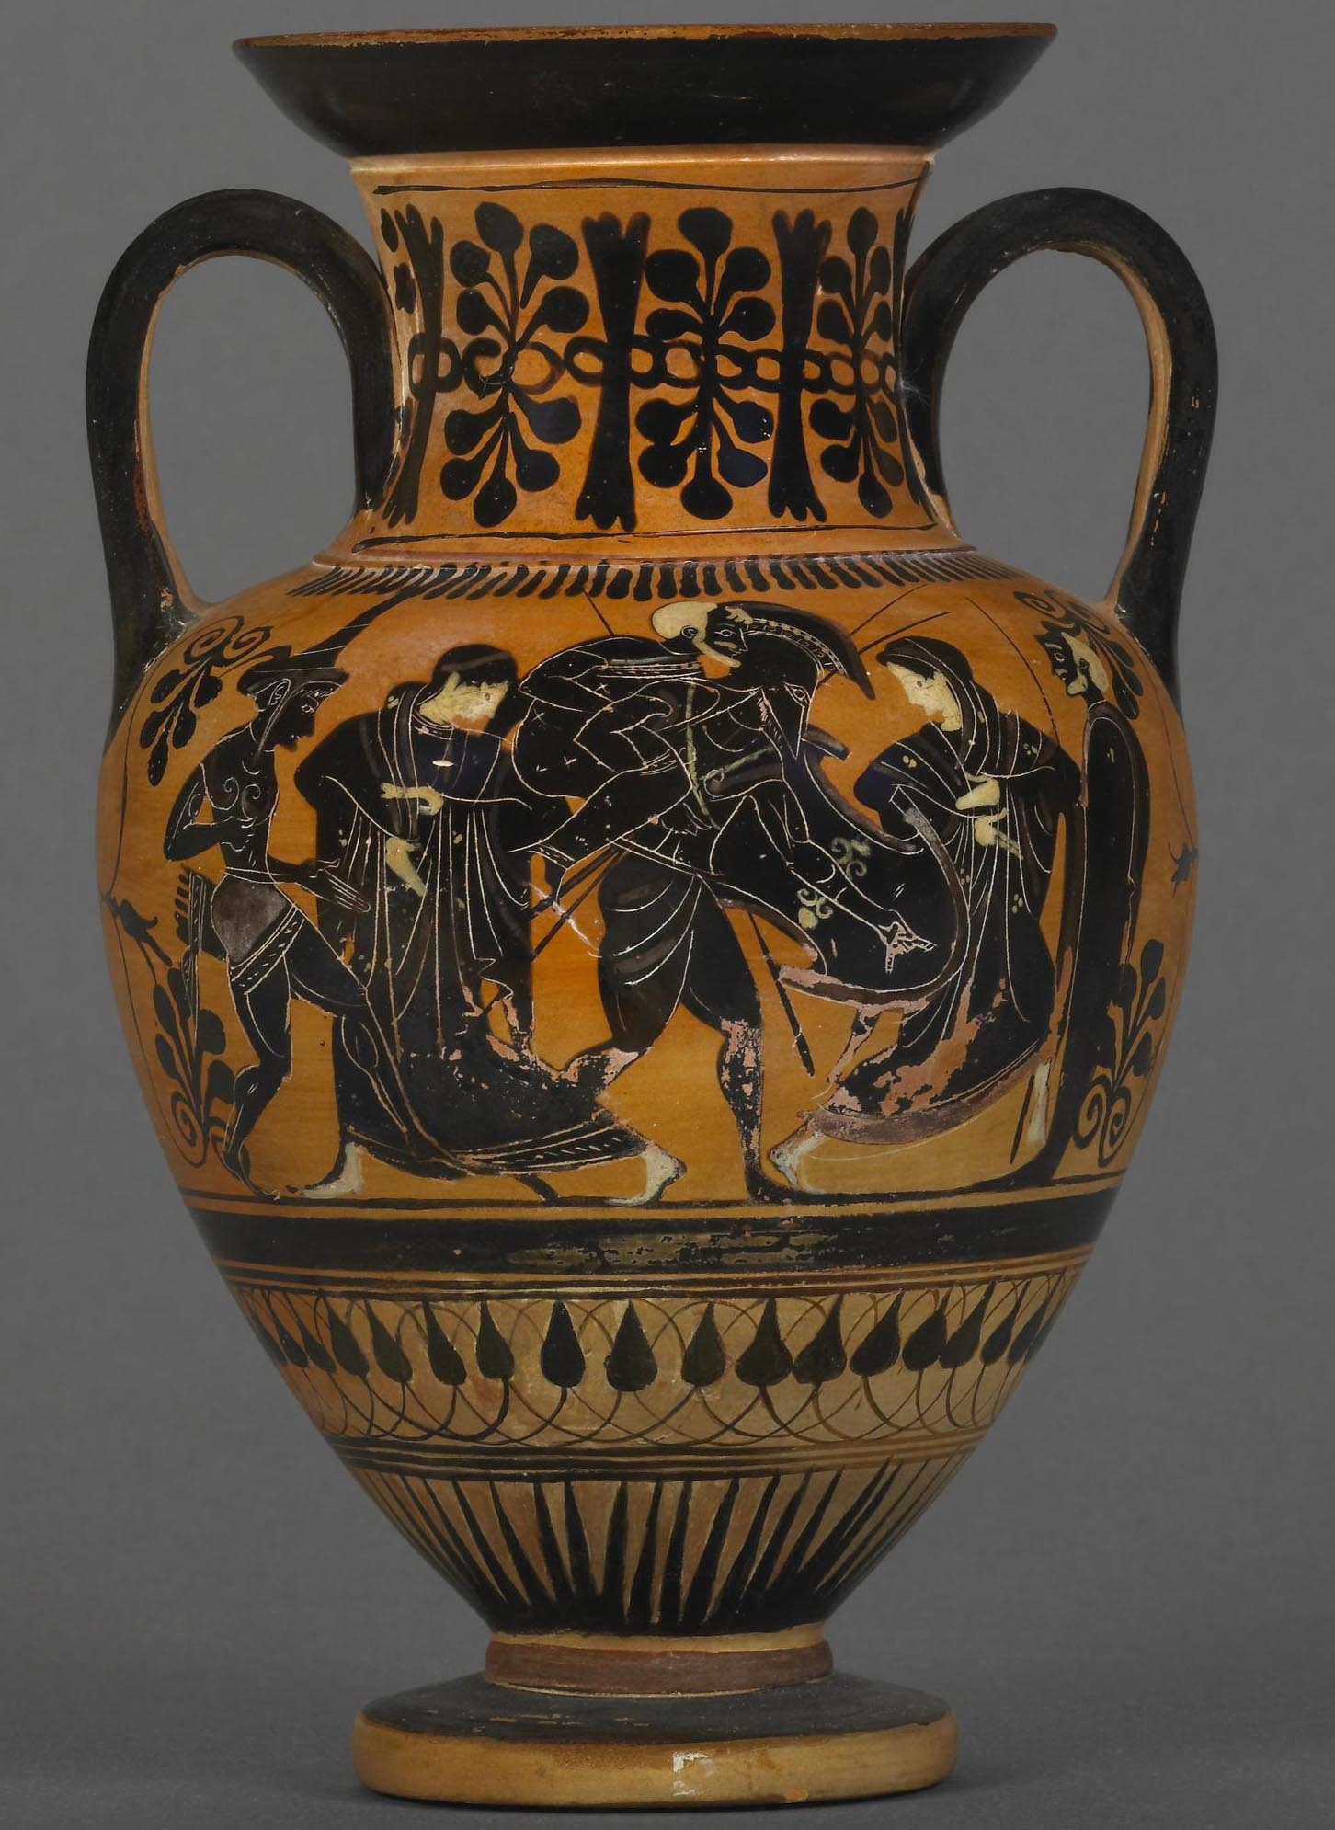
Aphrodite
Aphrodite was born from the severed genitals of Uranus, the divine sky, the grandfather of Zeus, Hera, Demeter, Poseidon and Hades.
Aphrodite is a goddess of sex and fertility. She oversees the fertility of humans, animals and, to an extent, plants and the soil itself.
Aphrodite is sometimes shown with her winged son, the love god, Eros. Here she is seen (2nd left) with her human son Aeneas, who is escaping from Troy. Aphrodite herself fought in the Trojan War. Paris and Helen were her favourites.
British Museum, 1836,0224.138

Slide 18
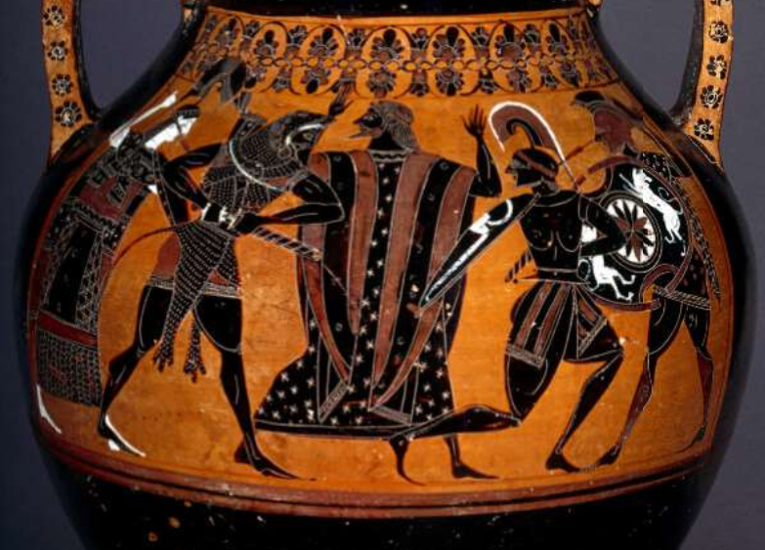
Ares. Ares is the son of Zeus and Hera. He is the god of war. He is typically shown as a warrior, with helmet and spear. Here we see him on the far right of the image. He is supporting his son (beside him), who is losing a fight.
Zeus is intervening in the middle. British Museum 1861,0425.50

Slide 19
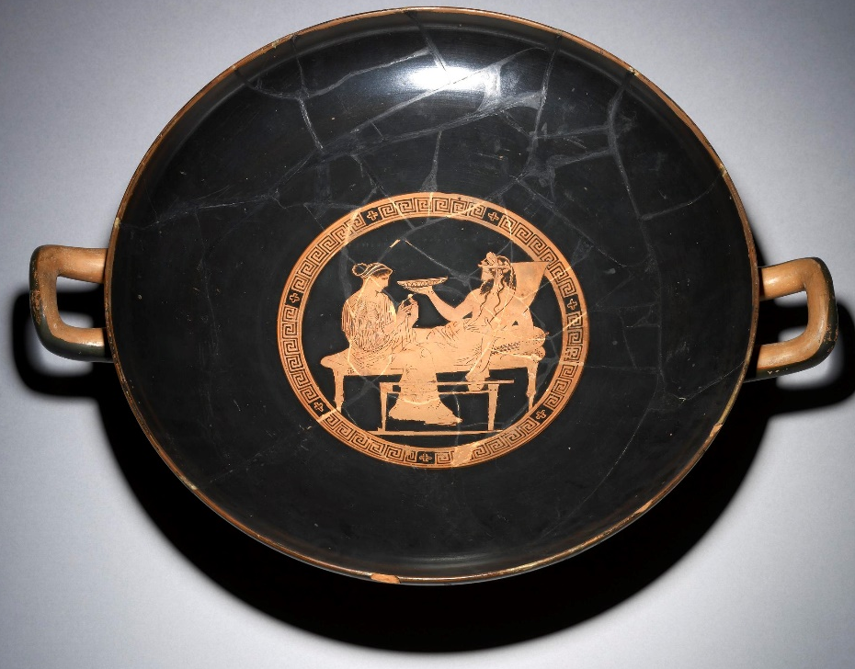
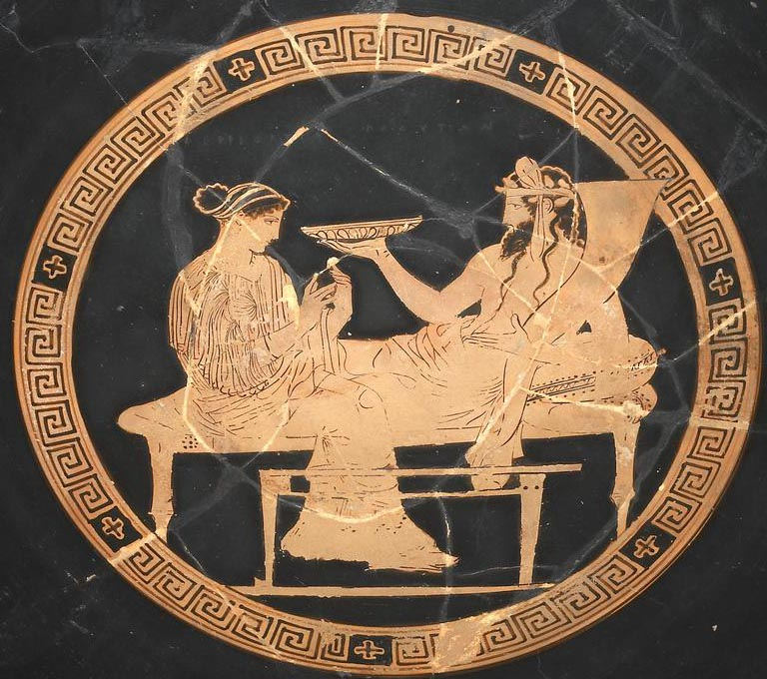
Hades
Hades is the son of Cronus and Rhea. He is the god of the Underworld, guarding the dead.
The Underworld is often known by his name as ‘Hades’.
Hades is not evil, but ancient Greeks did not wish to attract his attention!
We recognise him by his beard and cornucopia – horn of plenty. Crops, precious metals, and gems come from underground after all.
He is shown here with Persephone.
British Museum, 1847,0909.6.

Slide 20
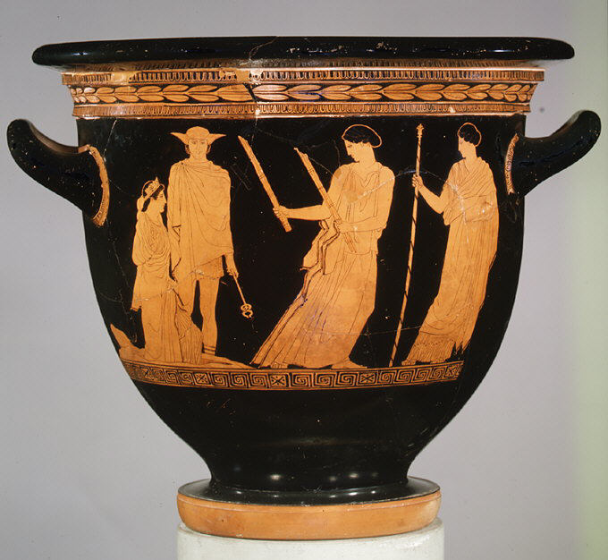
Demeter
Demeter is the daughter
of Cronus and Rhea.
She is the goddess of corn; of crops and vegetation. Her worship was an essential part of the agricultural year.
Here, Demeter is seen on the far right, welcoming her daughter, Persephone, who is emerging from the ground on the left.
Metropolitan Museum of Art,
28.57.23.

Slide 21
Persephone
Persephone is the daughter of Demeter and Zeus. She is often known as ‘Kore’, meaning ‘girl’.
To express the cycle of the seasons, a myth developed that Persephone was taken by the god, Hades, to live in the Underworld.
Her absence causes Winter. Here (left) we see her returning to the upper world for part of the year – she returns with the arrival of Spring.
Metropolitan Museum of Art, 28.57.23.

Slide 22
Hermes
Beside Persephone is Hermes.
Hermes is the son of Zeus
and the nymph, Maia.
Hermes is acting here in his role as a guide. He helped the dead make their way to Hades.
We can often recognise Hermes by his herald’s staff, a caduceus, by his traveller’s hat, traveller's cloak, and
his winged sandals or
travellers boots.
This image makes Hermes look quite young…
Metropolitan Museum of Art, 28.57.23.

Slide 23
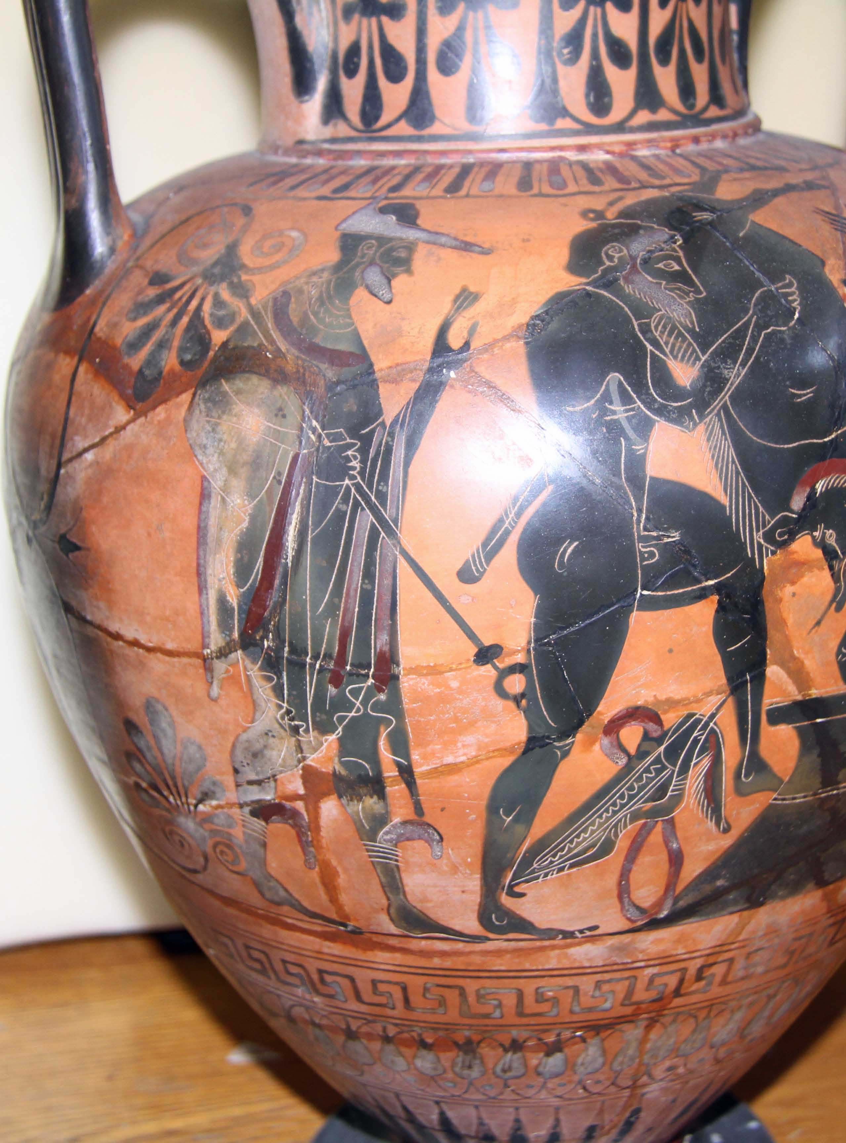
Hermes
…before the 4th century BCE, he was usually depicted looking older and bearded, as he does here.
We still recognise him by his caduceus and traveller’s hat, cloak and boots.
As a guide, Hermes often accompanies heroes.
He is the inventor of the lyre
and syrinx pipes.
He is the father of the god Pan and god of shepherds.
Hermes is a messenger god,
especially for Zeus.
He was the god of thieves and tricksters, of magic and technology. He brings prosperity… if he wishes to. He’s a busy god!
National Museum in Warsaw, 198042.
See this scene animated.

Slide 24
Hekate
Hekate, granddaughter of the ancient Titans, has many roles.
She is associated with magic and witchcraft. She is a figure of night-time and the moon. She protects cross-roads, roadside graves, and the Gates of Hades.
Hekate might give protection to hunters, warriors, and athletes, or she might choose not to.
She is a companion of Persephone and Artemis.
We recognise her by
her two torches.
Metropolitan Museum of Art, 28.57.23.

Slide 25
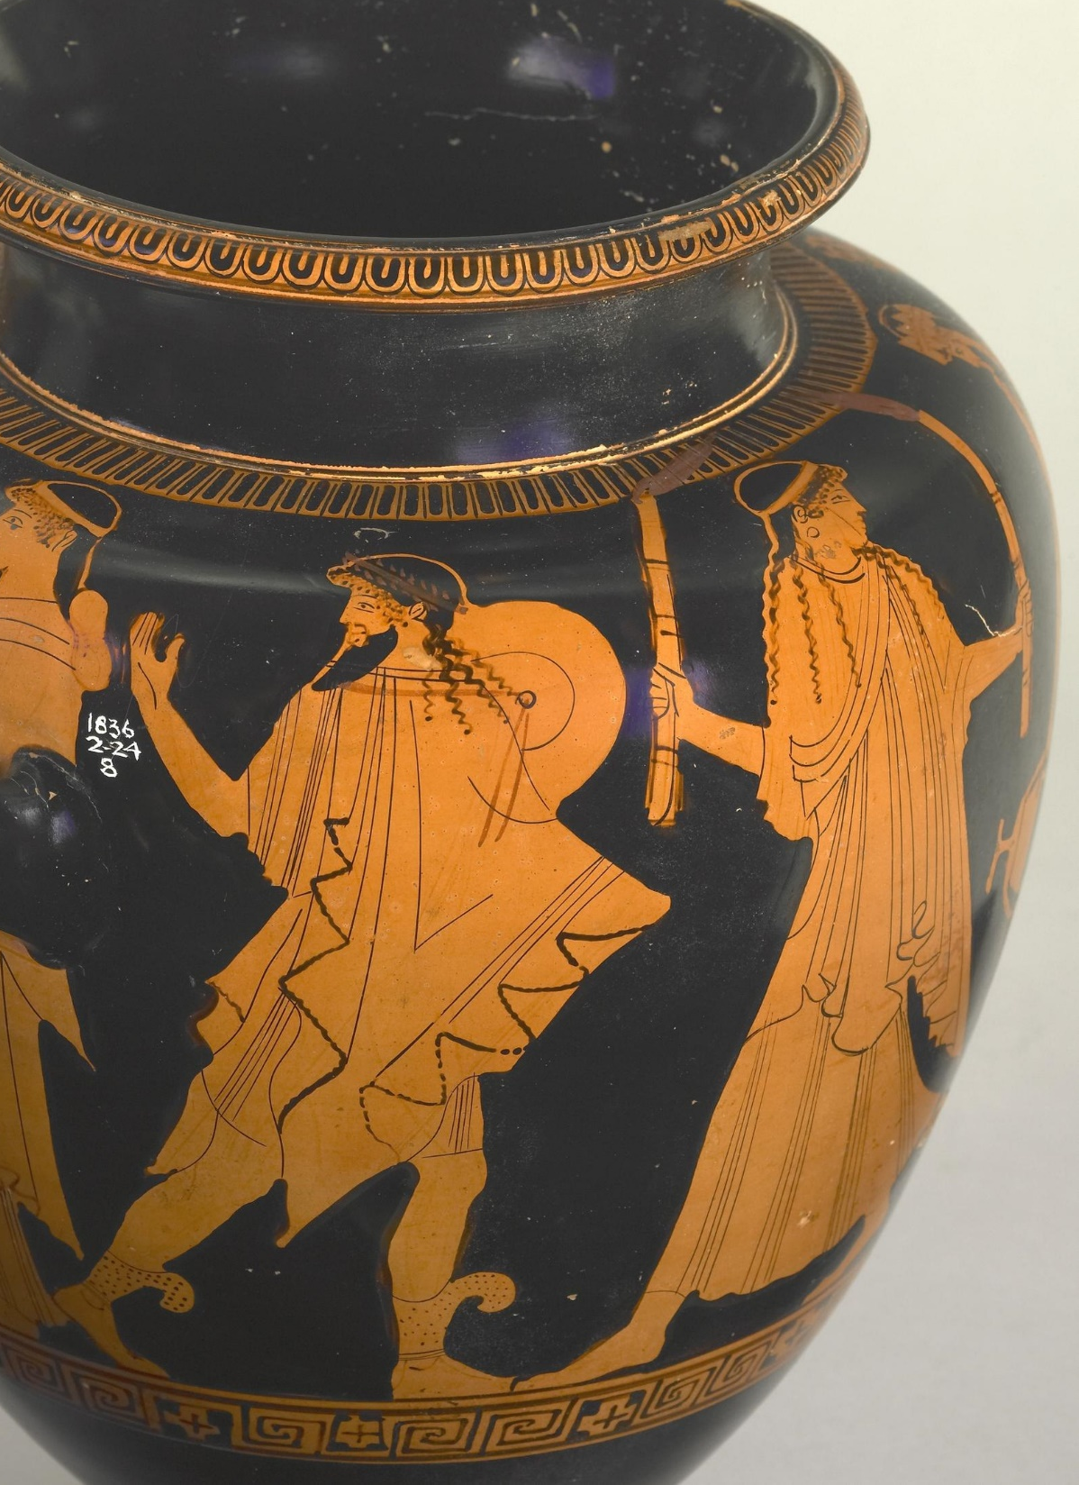
Hestia
Hestia (here on the right) is the daughter of Cronus and Rhea.
She is the goddess of the hearth.
A hearth is a fireplace – an important part of any ancient home.
The hearth was a place where there was comforting warmth, somewhere to cook, and somewhere to chat and tell stories. Many offerings were made at the hearth.
We often see Hestia, as here, looking like a young woman holding a flaming torch or torches. The torches can also signal Hekate.
British Museum, 1836,0224,8.

Slide 26
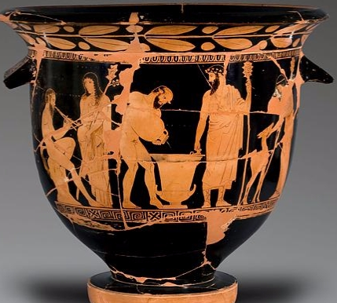
Dionysus
Dionysus is the son of Zeus and a human called Semele.
He is associated with things out of the ordinary – wild places, wine, masks and impersonation.
Dionysus is the god of drama.
Plays were performed for Dionysus as an offering.
Sometimes he looks mature, later he often looks young
Signs it his him include ivy, pine cones, and his followers - mythical satyrs and women known as ‘maenads’.
National Museum in Warsaw,
EXC43 MNW.
See this scene animated and a short documentary.

Slide 27
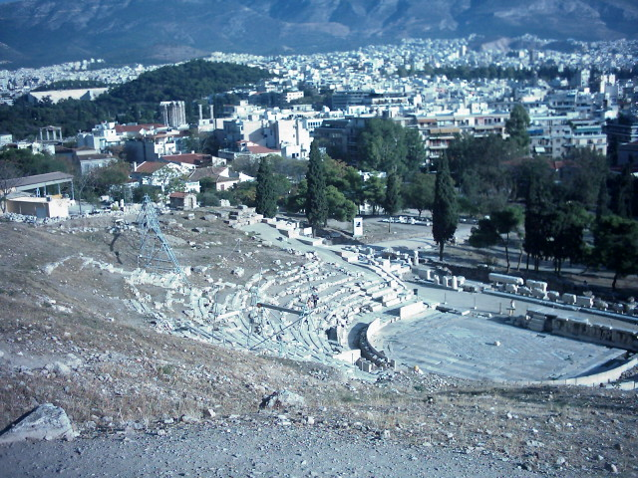
The Theatre of Dionysus in Athens, with the Temple of Zeus in the background.

Slide 28
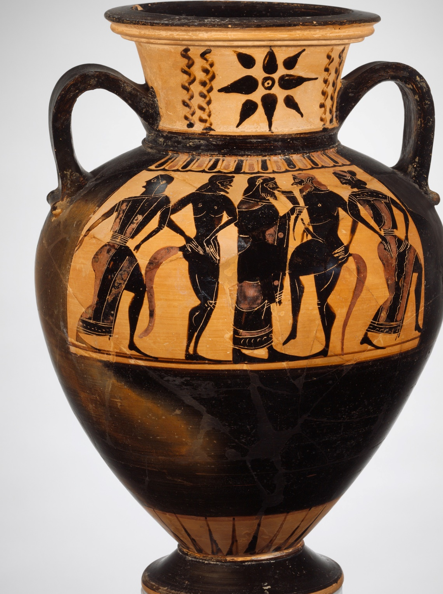
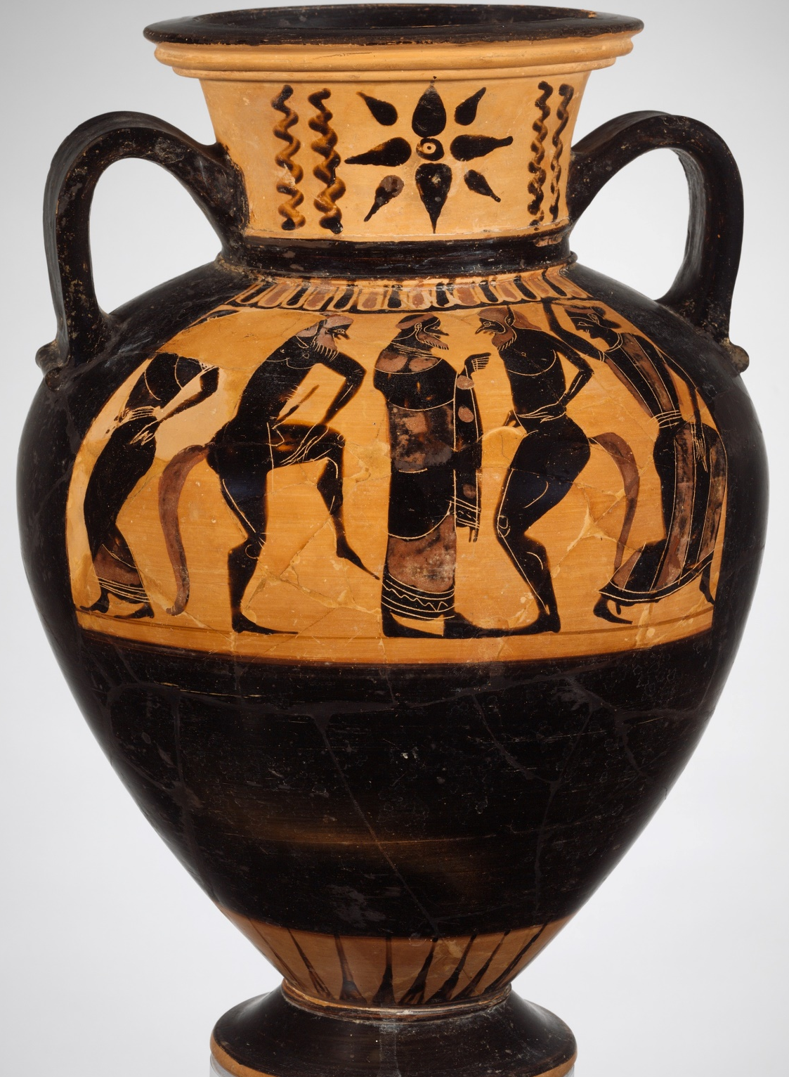
Satyrs and maenads dance around Dionysus (in the centre).
Two sides of one vase, Metropolitan Museum of Art, 1991.254

Slide 29
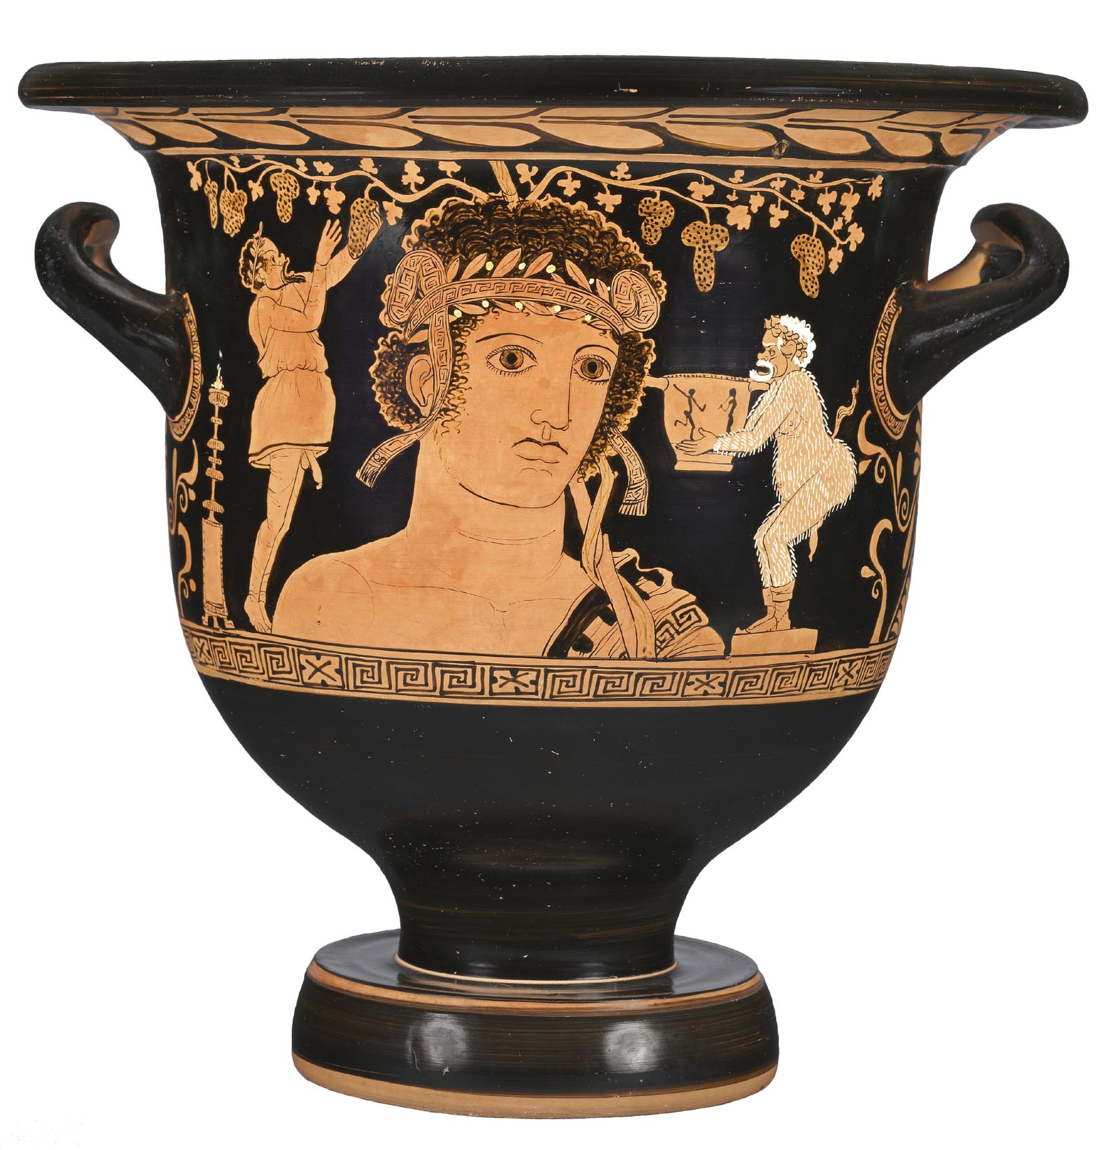
We have seen two images of Dionysus looking like a
mature man with
a beard.
Over time he began to be shown as a younger, beardless youth.
Here, comic actors wearing masks stand
on either side of Dionysus – or a statue of Dionysus.
He is surrounded by grapes. His staff leans on his shoulder and goes off the top of the vase.
Cleveland Museum of Art, 1989.73

Slide 30
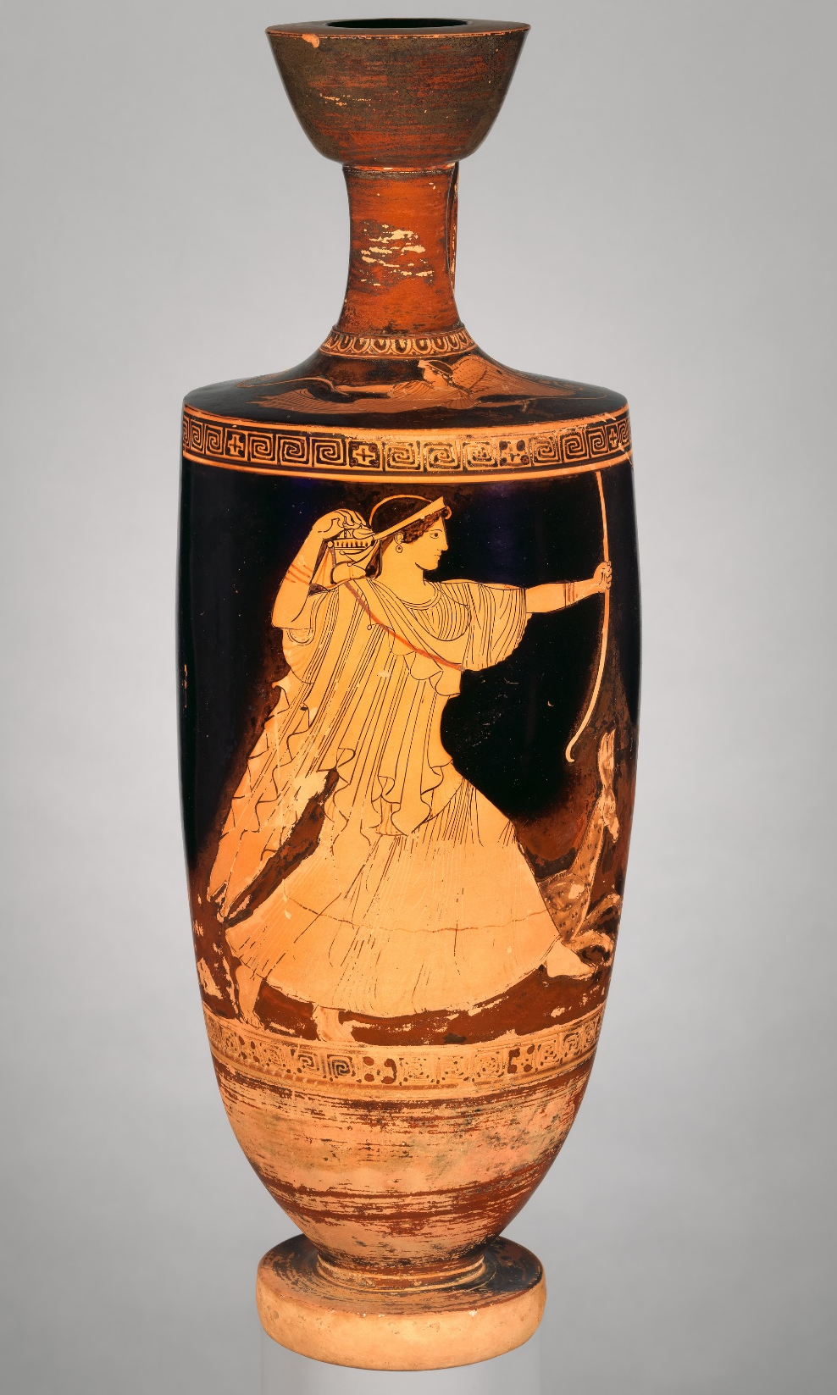
Artemis
Artemis is the daughter of Zeus and the goddess Leto.
Artemis is the goddess of wild places and of animals.
She is the goddess of hunters.
She is the protector of girls.
Warriors prayed to Artemis as battle was about to begin.
We often see her with a bow and arrow, with deer, and with her twin brother, Apollo.
Metropolitan Museum of Art.
Rogers Fund, 1941. 41.162.18

Slide 31
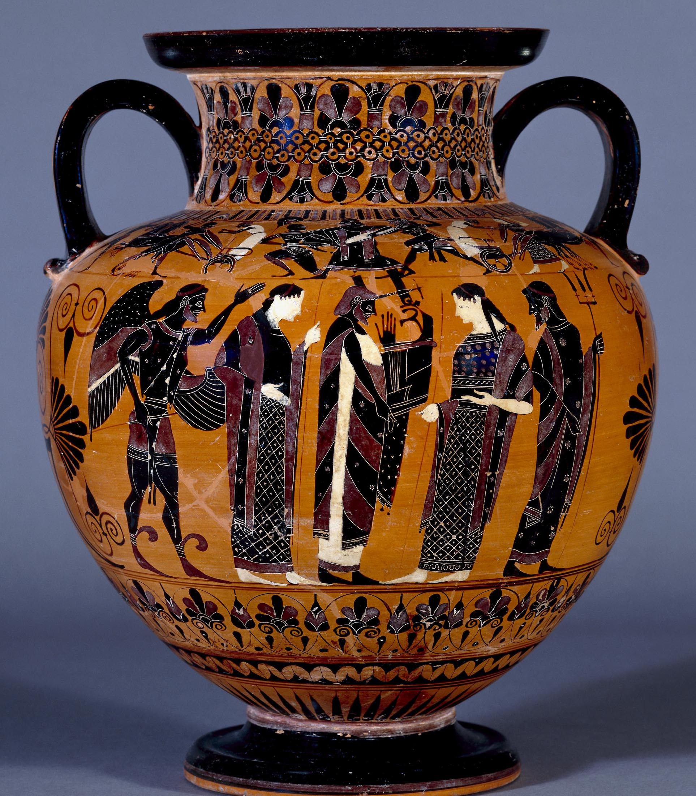
Apollo
Apollo is the son of Zeus and Leto; he is the twin brother of Artemis.
Apollo is the god of prophecy; his most important sanctuary
was at Delphi.
He is also a god of music and can often be seen, as here, playing a kithara
(a kind of lyre).
Apollo is another god who was presented as an older figure for many years then, later on, as a youthful figure.
British Museum
1843,1103.100.x

Slide 32
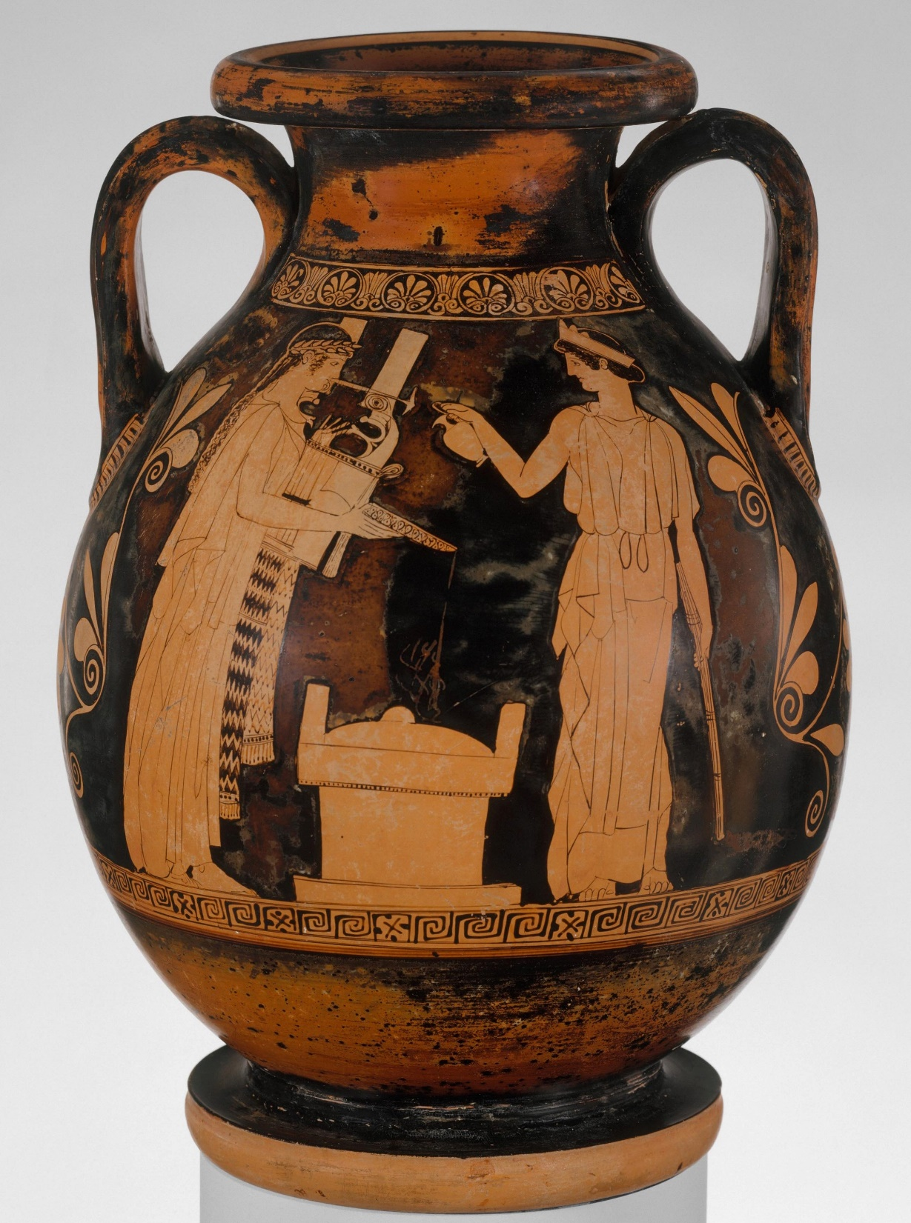
Artemis and Apollo
As twins, Artemis and Apollo are often shown together.
In this scene, they are together at an altar performing a libation – a liquid offering.
Apollo (on the left, holding a kithara) holds the bowl.
Artemis (on the right) will pour wine into the bowl, which Apollo will then pour on the altar.
Metropolitan Museum of Art 06.1021.191

Slide 33
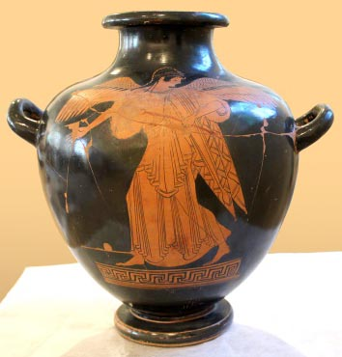
Iris
Iris is a messenger goddess and goddess of the rainbow. She carries messages for the gods, especially Hera and Zeus.
Like Hermes, Iris carries a caduceus, a herald’s staff, so people know that she’s a messenger and that they shouldn’t interrupt her. When she flies, she creates rainbows across the sky.
We can identify her by her staff and wings.
National Museum in Warsaw, 142289. See this vase animated and a short documentary.

Slide 34
Nike
Nike is the goddess of victory.
We have seen her already – with Zeus and Athena. Nike is on the left, dressing Zeus’ long hair.
Nike brought humans victory in battle, and in more peaceful competitions such as sport and music.
We can recognise Nike by her wings; unlike Iris, she does not carry a messenger’s staff.
National Museum in Warsaw, Poland, 142460 MNW.
See this scene animated.

Slide 35
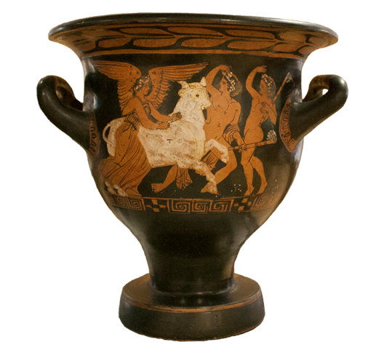
In this scene, Nike holds a bull’s halter, as two athletes call her forwards.
See this scene animated in two different ways.
University College Dublin Classical Museum, 197.

Slide 36
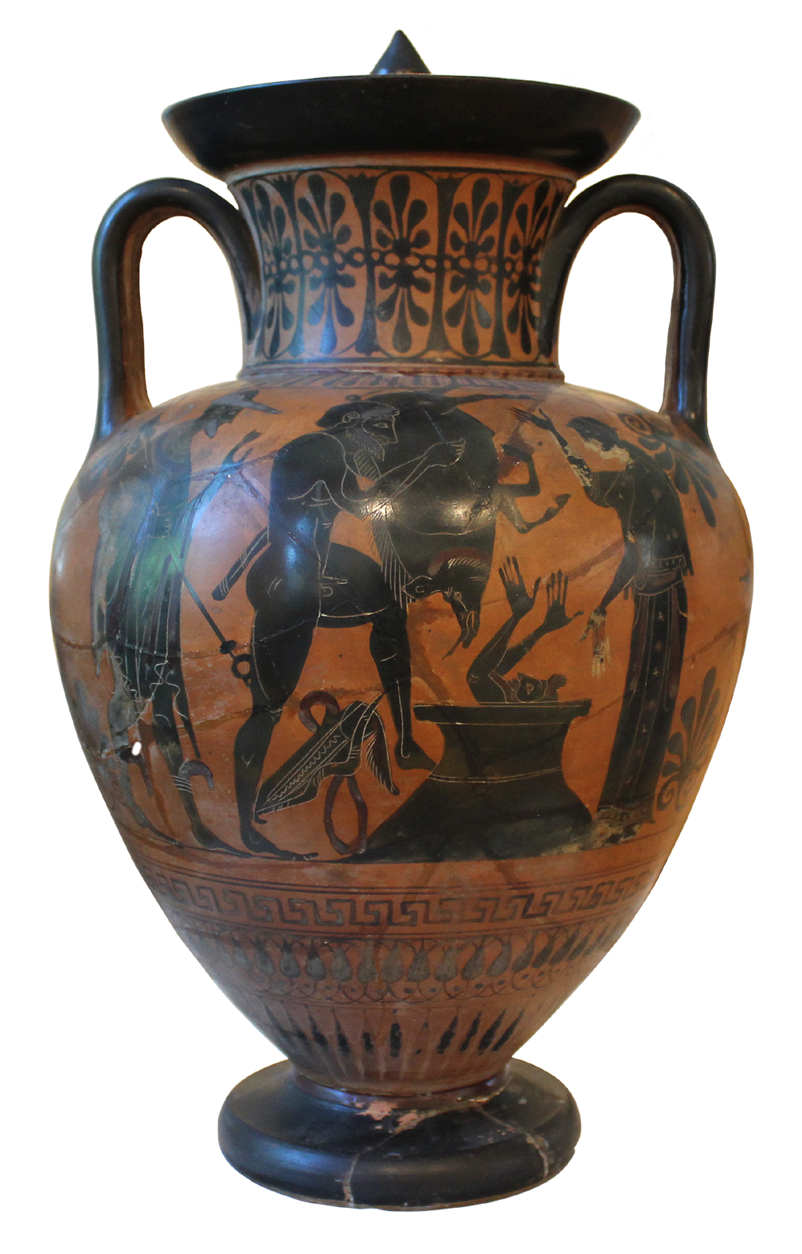
Herakles
Herakles is the son of Zeus and a
human woman called Alkmene.
Herakles was extremely strong and
went on many adventures.
In a terrible fit of madness, Herakles killed his family. To show how very sorry he was, Herakles committed to fulfill 12 Labours, or near-impossible tasks. The tasks were set by his cousin King Eurystheus.
In this image, Herakles has returned to Eurystheus with the Erymanthian Boar.
The king has hidden in a storage jar
to escape the frightening boar.
For completing the 12 Labours,
Herakles was made a god after his death.
National Museum in Warsaw, 198042.
See this scene animated and a short documentary.

Slide 37
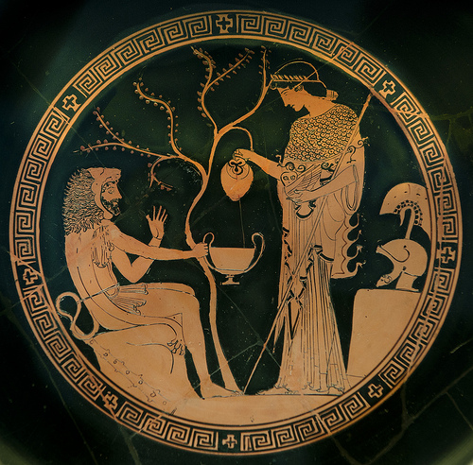
Herakles
Herakles is often identifiable through two things – both of which he has here: his lion-skin cloak and his club (shown here at his side).
Which goddess is
he with?
Munich Glyptothek 2648

Slide 38
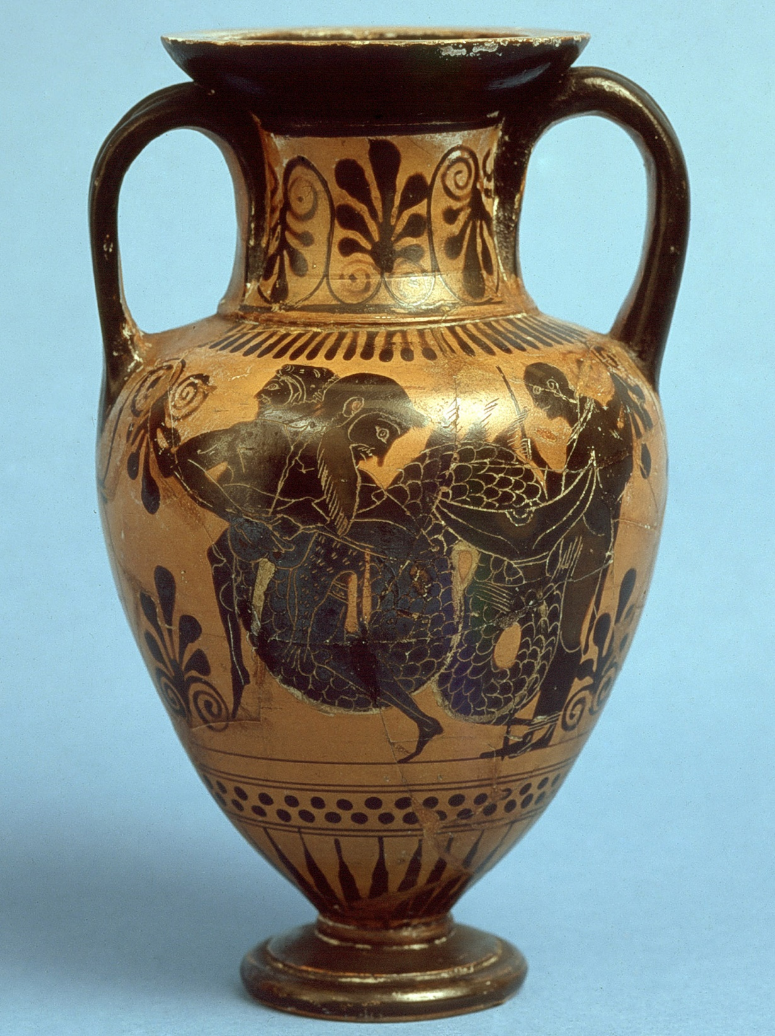
Herakles
Herakles is associated with helping civilisation by capturing and/or killing monsters and villains who were making people’s lives difficult.
In this scene he is wrestling a water-god, maybe Triton or Acheloüs.
Ure Museum of Greek Archaeology, 52.3.1
See this scene animated.

Slide 39
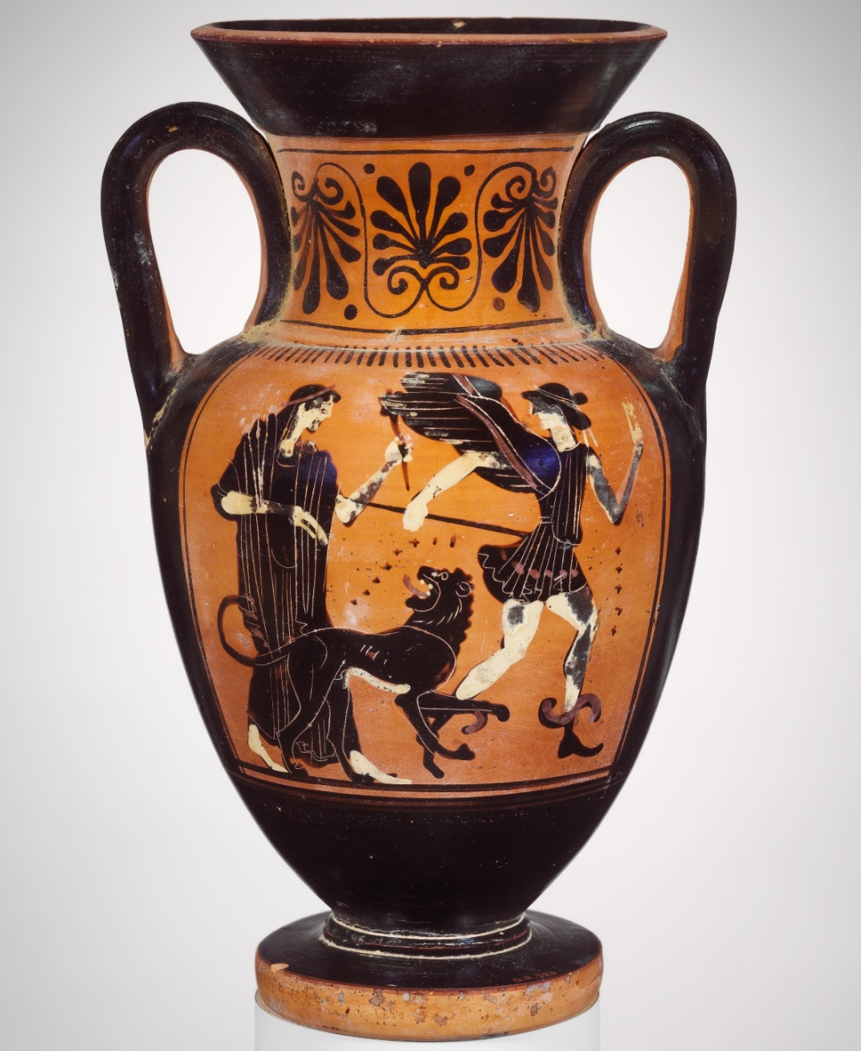
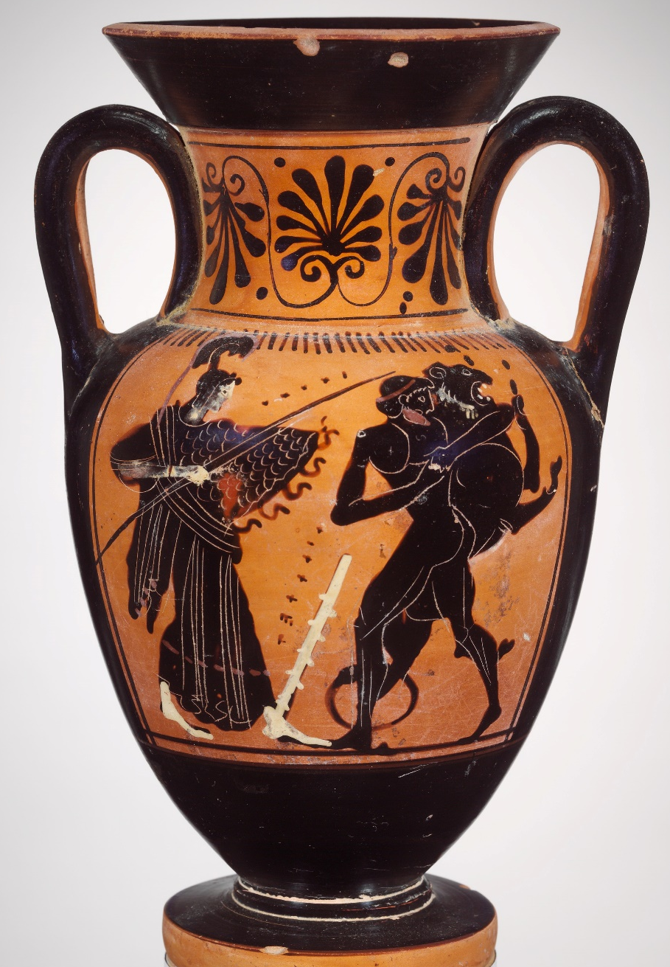
The two sides of this vase go together. In the left hand image, Hera is sending Iris (wings, caduceus, traveller’s boots) with the Nemean Lion to attack Greece. The other side (right) Heracles wrestles that lion (note his club beside him), as Athena watches. Heracles will make his famous lion skin cloak from this lion. Metropolitan Museum of Art, X.21.15.

Slide 40
I will sing of Heracles, the son of Zeus and much the mightiest of men on earth. Alcmene bore him in Thebes, the city of lovely dances, when the dark-clouded Son of Cronos had lain with her. Once he used to wander over unmeasured tracts of land and sea at the bidding of King Eurystheus, and himself did many deeds of violence and endured many; but now he lives happily in the glorious home of snowy Olympus, and has neat-ankled Hebe for his wife.
Hail, lord, son of Zeus, Give me success and prosperity.
Homeric Hymn To Herakles

Slide 41
For it is generally agreed that this man [Herakles] has come down to us as having surpassed, in the greatness of the deeds he accomplished, all those handed down in memory from antiquity; so it is difficult to report each of his exploits in a worthy manner and to make the account equal to such deeds, the greatness of which won him the prize of immortality.
Diodorus, Library of History, 4.8.1

Slide 42
There were many ways to honour the gods in ancient Greece
Honouring the gods was a way of showing them respect as more powerful beings.
That might win you favour, or at least put off their anger.
It was not a guarantee.
Honouring the gods could be enjoyable and could give people a sense of meaning, purpose, control, and community.

Slide 43
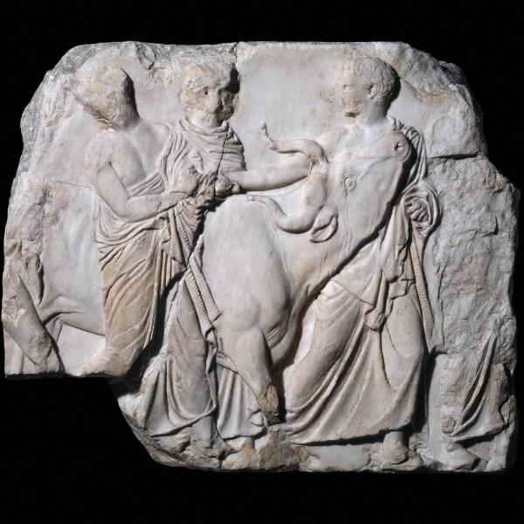
Ritual processions. Animals were led to sacrifice in magnificent processions. The gods were thought to enjoy watching these processions.
This scene is part of the Parthenon Frieze from a temple of Athena in Athens.

Slide 44
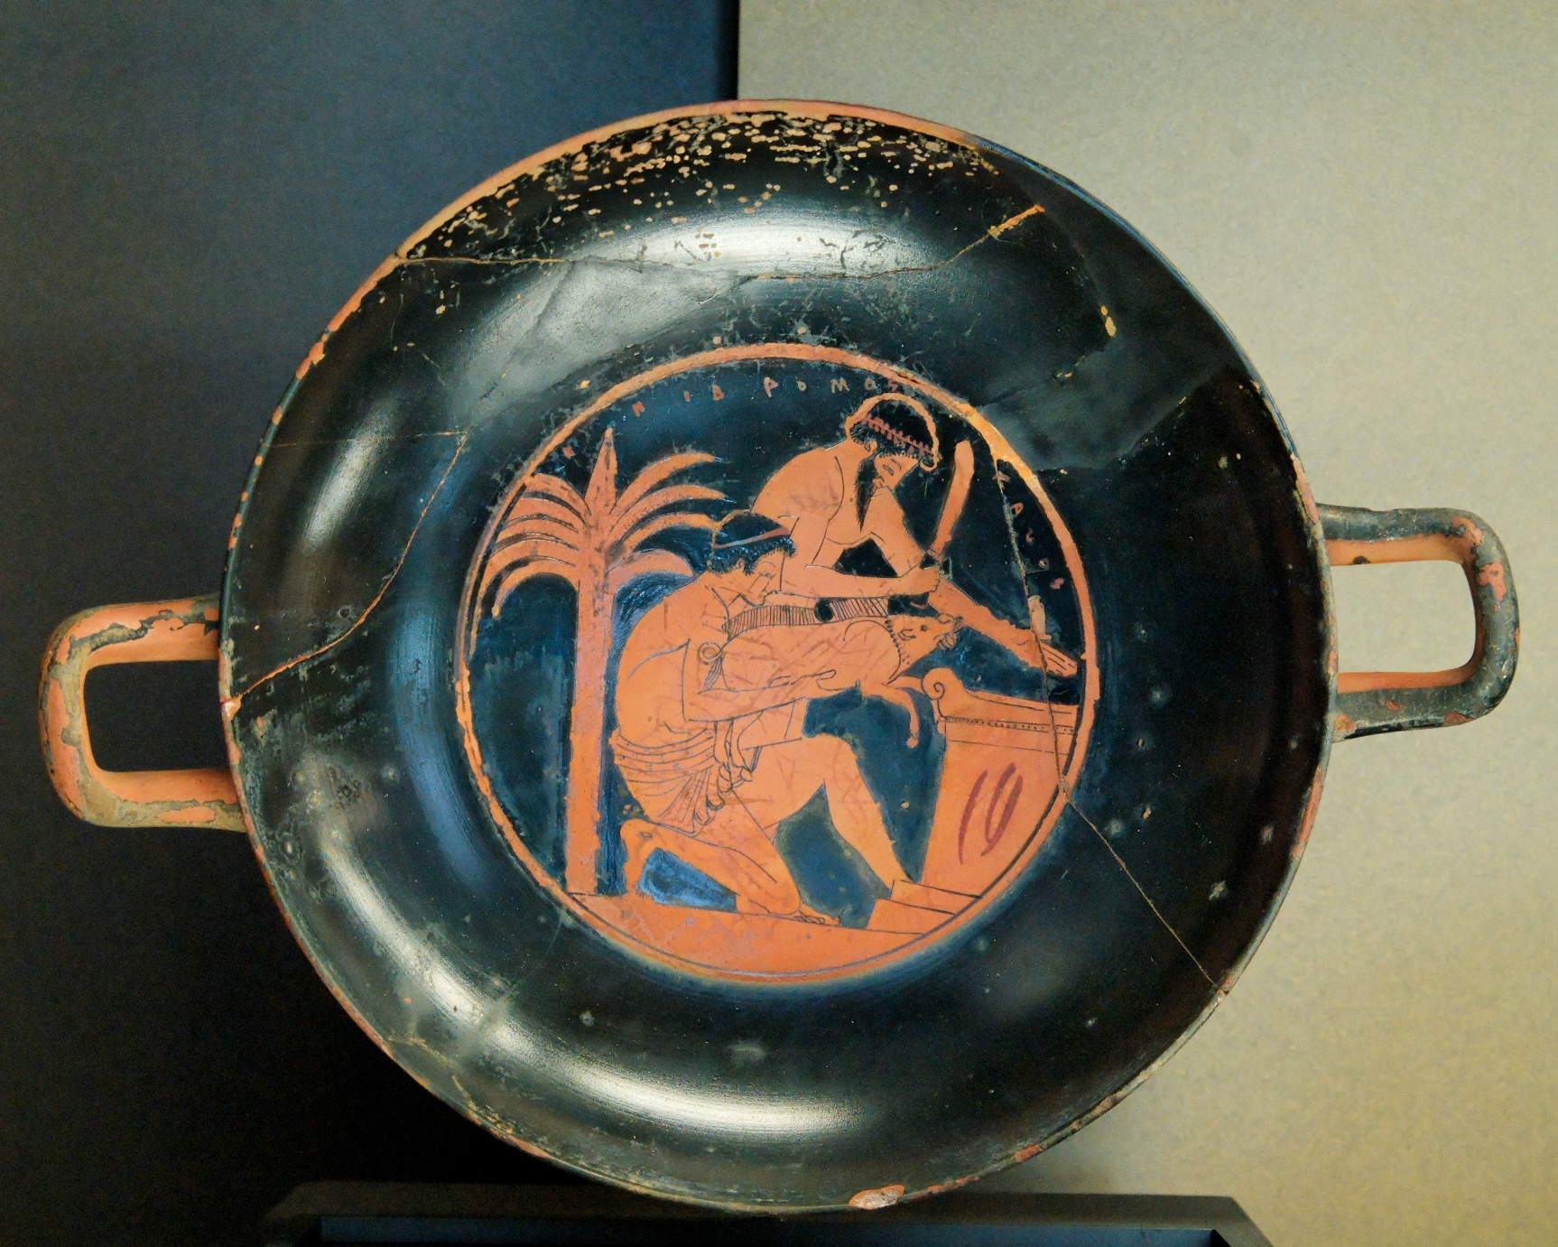
Ritual sacrifice. Here, the life of a young boar is offered to a god.
People would usually eat animals that were sacrificed. Louvre Museum, G112.

Slide 45
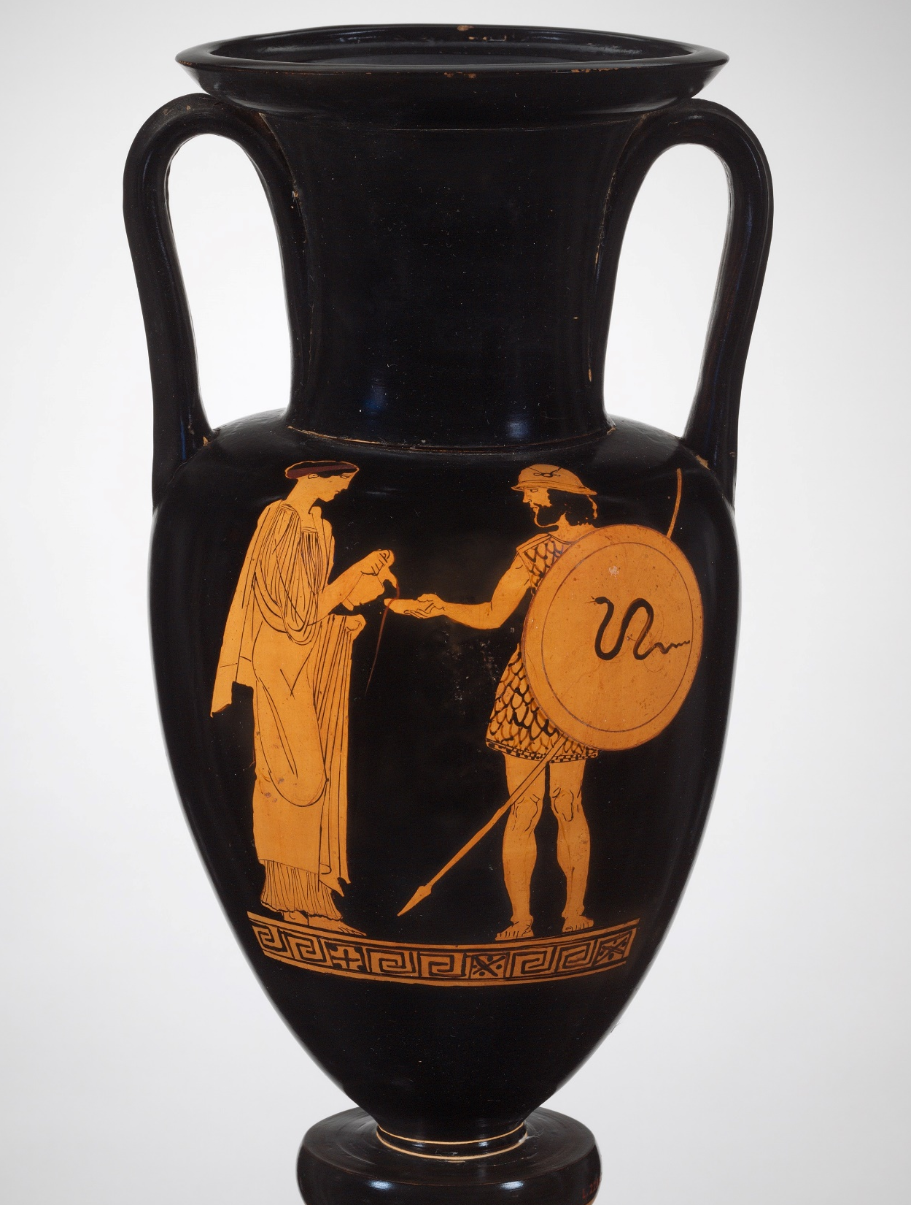
Ritual liquid sacrifice - libation
Liquids were offered to gods, especially wine, also milk, water, honey, and sometimes blood.
Here a woman pours wine into a bowl for a soldier who will make a libation with it as he departs for war.
See this ritual performed in the vase animation
Libation.
Metropolitan Museum of Art, 41.162.109.

Slide 46
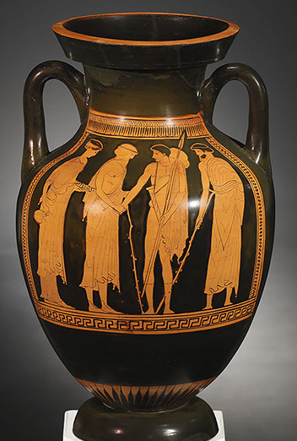
This amphora shows a soldier bidding goodbye to his family as he leaves home.
The woman on the far left holds a jug and bowl ready for making a libation.
See this scene animated.
Private collection, c. J-D Cahn.

Slide 47
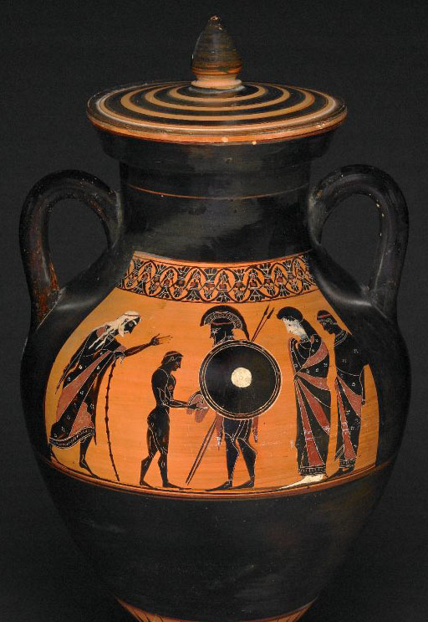
Ritual divination
Another benefit of a sacrifice was the chance to look for
signs sent from the gods.
The liver of an animal that had been sacrificed would be examined closely. A clear, healthy liver was an encouraging sign; a nasty looking liver was a warning.
This soldier is examining a liver with his family before he leaves for a military campaign.
Watch a solider examining a liver in the animation Hoplites! Greeks at War.
British Museum 1836,0224,22.

Slide 48
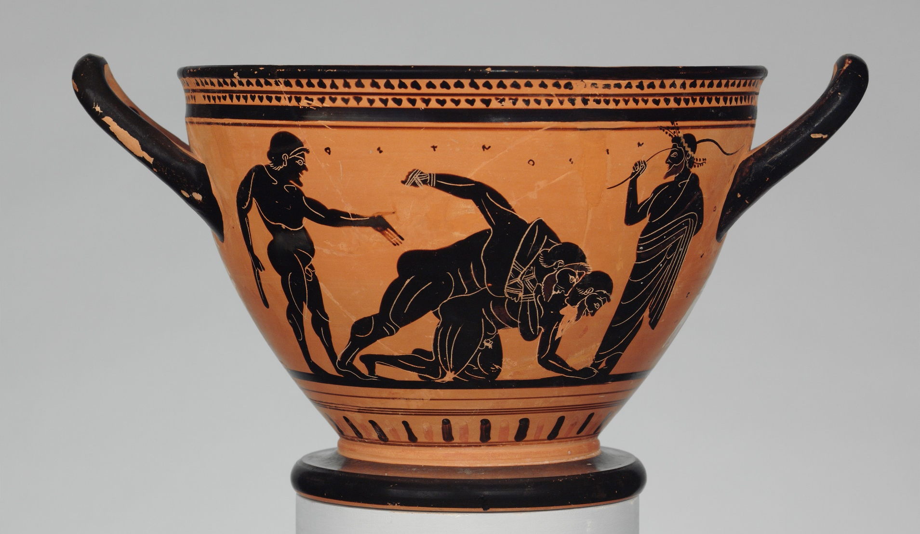
Sports. Sports such as wrestling, running, boxing, and pankration (mixed martial arts) could be offered to the gods.
The gods were thought to enjoy watching these sporting competitions and to appreciate the skill and dedication of the athletes.
Metropolitan Museum of Art, USA, 06.1021.49.

Slide 49
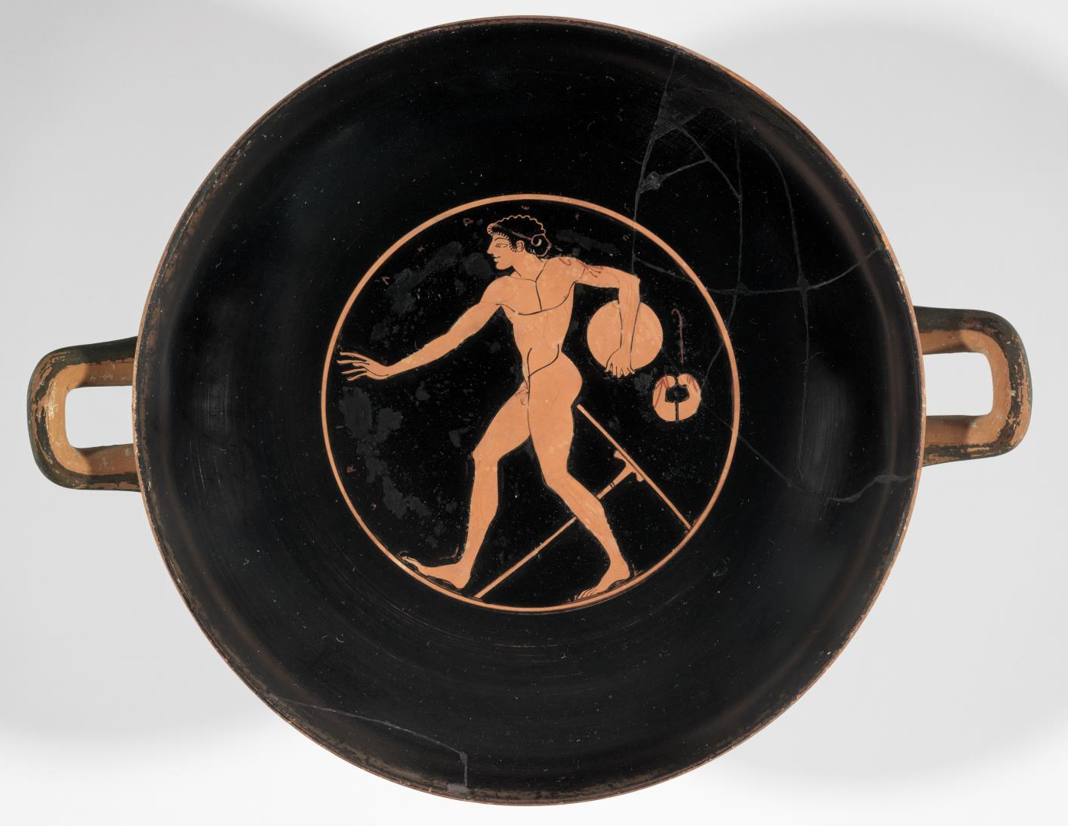
An athlete training with a discus. If he is good enough, he can offer his skill and dedication in the discus to a god at an athletics festival such as the Olympic Games.
Museum of Fine Arts, Boston, USA, 00.338.

Slide 50
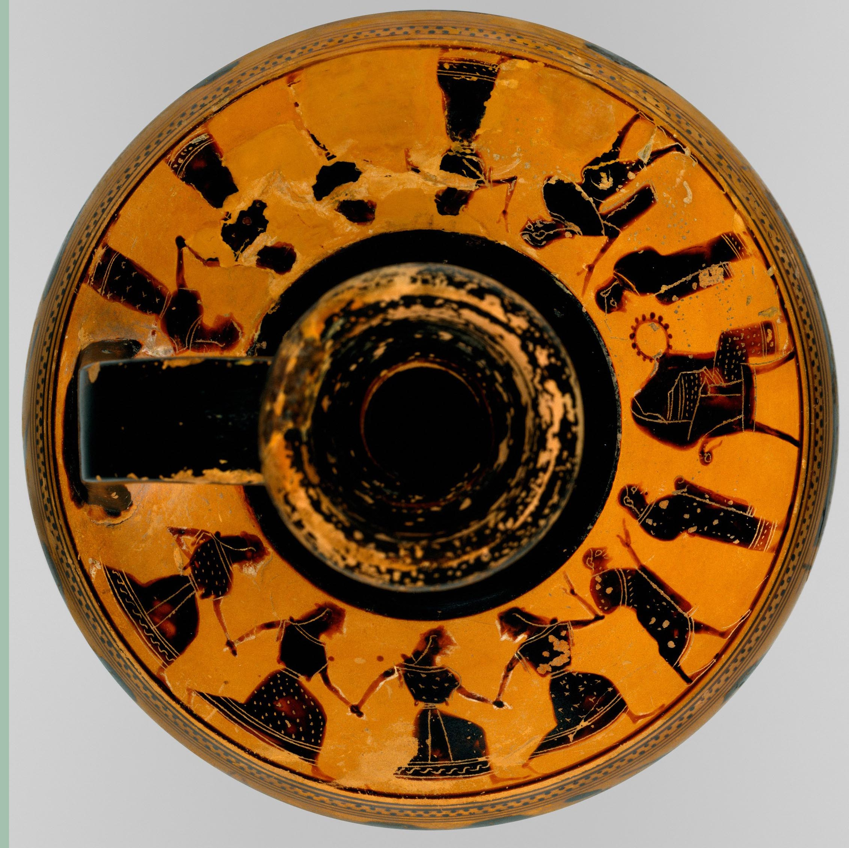
Ritual dance
Men, women, boys, and girls all danced for the gods.
Dance was part of young people’s education.
Dances were often done as part of a competition.
On the shoulder of this lekythos vase, two groups of four dancing young women and two young men approach a seated woman (who sits on the right, opposite the handle).
Metropolitan Museum of Art, Fletcher Fund 1931, 31.11.10

Slide 51
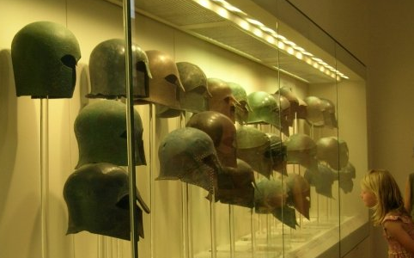
Ritual gifts, called votives. Ancient Greeks gave the gods gifts, known as a votive offerings. These helmets were given to Zeus at his sanctuary at Olympia. Other votives might take the form of statues, weapons, or temples.
Teenagers usually dedicated their toys to Artemis when they finished puberty.

Slide 52
“There is not so much gold in the world nor land so fair that we would take it for pay to join the common enemy and bring Greece under subjection. There are many compelling reasons against our doing so, even if we wished: the first and greatest is the burning of the temples and images of our gods – now ashes and rubble.... Again there is the Greek nation – the community of blood and language, temples and ritual, and our common customs.”
Herodotus, Histories, 8.144

Slide 53

‘Men create the gods in their own image…. But if cattle and horses or lions had hands, or were able to draw with their hands and do the work that men can do, horses would draw the forms of the gods like horses, and cattle like cattle, and they would make their bodies such as they each had themselves.’
Xenophanes of Colophon
(c. 570-470BCE).

Slide 54
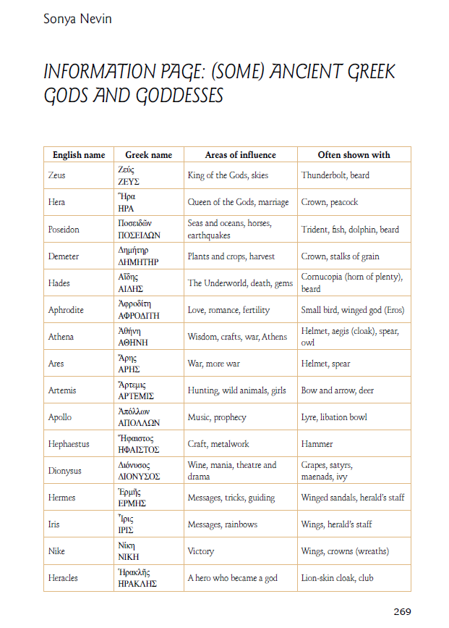
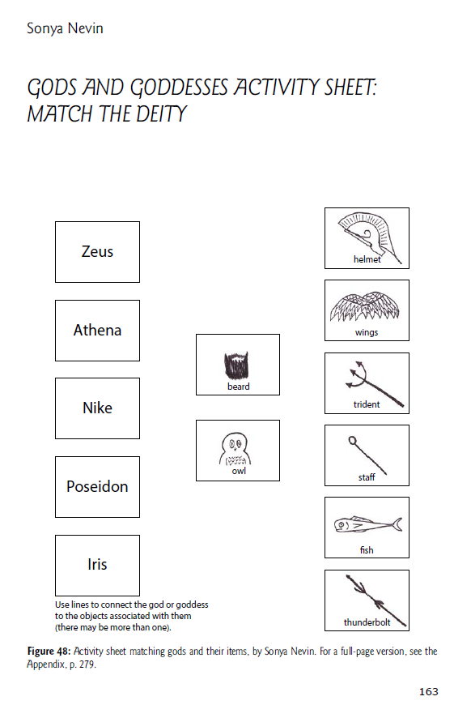
Two activity sheets available in:
Teaching Ancient Greece. Lesson Plans, Vase Animations, and Resources.

Slide 55
This PowerPoint was developed to accompany the Open Access book,
Teaching Ancient Greece. Lesson Plans, Vase Animations, and Resources.
The book includes lesson plans and other activities based around these five vases and animations made from those vases.
The gods featured are Iris, Zeus with Nike and Athena, Dionysus, and Herakles, plus the mortal Sappho.
The animations and short documentaries based on these vases can be found at:
https://panoply.org.uk/our-mythical-childhood
along with other animations and resources.

Slide 56
This PowerPoint was made by
Dr Sonya Nevin of the Panoply Vase Animation Project, for the ERC-funded project Our Mythical Childhood: http://www.omc.obta.al.uw.edu.pl/
Feel free to use this PowerPoint for educational purposes, including editing it.
Please do not post it online. If you would like to share it, please share its url.
The PowerPoint can be downloaded from:
https://panoply.org.uk/further-resources

