Slide 1
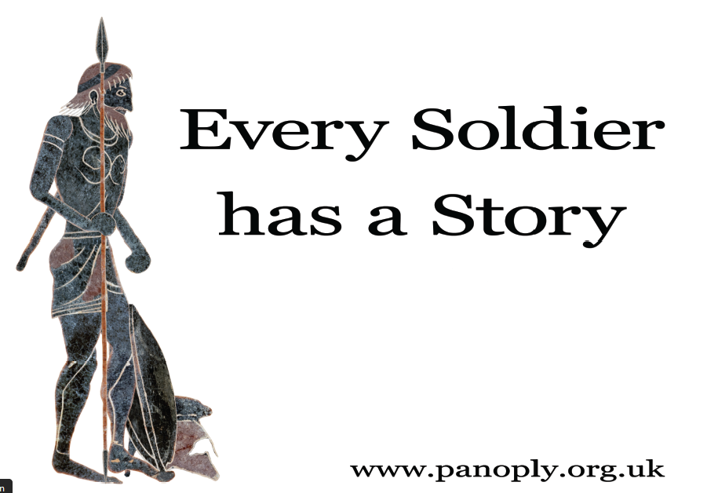

Slide 2
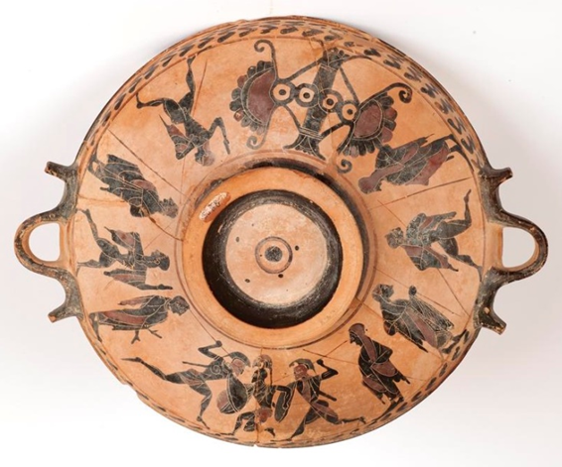
The animation Hoplites! Greeks at War was made from the scenes on this
ancient Greek vase, which is housed in the
Ure Museum
in Reading (catalogue 56.8.8).
The vase was made on the Greek island of Euboea in around 550BCE.
It’s a sort of shallow dish, called a lekanis. It would once have had lid and would have been used at fashionable symposium dinner parties.

Slide 3
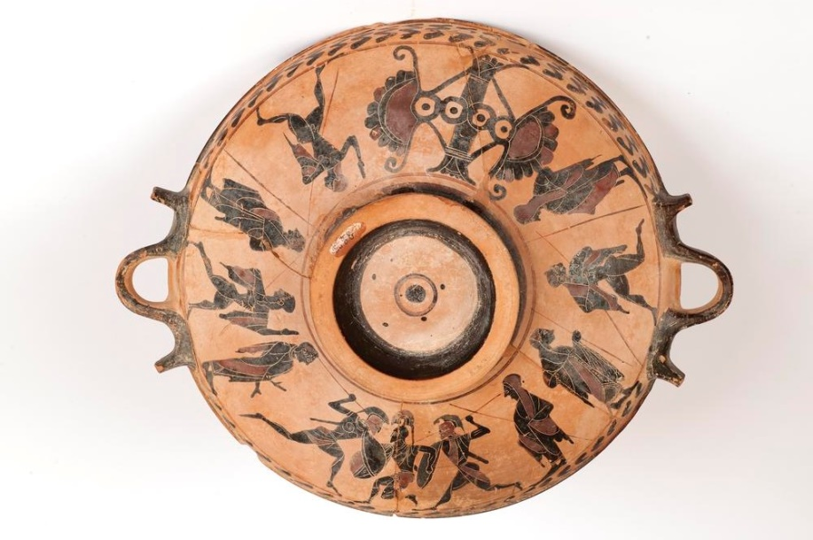
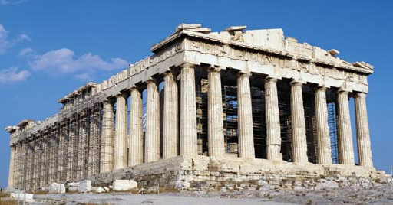
610
600BCE
590
580
570
560
550
540
530
520
510
500BCE
490
480
470
460
450
440
The vase was made in around 550BCE
Persian Wars
The Parthenon temple begun at Athens

Slide 4
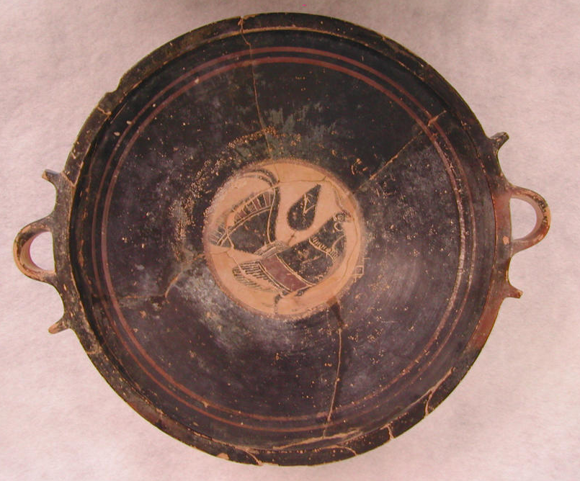
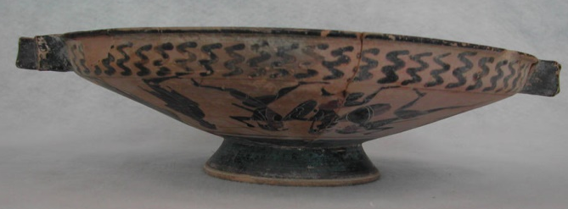
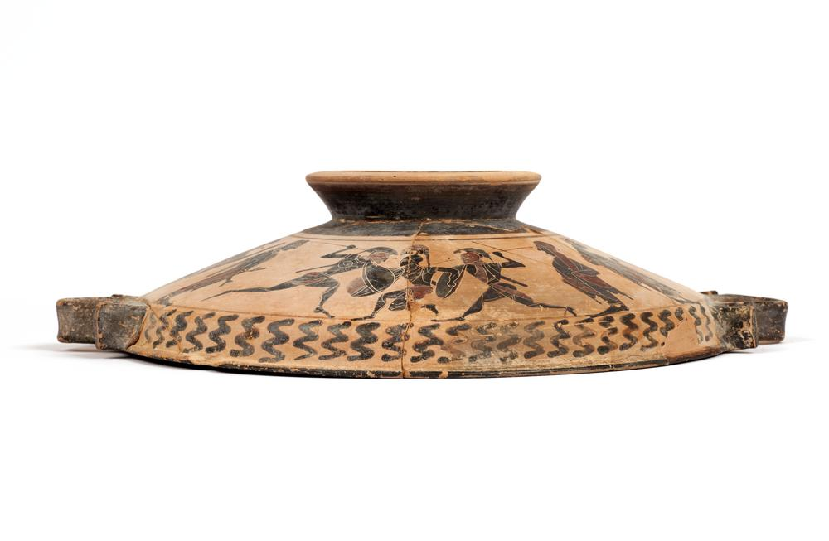
This is it From Above
From Below
From the Side. Sitting on its base, and on its rim.

Slide 5
The underside of the vase is divided into four main sections:
abstract pillar design
athletics training
athletics
training
combat training

Slide 6
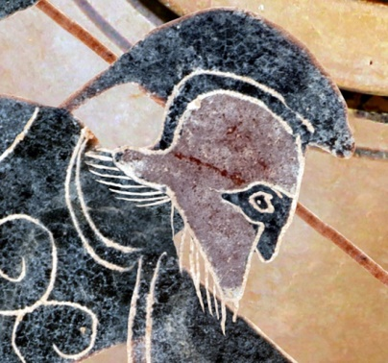
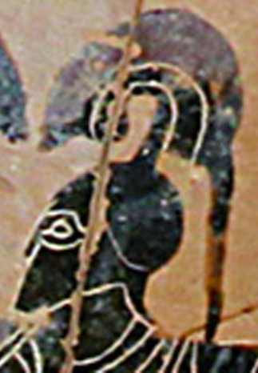
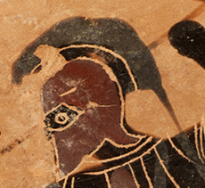
We can see three fighters

Slide 7
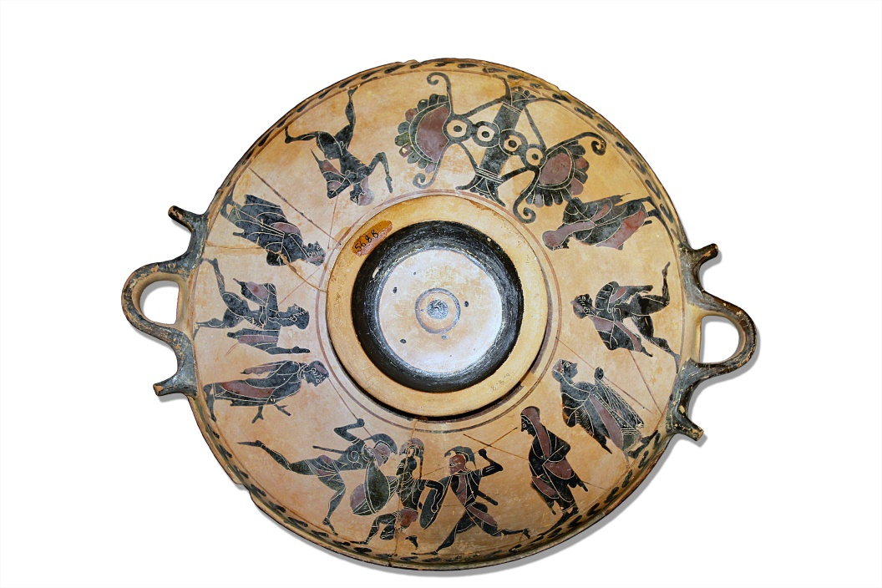
and three runners

Slide 8
Could this be showing the same people doing different activities?
3 fighters: 3 runners

Slide 9
What about here? Could this be the same person watching the running and
the fighting?

Slide 10
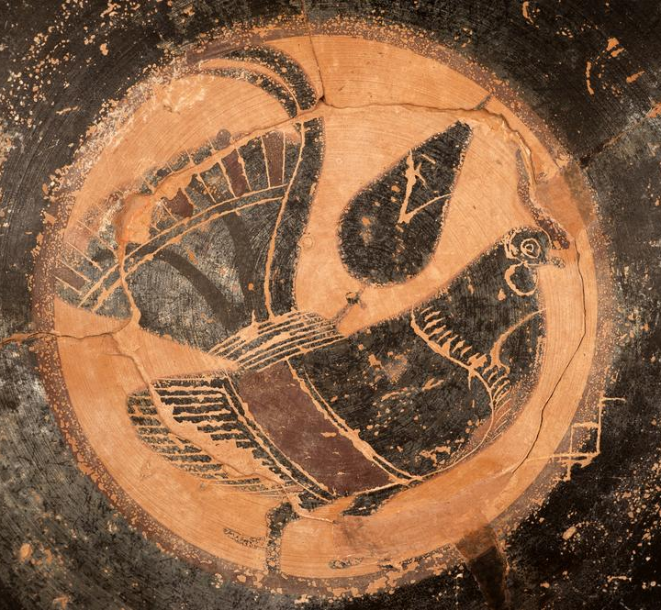
Only people with enough wealth to have leisure time could afford to spend lots of time training at the gymnasium or the cost of expensive armour
A gym-fit body and decent fighting skills were a sign of wealth and social status.

Slide 11
athletics, hoplite fighting, fighting cockerels…
…these are all elite activities -
- this vase is so aristocratic!

Slide 12
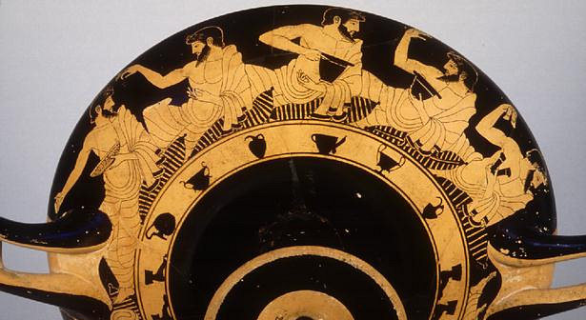
Being able to afford symposium dinner-parties was a sign of wealth too – no wonder people joined the two together and displayed images of athletes and fighters at their symposiums!
The vase on the right shows some
Athenian men at a symposium.
Berlin Painter, c.500BCE
Antikensammlung SMPK, Berlin

Slide 13

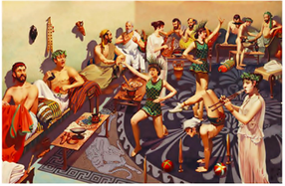
This drawing (from The Greek Gazette) shows another symposium.
Notice the room lay-out, with double-couches set out against the wall and low tables with food and drink in different shaped vases.
The guests are being entertained by
musicians, acrobats and lively conversation.

Slide 14
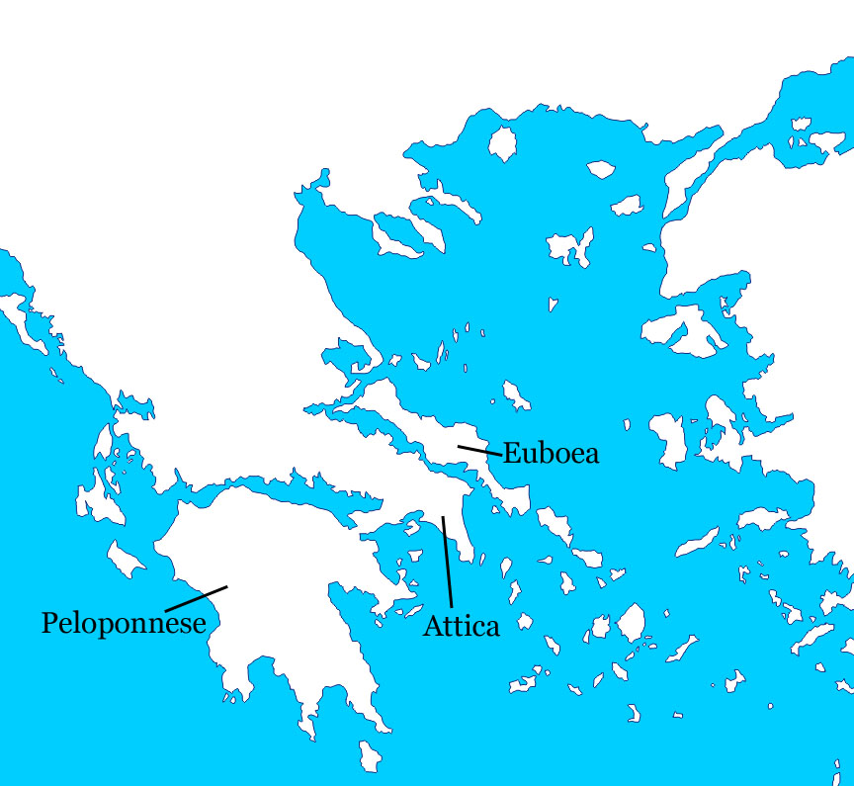
The vase is from the Greek island of Euboea

Slide 15
How do we know where the vase came from?
When the Ure Museum purchased the vase in the 1960s, curator Annie Ure studied it. She found that its style of decoration indicated that it was made on Euboea.
Vase specialist Sir John Boardman studied the clay on Euboea. He wrote that the clay there
‘is pink-red, slightly paler than Attica, occasionally even yellowish, without mica.’
When he looked at the chemical make-up of the vase and the chemical make-up of the clay on Euboea, he saw that they were extremely similar. This confirmed what Annie Ure had suggested – the vase is from Euboea. John Boardman called this ‘a happy congruence here of results from stylistic and chemical analysis.’
See the results for yourself on the next slide.
New developments in archaeology were beginning to enable people to know where vases were made by analysing the clay they were made from as each bed of clay has its own chemical mixture.
Ure, A.D. (1962 - 1963) ‘Recent Acquisitions by the Museum of Greek Archaeology, University of Reading’, Archaeological Reports, No. 9, pp. 56-62 , and
Ure, A.D. (1973) ‘Observations on Euboean Black-Figure’, The Annual of the British School at Athens, Vol. 68, pp. 25-31
Boardman , J. and Schweizer, F. (1973) ‘Source Clay Analyses of Archaic Greek Pottery’, The Annual of the British School at Athens, Vol. 68 , pp. 267-283

Slide 16
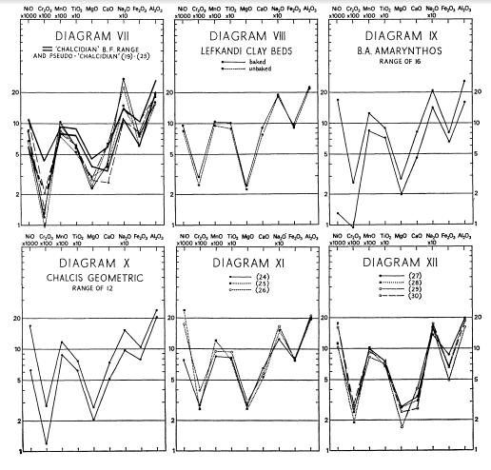

The similarity of the graphs in Diagram VIII (Euboean clay) and Diagram XII
(vase 56.8.8) demonstrated that ‘though a little low
in Ca, high in Ni’,
the vase was made
of Euboean clay.
This chemical analysis confirmed what Annie Ure had suggested based on the style of the decoration.
(Boardman & Schweizer 1975:
273-276 )

Slide 17
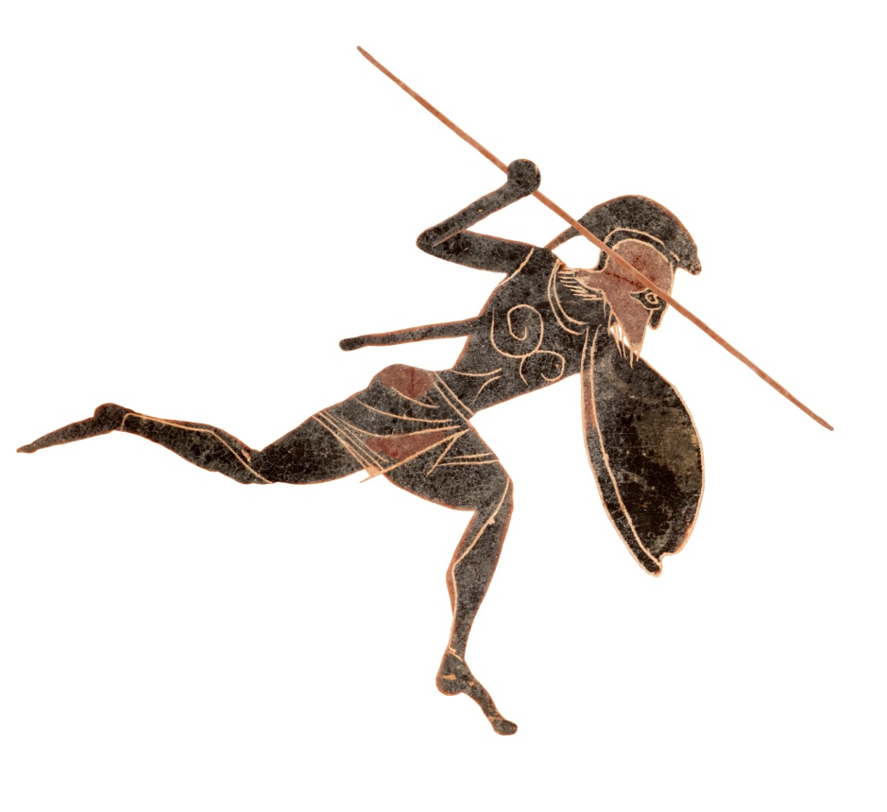

Greeks at War
This hoplite soldier has:
a spear – the most important weapon in Greek warfare
a sword – a useful back-up weapon for close fighting
a crested helmet – very protective
a large round shield
greaves – metal shin protectors
a kilt-like skirt –
giving lots
of mobility
a breastplate – the chest-like design shows us that it’s metal.

Slide 18
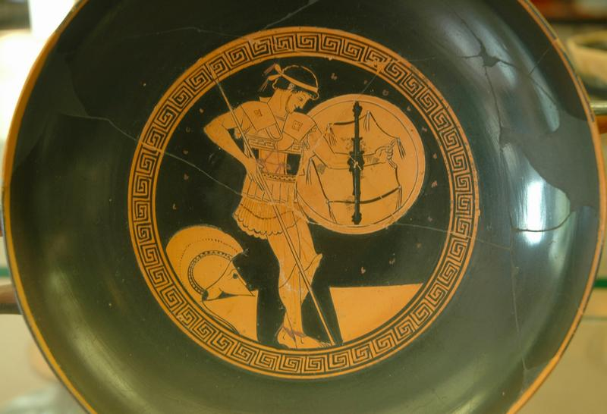
This vase shows how the grips on the inside of the shield worked. This vase was made in the fifth-century BCE, around 100 years after our vase. By this time, hoplites were wearing lighter linen corselets like this one instead of metal breastplates. What do you think might have motivated the change?

Slide 19
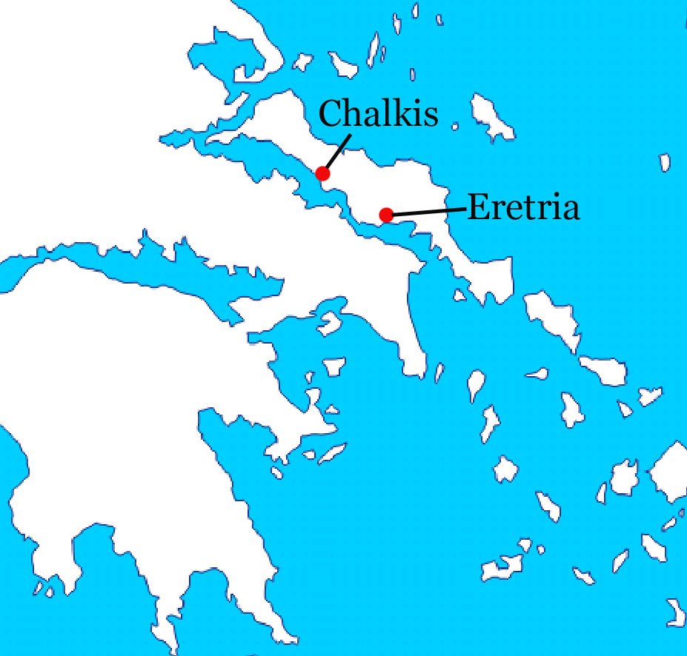
Euboea at War
There was serious rivalry on Euboea between its two biggest city-states:
Eretria (where this vase is from) and Chalkis.
Each city wanted to own the land in between the two cities.
In the years before the vase was made, the two cities had fought many battles to decide their borders.
The most common enemy for Greek soldiers was other Greeks.

Slide 20
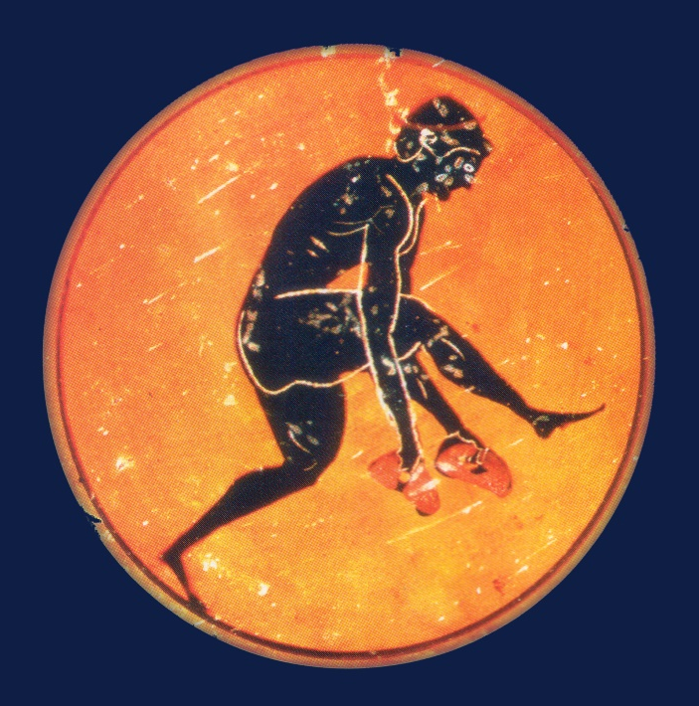

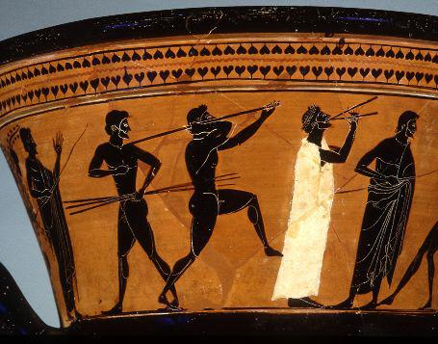
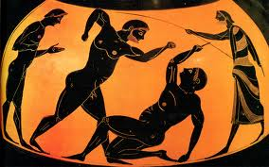
Athletics competitions at religious festivals, such as the
Olympic Games, gave the Greeks peaceful ways to compete.
Wars stopped when it was time for the Games.
Great warriors could also be great athletes, great horse-riders, or great organisers.
Vases showing running, long jump, javelin, and mixed martial arts
Soldiers
Away From Wars

Slide 21

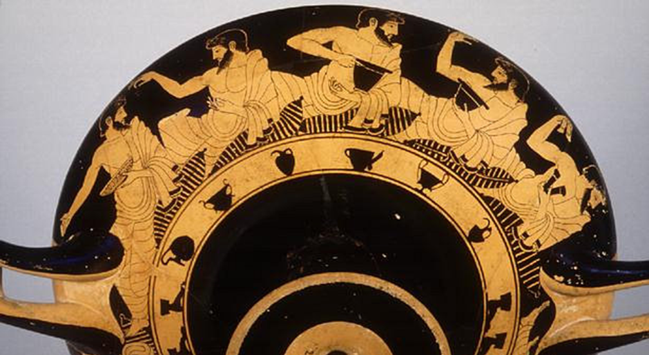
Soldiers were also citizens.
They had to look after their families, take part in the running of their city, and manage their farms.
Some soldiers would have been merchants.
They would all take part in some of the usual Greek pass-times: enjoying music and dancing, listening to poetry, maybe writing poetry, experimenting in science and maths, hunting game and exercising, and - of course – meeting at symposiums.

