Slide 1
This PowerPoint was made by Dr Sonya Nevin of the Panoply Vase Animation Project to accompany The Ephedrismos Procession animation as part of the Locus Ludi project.
Feel free to use it for educational purposes, including editing the PowerPoint and embedding the animation from YouTube. Please do not post the PowerPoint online.

Slide 2
What is ephedrismos?
Ephedrismos was a popular game throughout ancient Greece.
The name ‘ephedrismos’ means ‘carry on the back.’
The game could be played lots of different ways, but it always involved one person giving another person a piggyback.

Slide 3
What is ephedrismos?
In one version of the game, a stone would be set on the ground as a marker and players threw stones at the marker to knock it over. The person who knocked it over first was the winner. They would climb on the back of the other player and cover that person’s eyes. The carrier had to keep on trying to find or hit the target, now carrying his opponent!
In another version, pairs of riders and carriers played a ball game, with a referee throwing the ball amongst them.
Ephedrismos processions seem to have been popular too.

Slide 4
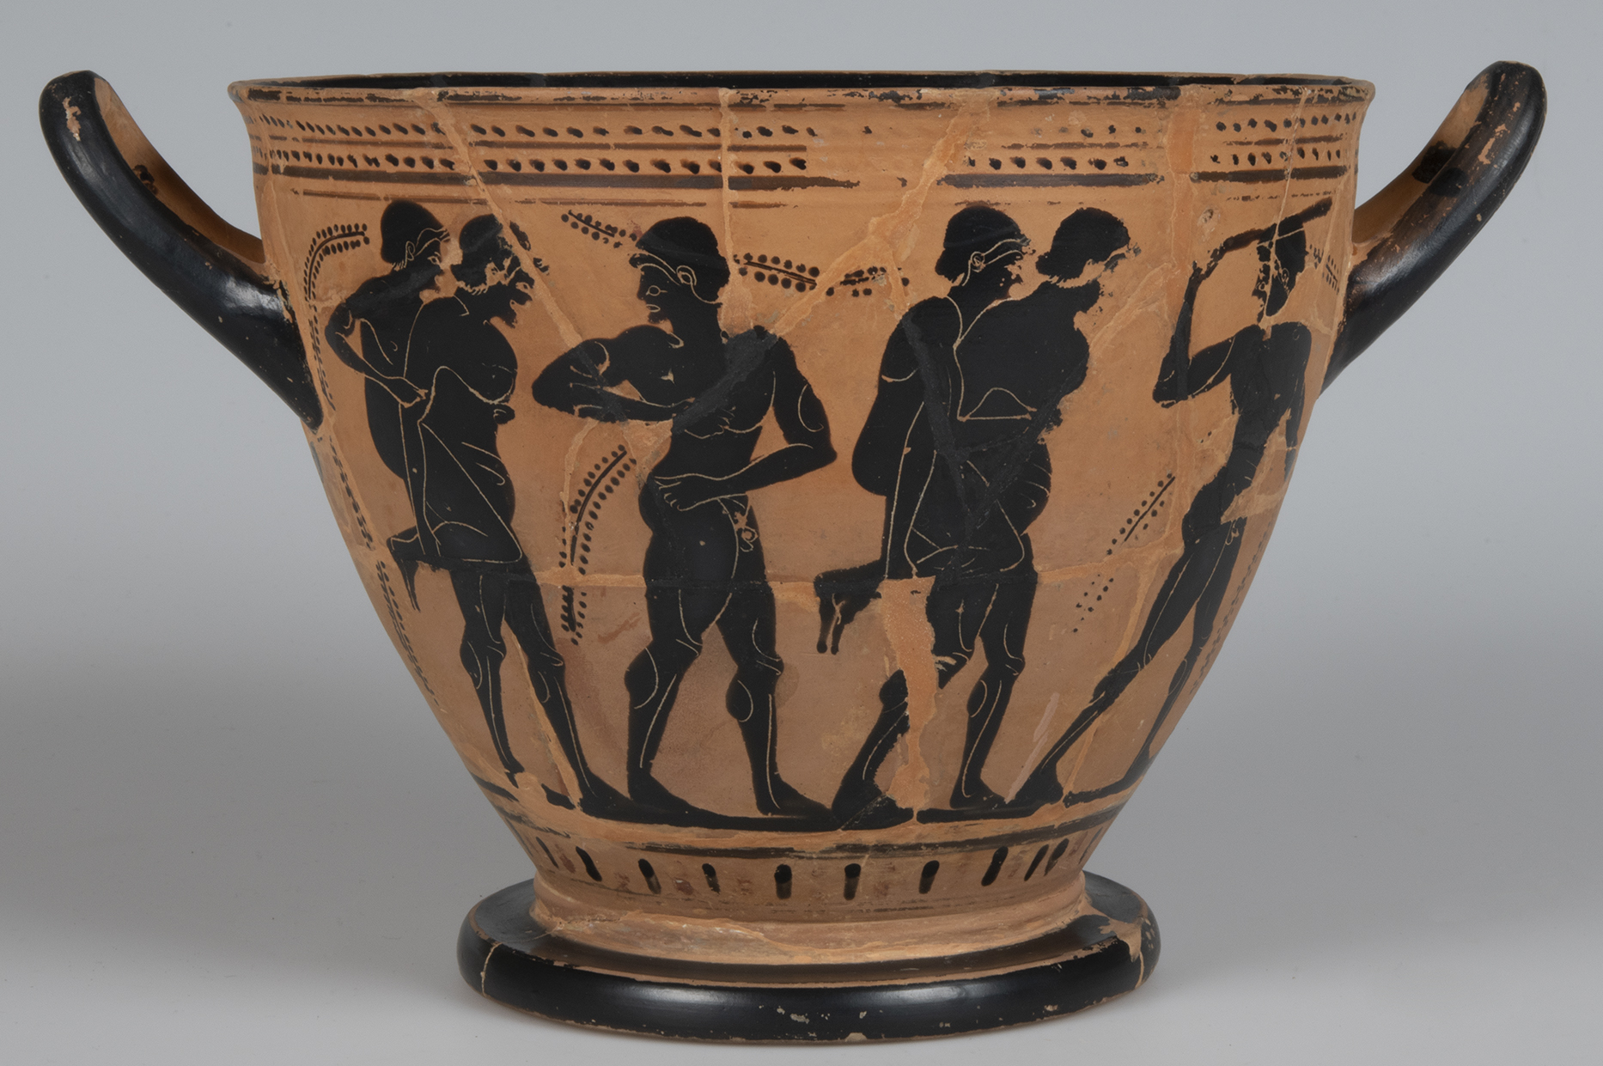
Athenian black-figure skyphos, 525-475BCE, by the Theseus Painter. Musées Royaux, Brussels, Belgium, R327 (Beazley no. 330683).
An ephedrismos procession. The pairs of men are accompanied
by men who are walking, one of whom holds a club.

Slide 5
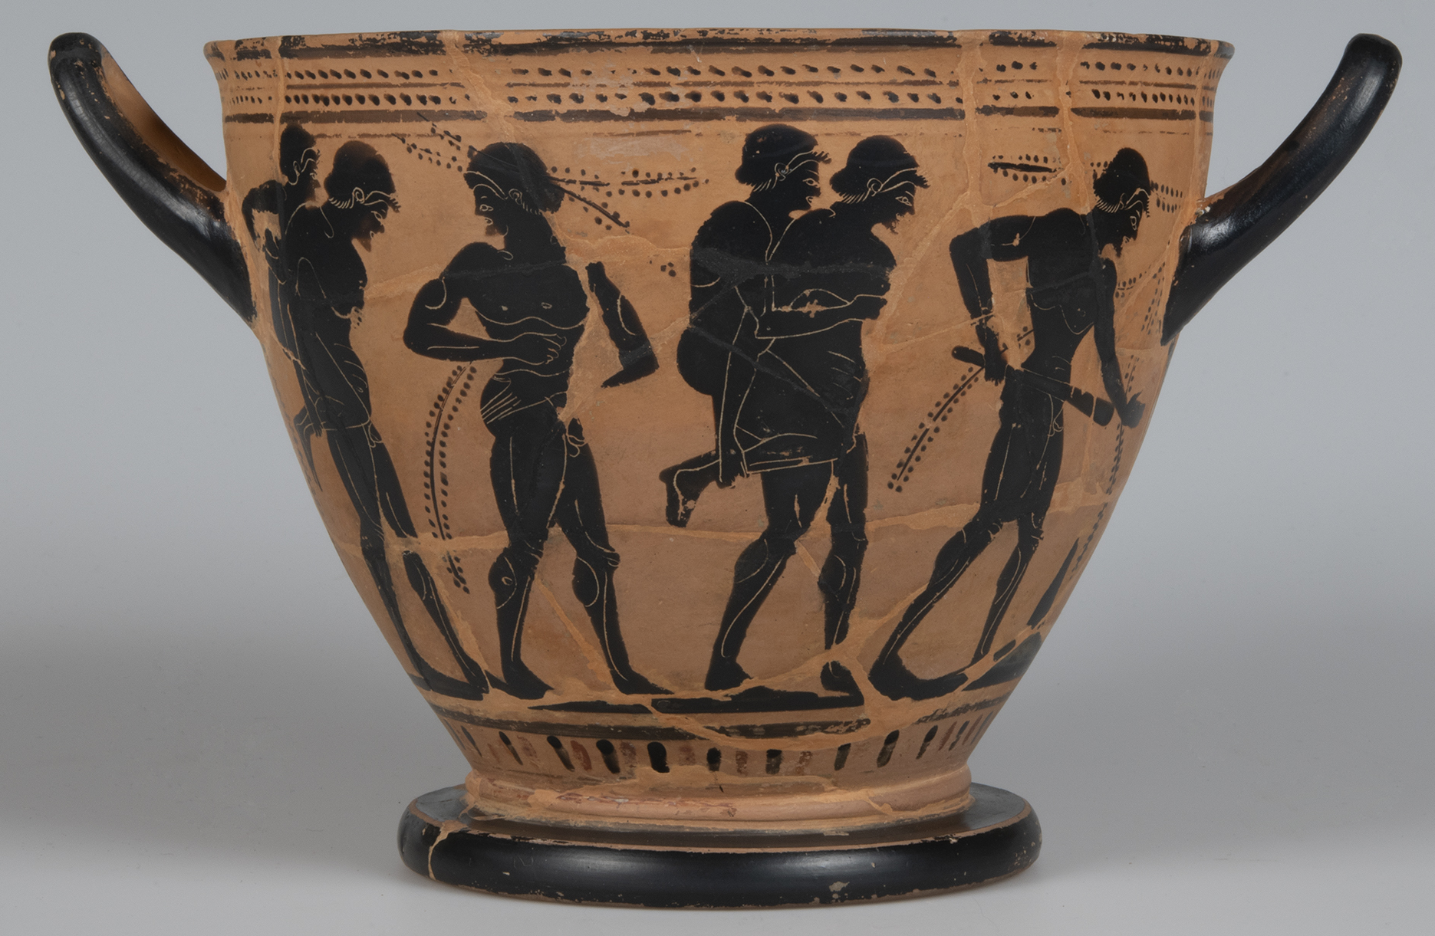
Athenian black-figure skyphos, 525-475BCE, by the Theseus Painter. Musées Royaux, Brussels, Belgium, R327 (Beazley no. 330683).
The other side of the same skyphos cup. What do you notice about how the rider and carrier stay together? What else do you see?

Slide 6
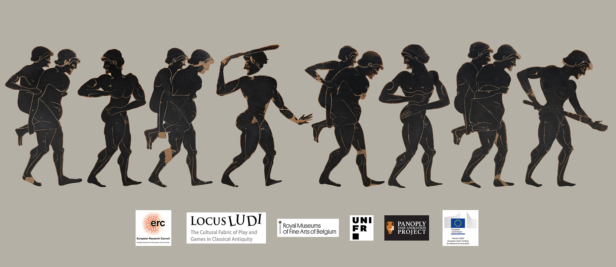
This image shows all the figures from both sides of the cup, straightened into a line. As you can see, they have been digitally cut out from the background of the vase. This is part of the process for creating a vase animation.

Slide 7
Teams of young men playing ephedrismos.
Each pair prepares to catch the ball that will be thrown by the seated, clothed figure – the referee (brabeus).
Athenian black-figured amphora.
British Museum, 1837,0609.65

Slide 8
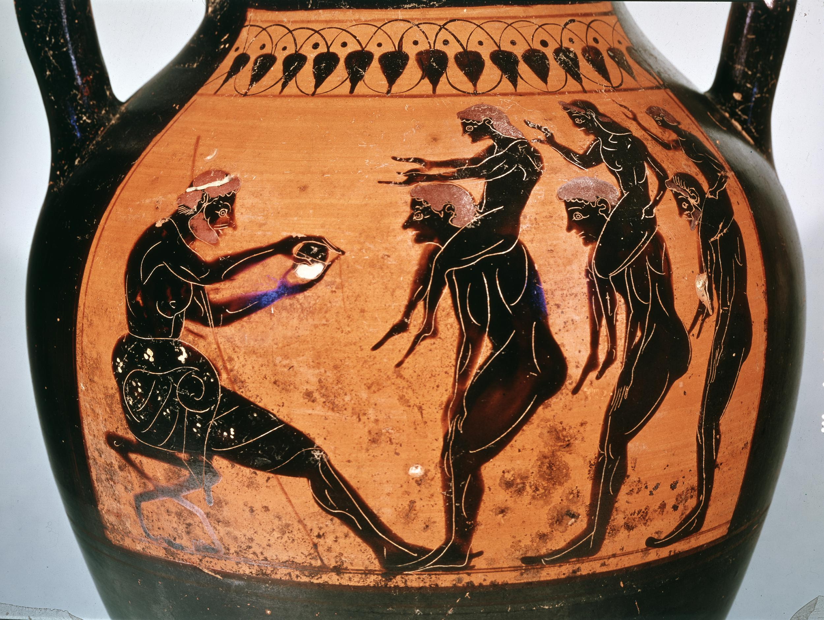

Slide 9
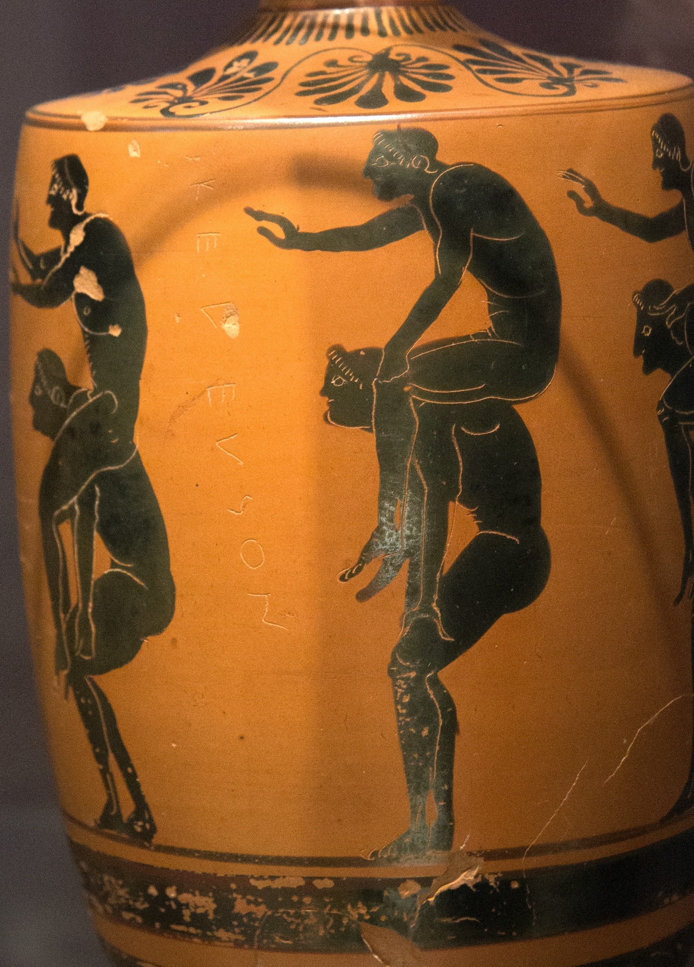
Youths playing ephedrismos; the pairs prepare to compete for a ball thrown by a referee.
Athenian black-figure lekythos, by the Edinburgh Painter, 525-475 BCE.
With the scratched inscription: KELEUSSON.
Ashmolean Museum, Oxford, 1890.27. (Beazley no. 380847).
Photo by Zde, CC BY-SA 4.0.

Slide 10
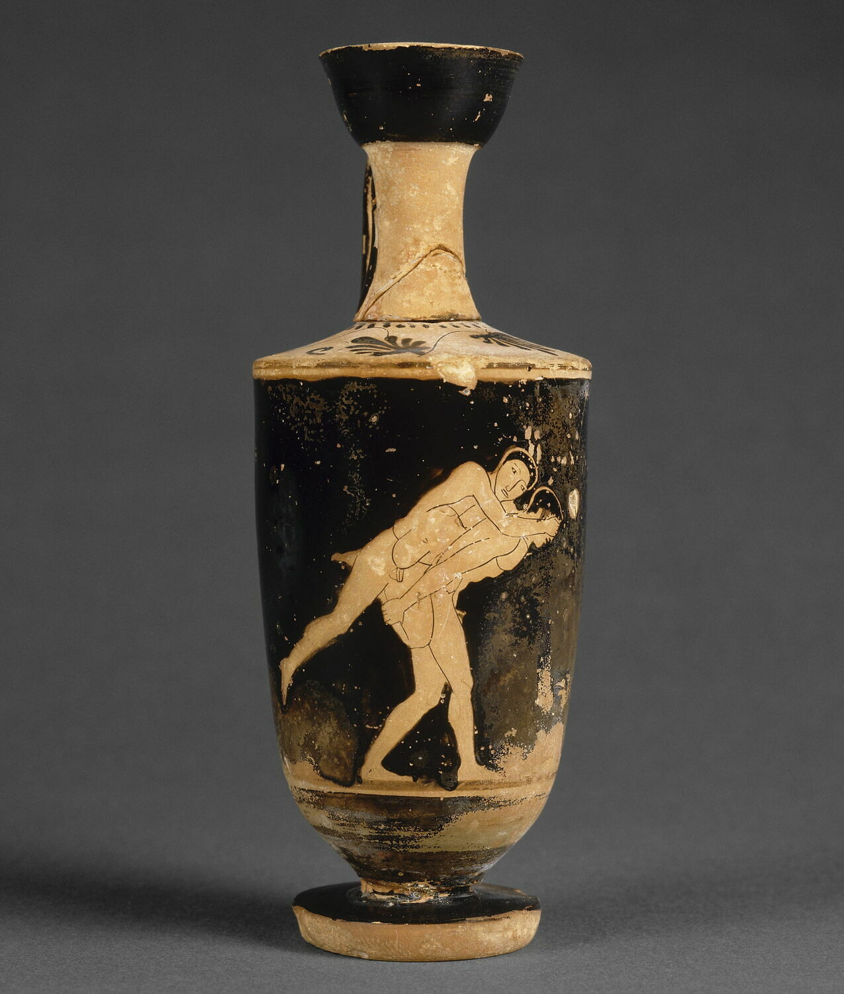
Young men playing ephedrismos; the rider covers the carrier’s eyes.
Attic red-figure Lekythos, c.470BCE.
Louvre Museum, Paris, CA 1988.

Slide 11
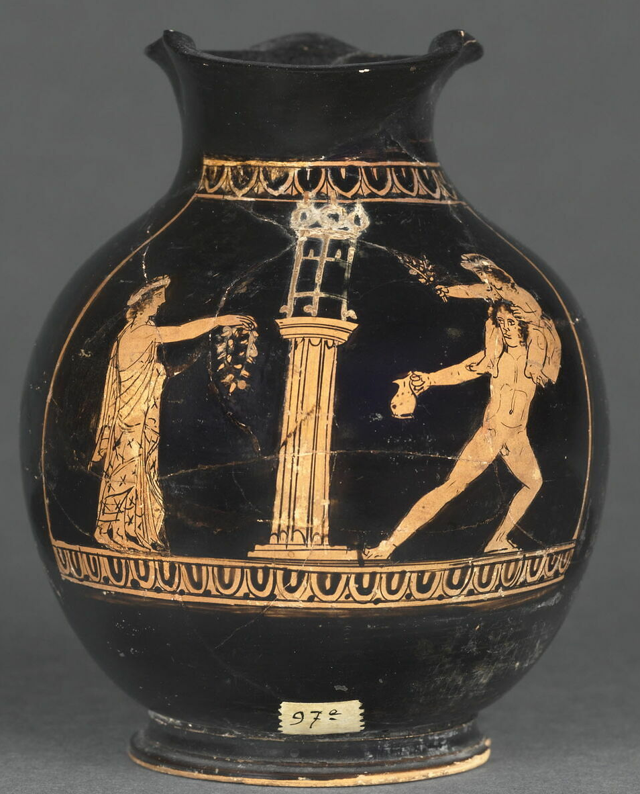
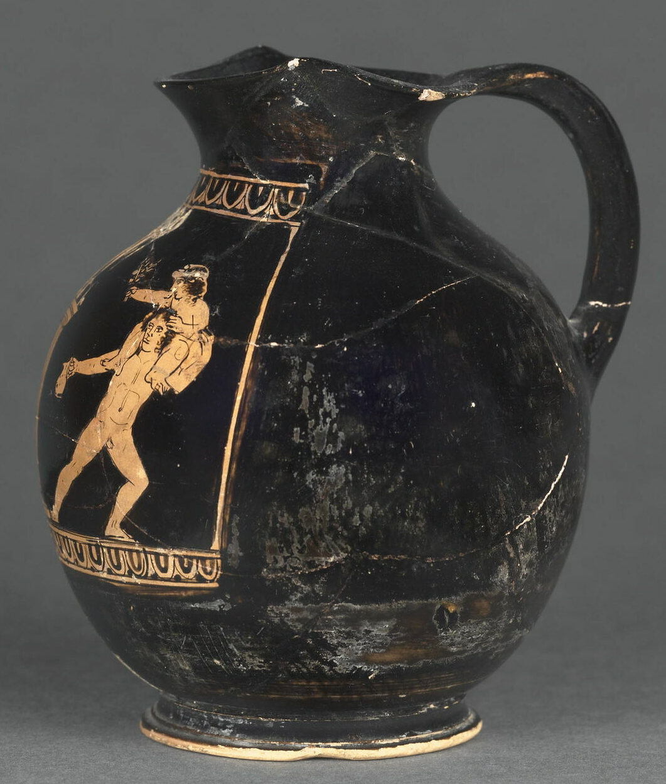
An ephedrismos scene, with a prize being offered;
one player older than the other.
Attic red-figure oinochoe (jug), c.420BCE. Louvre Museum, Paris, CA 1354.

Slide 12
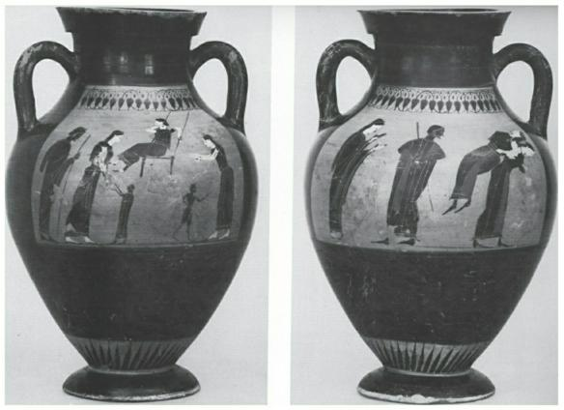
Pass-times for girls. One side of this amphora shows girls at a swing; the other shows a game of ephedrismos.
Attic black-figure amphora by the Princeton Painter (c. 540bce). Landesmuseum Württemberg Stuttgart. Image from V. Sabetai, ‘Playing at the Festival: Aiora, a Swing Ritual’ in Dasen and Vespa Play and Games in Antiquity.

Slide 13
See another scene of young women playing ephedrismos on a vase now in the Antikensammlungen in Munich, 2396.
Beazley 230348: https://www.beazley.ox.ac.uk/record/15B37ED1-F4EC-4CE4-B951-D6EF41E9F115

Slide 14
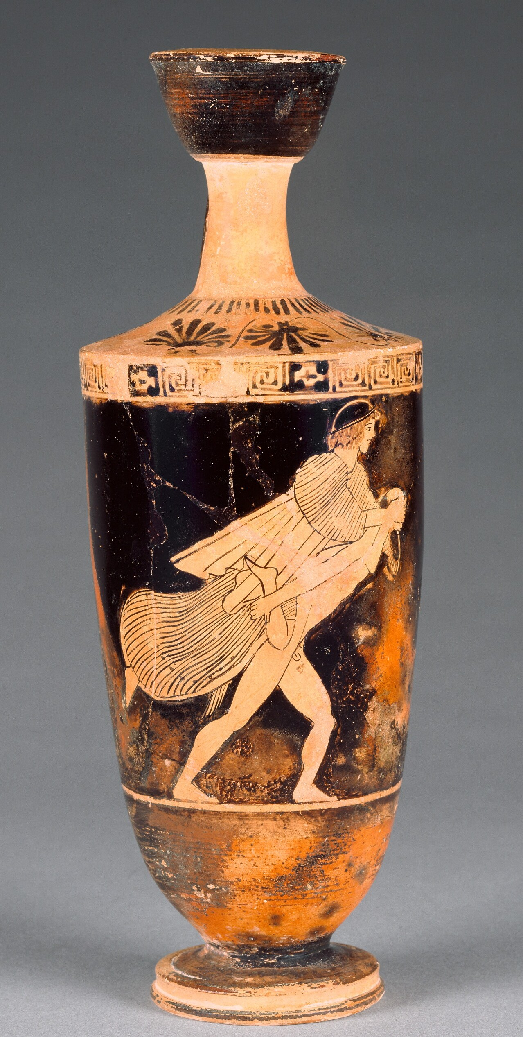
An unusual mixed-sex ephedrismos scene,
with a satyr carrying a maenad
(a female follower of Dionysus).
Attic red-figure lekythos, 470–460 B.C.E., by the Carlsruhe Painter, J-P Getty Museum, USA. 71.AE.444

Slide 15
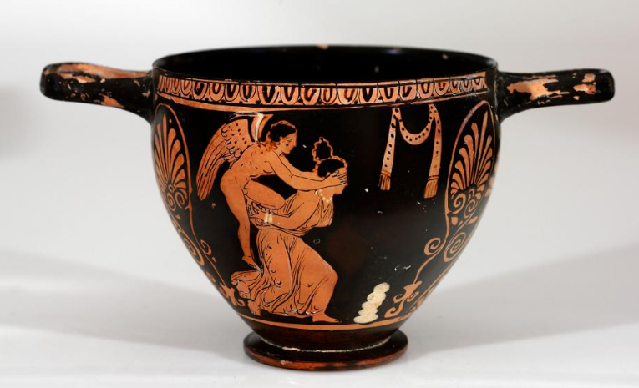
Eros playing ephedrismos with a young woman.
This clearly shows the symbolic aspect of the game.
Skyphos from Apulia in Southern Italy, c. 375-350 BCE. RISD Museum 25.089.
Courtesy of the RISD Museum, Providence, RI.

Slide 16
The ancient Greeks enjoyed many other games and sports.
Such as wrestling (above), running, boxing, and pankration (mixed martial arts).
Metropolitan Museum of Art, USA, 06.1021.49.

Slide 17
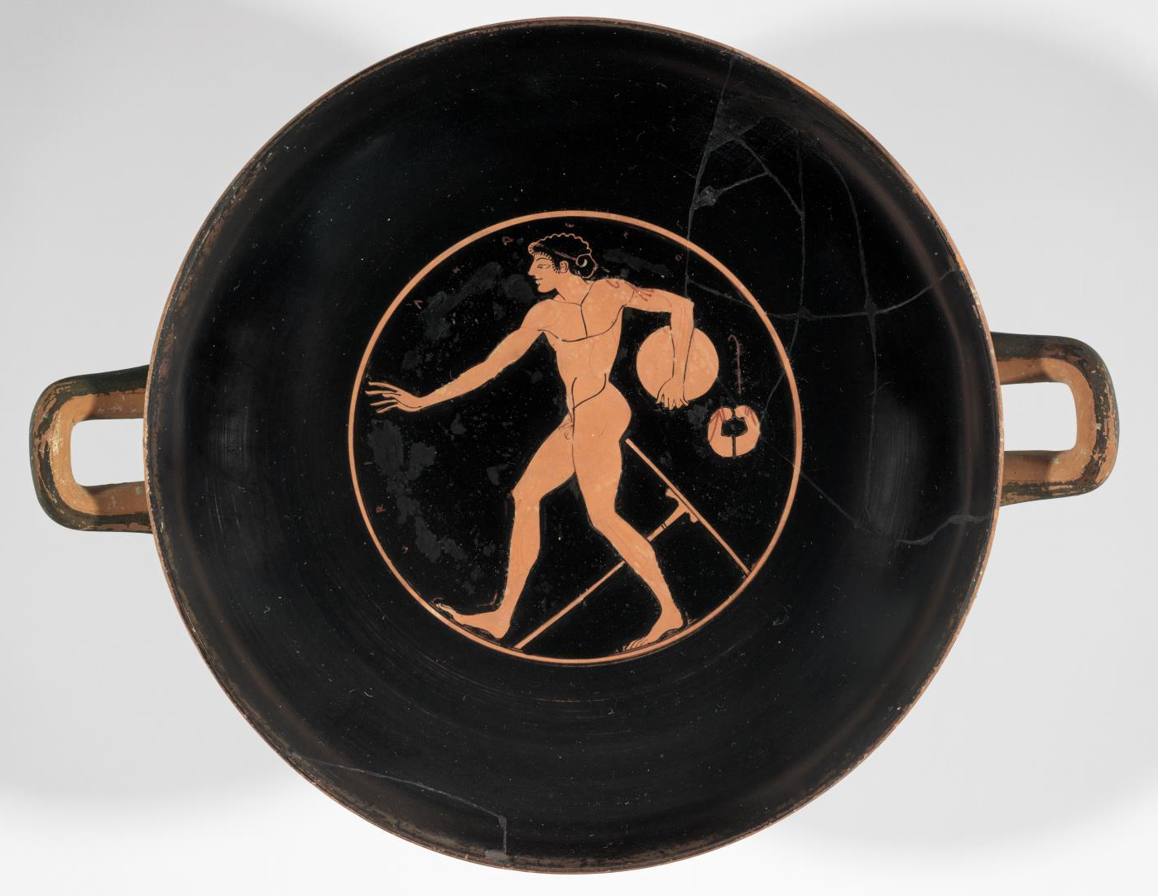
Inside this cup, an athlete is training with a discus.
Museum of Fine Arts, Boston, USA, 00.338.

Slide 18
This PowerPoint was created by Dr Sonya Nevin of the Panoply Vase Animation Project.
It supports the animation Ephedrismos:
Ephedrismos was made as part of the Locus Ludi project: https://locusludi.ch/
Feel free to use it for educational purposes, including editing the PowerPoint and embedding the animation from YouTube.
Please do not post the PowerPoint online.
The PowerPoint can be downloaded from: https://panoply.org.uk/ephedrismos

