Slide 1

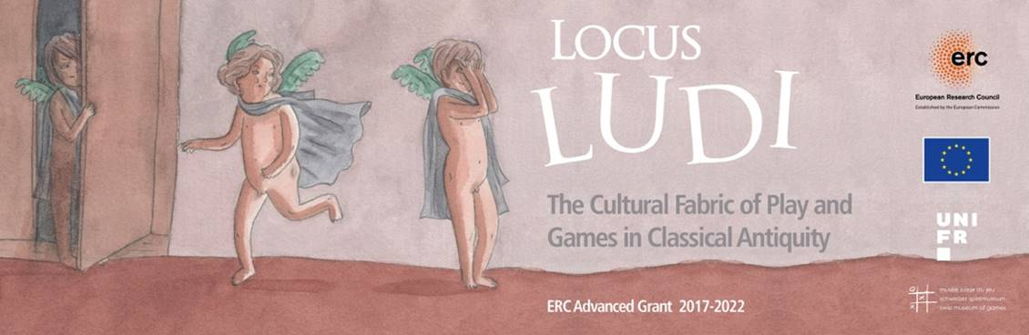
The Rattle.
Early Childhood in
Ancient Greece

Slide 2
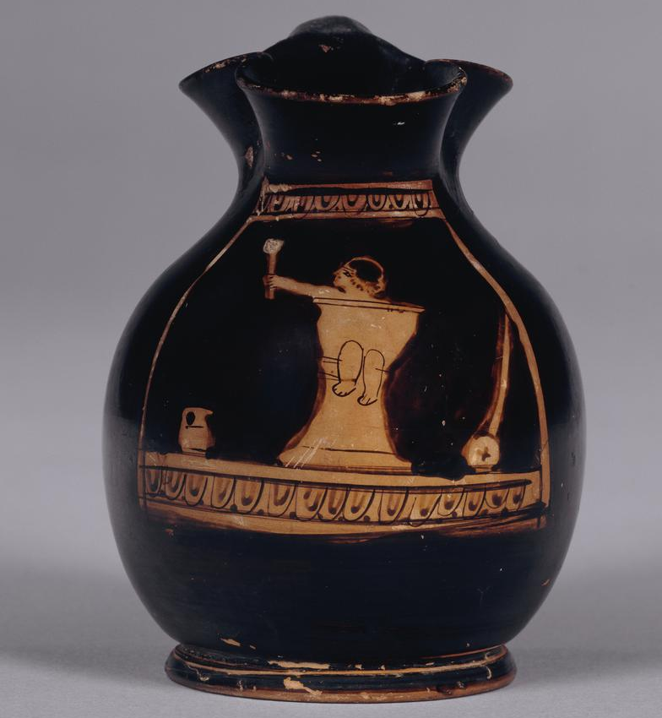
Red figure chous (jug), Attica,
c.440-430BCE.
British Museum,
UK, 1910.0615.4
https://www.britishmuseum.org/collection/object/G_1910-0615-4

Slide 3
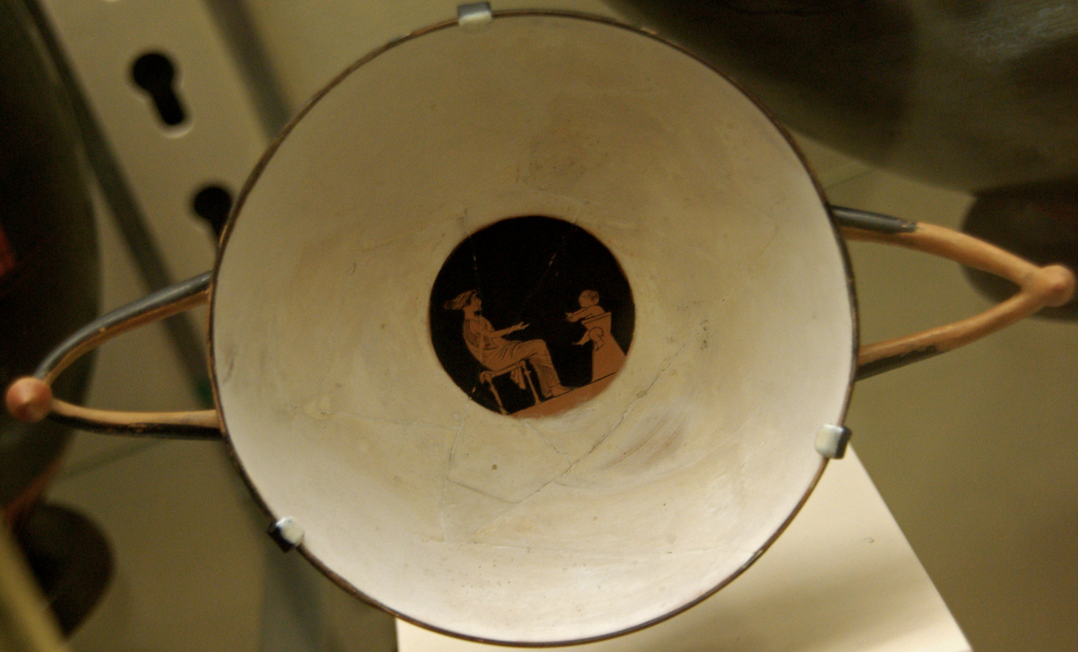
Photo by Sebastià Giralt,
5585261079_dcc2123463_o CC2

Slide 4
Red figure kylix, Athens, c.500-450BCE.
Musees Royaux de Cinquantenaire,
Brussels, Belgium, A890.

Slide 5
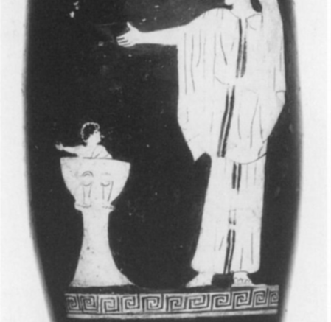
Red figure lekythos, Attica c.460BCE.
Antikensammlungen, Berlin, Germany, 2209.

Slide 6
Black figure potty chair, 6th century BCE, Athenian Agora Museum, P18010.
Papadopoulos, J.K., and Lynch, K.M., 2006, ‘Sella Cacatoria. A Study of the Potty
in Archaic and Classical Athens’, Hesperia 75, pp. 1-32.

Slide 7
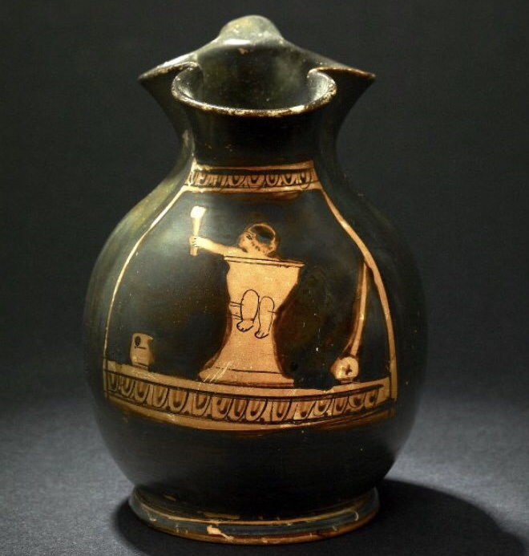
British Museum,
1910.0615.4

Slide 8
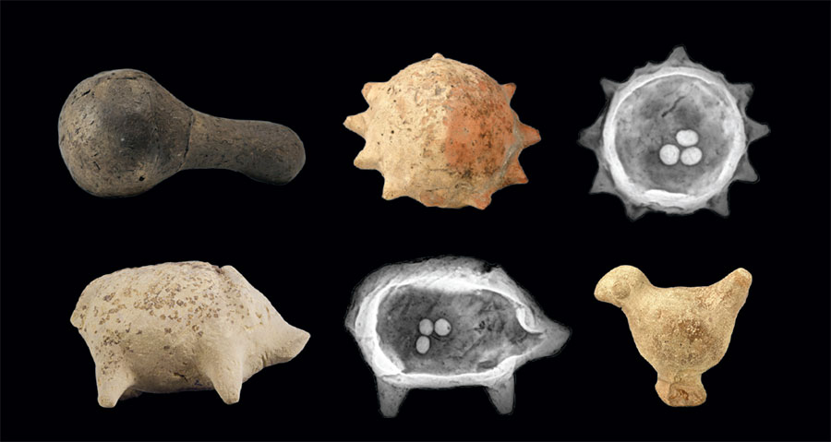
Ancient Greek rattles now housed in the Penn Museum, USA.
Rattles taught children cause-and-effect and rhythm.

Slide 9
British Museum,
1910.0615.4
Beside the child is a trundle-wheel. These would help children learn to walk. They are still used today.

Slide 10
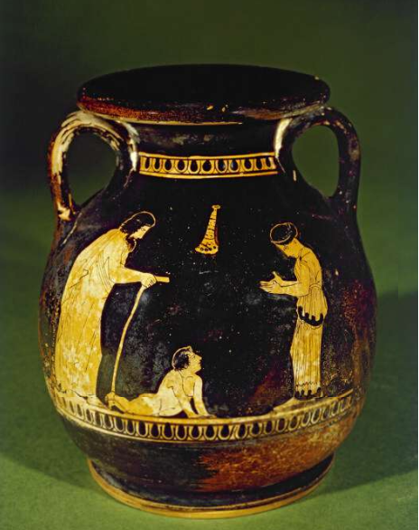
Adults encourage a toddler to walk.
Red figure pelike, Attica c.440-420BCE.
British Museum, UK.
1864,1007.189
https://www.britishmuseum.org/collection/object/G_1864-1007-189

Slide 11
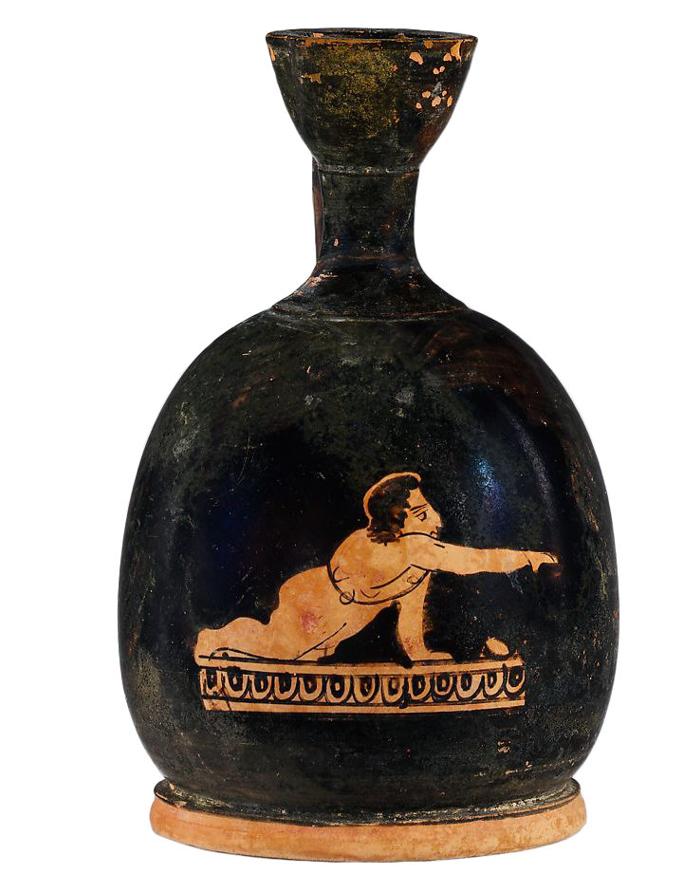
This toddler wears a string of charms around his torso. These were thought to protect the child by keeping away malign forces.
Red figure squat lekythos, Attica c.420BCE.
Metropolitan Museum, USA.
57.12.19
https://www.metmuseum.org/art/collection/search/254957

Slide 12
British Museum,
1910.0615.4
Beside the child is a small jug. This represents the need for a child to learn cleanliness, and to learn about rituals such as libations – liquid offerings.

Slide 13
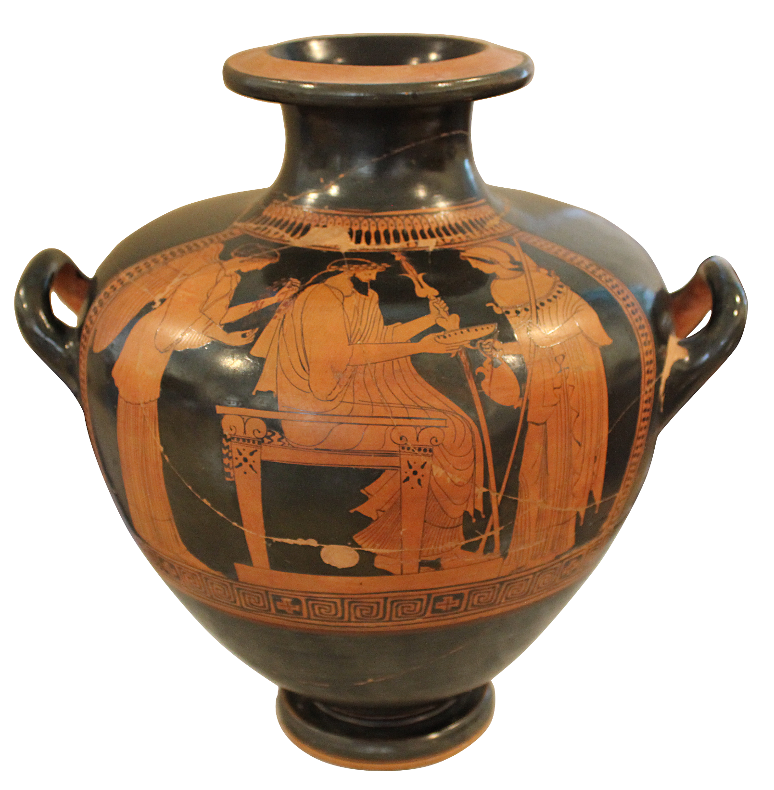
Zeus and Athena perform a libation. See:
https://www.panoply.org.uk/libation
Red figure hydria, Attica, c.450BCE.
National Museum in Warsaw, Poland,
142460 MNW.

Slide 14
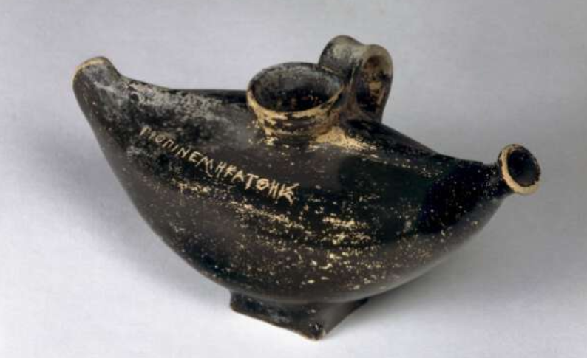
Inscription:
ΓΡΟΓΙΝΕ ΜΗ ΚΑΤΘΗΙΣ
Προπινε μή κατθής
Translation:
Drink, don't drop.
Black glazed baby feeder.
Made by Greeks in Italy c.350-300BCE. British Museum, UK, 1836,0224.262
https://www.britishmuseum.org/collection/object/G_1836-0224-262

Slide 15
This PowerPoint was made by Dr Sonya Nevin of the Panoply Vase Animation Project, for the ERC-funded project Locus Ludi, https://locusludi.ch/.
It supports the animation The Rattle https://www.panoply.org.uk/rattle
Feel free to use it for educational purposes, including editing the PowerPoint and embedding the animation and/or About the Rattle documentary from YouTube.
Please do not post it online.
The PowerPoint can be downloaded from: https://www.panoply.org.uk/rattle

