Slide 1
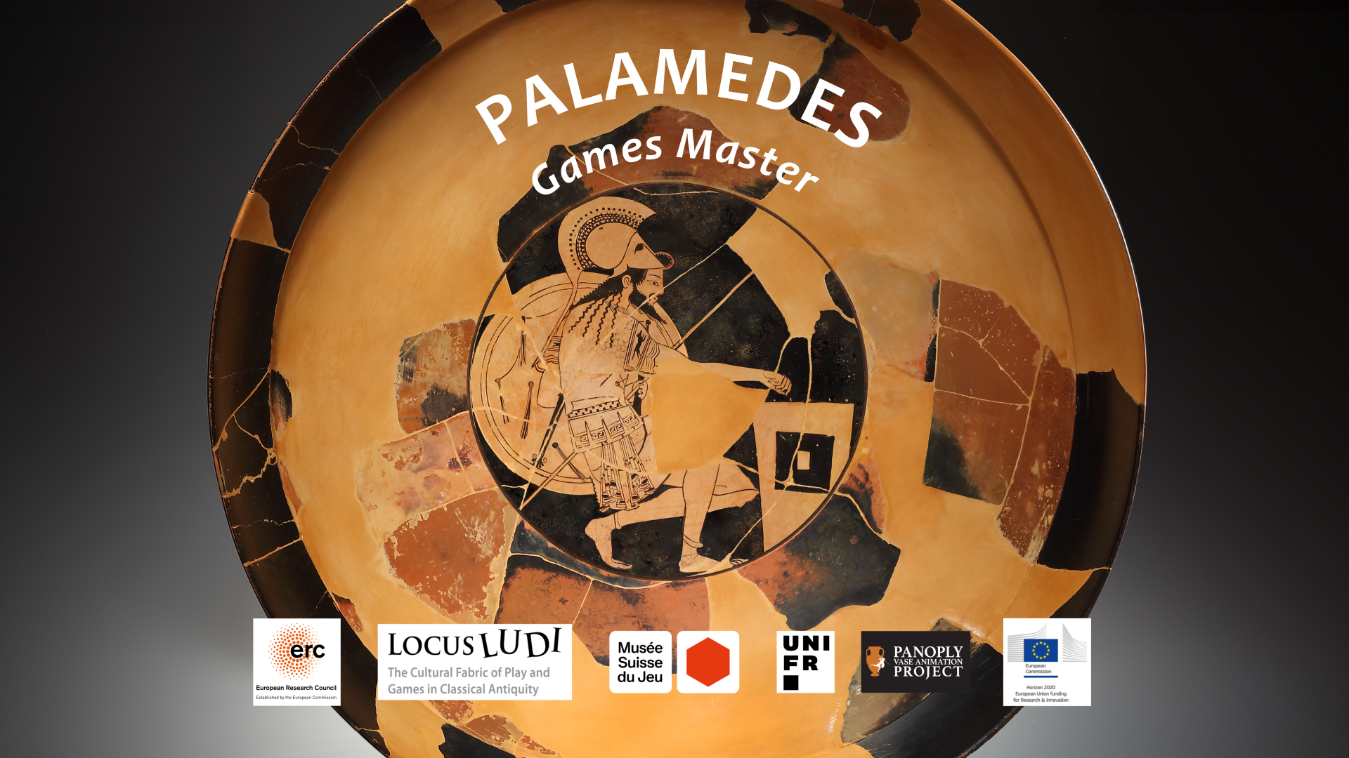
Palamedes. Games Master

Slide 2
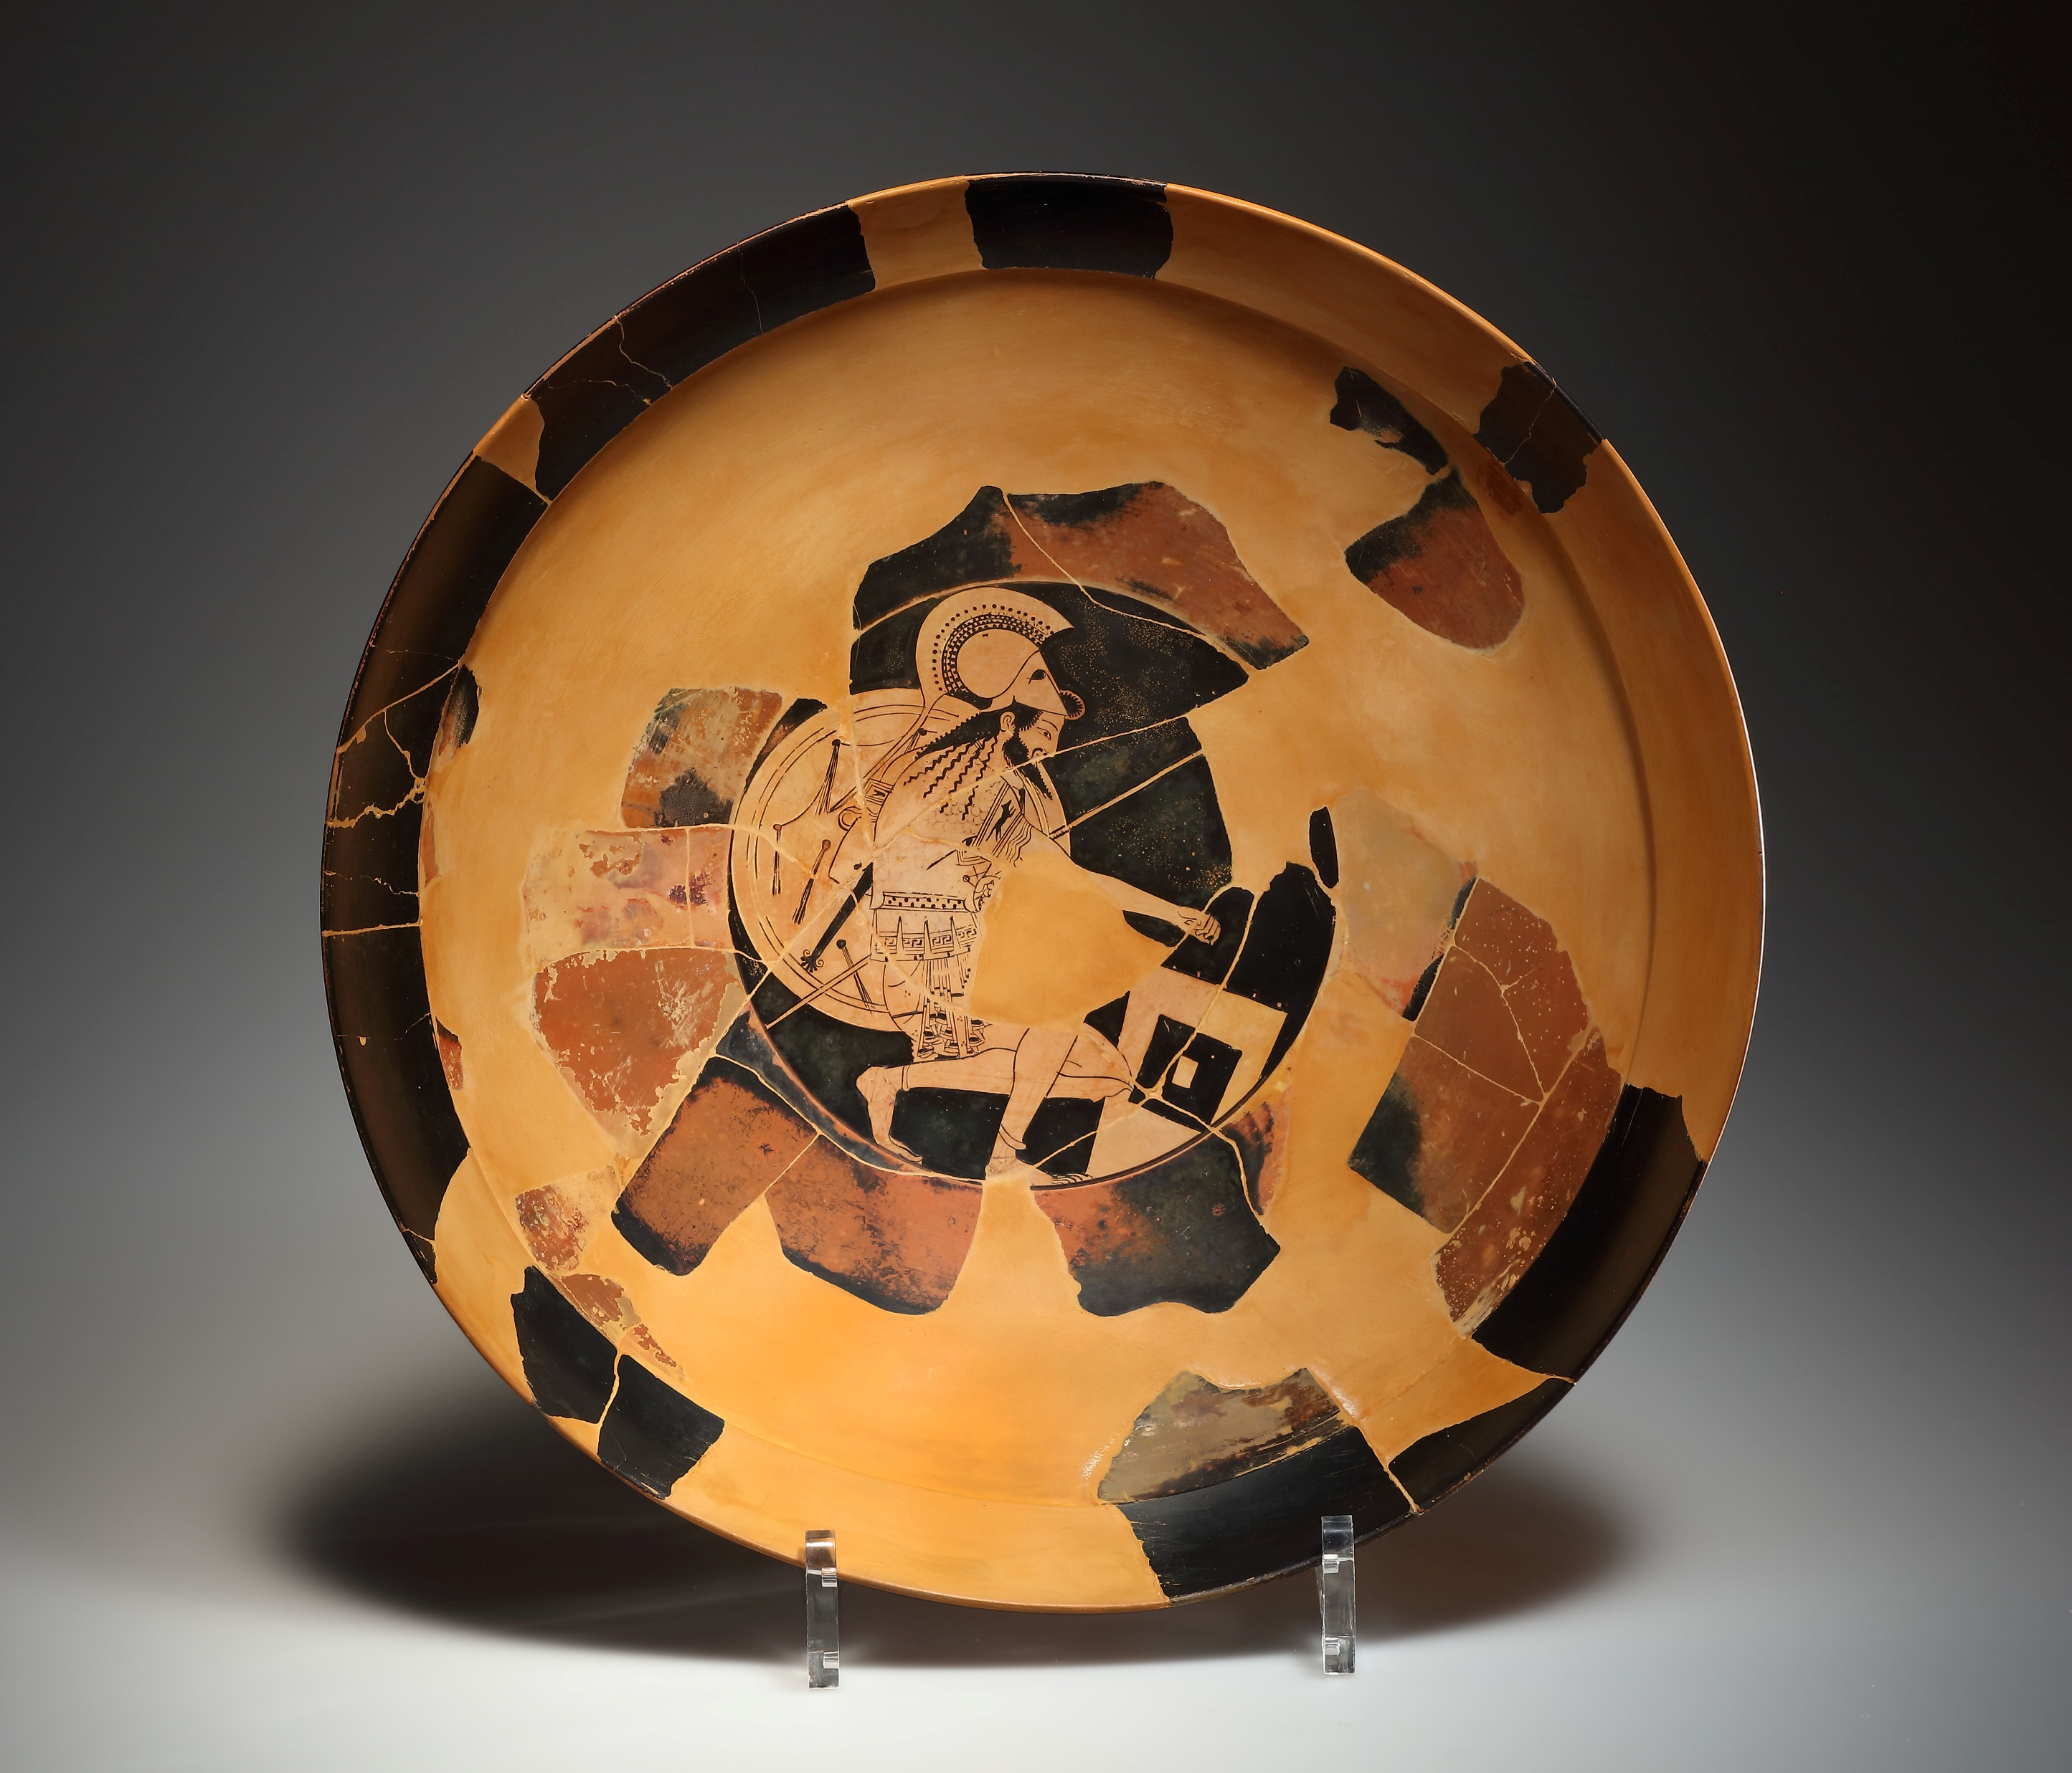
Palamedes cup, red-figure, late 6th century.
Cahn Gallery, 133.
Beazley: 275053.
ARV² 1626.115, 1708.

Slide 3
Palamedes cup, red-figure, late 6th century.
Cahn Gallery, 133

Slide 4
About Palamedes:
Palamedes was a Greek hero who fought in the Trojan War. His father was Nauplius, King of the island of Euboea, whom some say was the son of Poseidon, though others say Poseidon and Nauplius were his distant ancestors.
Palamedes was known for his great intellect. He was said to have invented many useful devices, such as alphabetic letters, mathematical symbols, the use of letters as number symbols, and the first Greek boardgame. His inventions developed civilisation by encouraging order. The Greek army whiled away their time with Palamedes’ game as they waited at Aulis to depart for Troy, and later through the long years of the Trojan War. The game was a helpful distraction, which reduced quarrelling and in-fighting within the army….

Slide 5
Palamedes himself nonetheless became a victim of in-fighting. An early story tells us that Palamedes became a terrible enemy of Odysseus, King of Ithaca. Odysseus was bound by an oath to join the mission to Troy, but he really didn’t wish to go. Odysseus pretended to be mad; Palamedes saw through his deception and revealed it, forcing Odysseus to leave his family and join the army.
Odysseus got revenge much later by forging a letter from King Priam to Palamedes, pretending that Priam was bribing Palamedes to betray the Greeks. King Agamemnon believed the deception and gave Palamedes over to the Greek army for execution. The grief-stricken Nauplius got his own revenge, causing many of the Greek leaders wives’ to be unfaithful to their husbands, and wrecking the Greeks’ ships off the Euboean coast by luring them in with false beacons.
Palamedes is not mentioned in the Odyssey, and even in ancient Greece, some said that he was a later invention. Nonetheless, he was a celebrated figure, known for his cleverness and ingenuity, and pitied for his ignoble death.

Slide 6
In the 5th century, the great orator, Gorgias, wrote his Apology of Palamedes, an example for up and coming legal speech-writers of how to write a defence speech using someone’s good points to defend them against accusations. Gorgias imagines Palamedes putting forward his inventions in his defence when the Greek army accuse him of being a traitor:
I am a great benefactor to you, to the Greeks and to all people… For who would have transformed human life from resourceless to resourceful, and from disordered to ordered, by inventing military formations (the most important thing for victories), written laws (the guardians of justice), letters (an instrument of memory), measures and weights (resourceful means of exchange for commerce), mathematics and number symbols (the guardian of valuables), signal fires (the strongest and swiftest messengers), and play with counters (a painless way of passing leisure time)?
Gorgias, Apology of Palamedes, 30 (5th century BCE).

Slide 7
Omens and Signs:
Palamedes’ inventions can also be thought of as a particular insight into divine signs which were there, but which most people couldn’t properly interpret.
One of Plato’s speakers talks about the ideas being ‘revealed’ to Palamedes. [See the next slide].
In the ancient Greek world, all sorts of things could be interpreted as a sign from a god, such as dreams, rainbows, earthquakes, the movement of animals, chance encounters - as well as the signs contained in livers revealed by sacrifice.
Palamedes gains his insight when he sees a flock of cranes flying in a triangular delta (D) shape.

Slide 8
Once while the Greeks were in assembly some cranes happened to be flying in their customary formation, and Odysseus looked at Palamedes and said, “The cranes call the Greeks to witness that it was they who discovered writing, not you.” Palamedes answered, “I did not discover writing—I was discovered by writing, since it had long been stored in the house of the Muses waiting for the right man; the gods customarily make known such things through wise men. The cranes, however, do not claim to make letters; they show their admiration for military order and arrangement in their flight; in fact, they are flying to Libya to fight with some tiny men. But then, arrangement is something you can’t speak of, since you always ignore it in battle.”
Philostratus, Heroicus, 33.10 (2nd -3rd century CE).

Slide 9
Clinias: Do you mean that these things were unknown to the men of those days for thousands upon thousands of years, and that one or two thousand years ago some of them were revealed to Daedalus, some to Orpheus, some to Palamedes, musical arts to Marsyas and Olympus, lyric to Amphion, and, in short, a vast number of others to other persons—all dating, so to say, from yesterday or the day before?
Plato, Laws, 3.677d (4th century BCE).

Slide 10
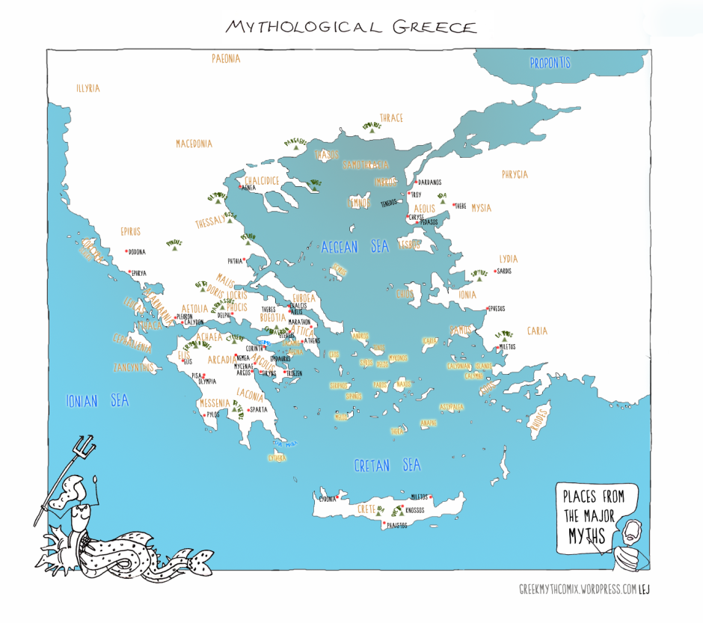
Greek Myth Comix

Slide 11
The Epic Cycle is a collection of epic poems which together tell the story of Greece from creation to the end of the age of heroes.
While the Iliad and Odyssey survive intact, the rest are known through fragments or by summaries written by later writers.
The Epic Cycle was composed across the 7th and 6th centuries.
The Cypria told the story of the lead up to the Trojan War.
The following slide contains sections of the Cypria which relate to Palamedes.
These suggest that the story of the enmity between Odysseus and Palamedes was very old, and that there were other stories about Palamedes’ death which differ from the story of him being framed.

Slide 12
They travelled over Greece and gather the leaders, detecting Odysseus when he pretends to be mad, not wishing to join the expedition, by seizing his son Telemachus for punishment at the suggestion of Palamedes.
Cypria, 1 (appears in Proclus, Chrestomathy, 1).
Patroclus carries away Lycaon to Lemnos and sells him as a slave, and out of the spoils Achilles receives Briseis as a prize and Agamemnon Chryseis. Then follows the death of Palamedes. Cypria, 1.
Palamedes drowned when he went out fishing; Diomedes and Odysseus caused his death. I know, because I have read it in the epic Cypria. Cypria, 19 (appears in Pausanias, 10.31.2).

Slide 13
Troy:
When the Greeks planned to sail for Troy, they found themselves trapped at Aulis as the winds would not blow right for them. Palamedes’ new game gave soldiers something to do while they waited. Euripides set his play, Iphigenia at Aulis, in the Greek camp there. The Chorus see the Greek heroes passing their time, some talking, some exercising with a discus, and Protesilaus and Palamedes playing the new game:
Chorus: Through the grove of Artemis, rich with sacrifice, I sped my course, my cheek red with maiden modesty, in my eagerness to see the soldiers' camp, the tents of the armour-clad Greeks, and their crowd of horses.
I saw two met together in council; one was Ajax, son of Oileus (Lesser Ajax); the other Ajax, son of Telamon (Great Ajax), crown of glory to the men of Salamis; and I saw Protesilaus and Palamedes, sprung from the son of Poseidon, sitting there amusing themselves with intricate figures at checkers; Diomedes too at his favourite sport of discus; and Meriones, Ares' son, a marvel to mankind, stood at his side; likewise I beheld Odysseus the son of Laertes, who came from his island hills, and with him Nireus, the most handsome of the Achaeans.
Euripides, Iphigenia at Aulis, 185-205 (5th century BCE).

Slide 14
Odysseus, not wishing to go to the war, feigned madness. However, Palamedes, son of Nauplius, proved his madness to be a deception; and when Odysseus pretended to rave, Palamedes followed him, and snatching Telemachus from Penelope’s breast, drew his sword as if he would kill him. In his fear for the child, Odysseus confessed that his madness was pretend, and he went to the war.
Having taken a Phrygian prisoner, Odysseus forced him to write a letter that appeared to be treasonous ostensibly sent by Priam to Palamedes. Having buried gold in Palamedes’ quarters, Odysseus dropped the letter in the camp. Agamemnon read the letter, found the gold, and delivered up Palamedes to the allies to be stoned as a traitor.
Pseudo-Apollodorus, Epitome, 3.7-8 (c.1st-2nd century CE).

Slide 15
[Some of the returning Greek ships were]driven to Euboea by night. Nauplius kindled a beacon on Mount Caphareus; and they, thinking it was some of those who were saved, headed towards the shore. The vessels were wrecked on the Capherian rocks, and many men died.
Palamedes, the son of Nauplius and Clymene daughter of Catreus, had been stoned to death through the schemes of Odysseus, and when Nauplius learned of it, he sailed to the Greeks and claimed satisfaction for the death of his son; but when he returned unsuccessful (for they all favoured King Agamemnon, who had been Odysseus’ accomplice in the murder of Palamedes, he coasted along the Greek lands and contrived that the wives of the Greeks should betray their husbands: Clytemnestra with Aegisthus, Aegialia with Cometes, son of Sthenelus, and Meda, wife of Idomeneus, with Leucus…
These were the earlier contrivances of Nauplius; afterwards, when he learned that the Greeks were on their way home to their native countries, he kindled the beacon fire on Mount Caphereus, which is now called Xylophagus; and there the Greeks, approaching the coast in the belief that it was a harbour, were killed.
Pseudo-Apollodorus, Epitome, 6.7-11 (c.1st-2nd century CE).

Slide 16
Menelaus: How do you stand in the city after that deed of yours?
Orestes: I am so hated that no one will speak to me.
Menelaus: Have your hands not even been cleaned of blood, according to custom?
Orestes: No, for wherever I go, the door is shut against me.
Menelaus: Which citizens are driving you from the land?
Orestes: Oeax [Palamedes’ brother], who refers to my father his reason for hating Troy.
Menelaus: I understand; he is avenging on you the blood of Palamedes.
Orestes: That was nothing to do with me; yet I am destroyed for three reasons.
Euripides, Orestes, 427-424 (5th century BCE).

Slide 17
The myth of Nauplius and his sons has been fabricated by the more recent writers of myth, for Homer would not have failed to mention these, if Palamedes had displayed such wisdom and sagacity, and if he was unjustly and treacherously murdered, and if Nauplius wrought destruction to so many men at Cape Caphereus.
Strabo, Geography, 8.6.2 (1st century BCE-1st century CE).

Slide 18
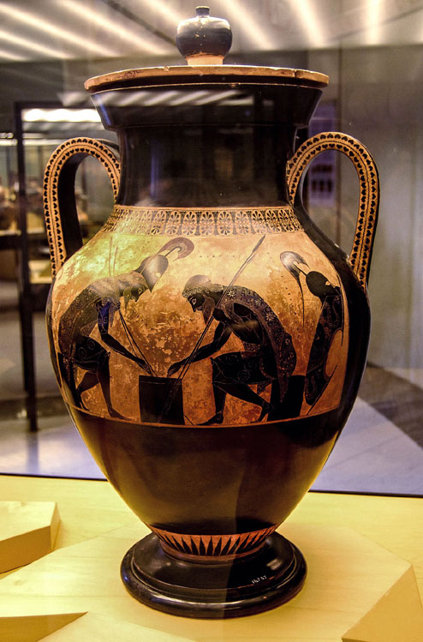
Gaming on pottery:
Black figure amphora, c.540-530 BCE, by Exekias.
Achilles and Ajax gaming, playing a game such as the one invented by Palamedes.
Vatican Museum 344.
See this scene animated by Panoply at:
https://www.panoply.org.uk/clash-dicers
https://www.beazley.ox.ac.uk/record/A33A92D1-A210-456B-9738-EB257BDE1306

Slide 19
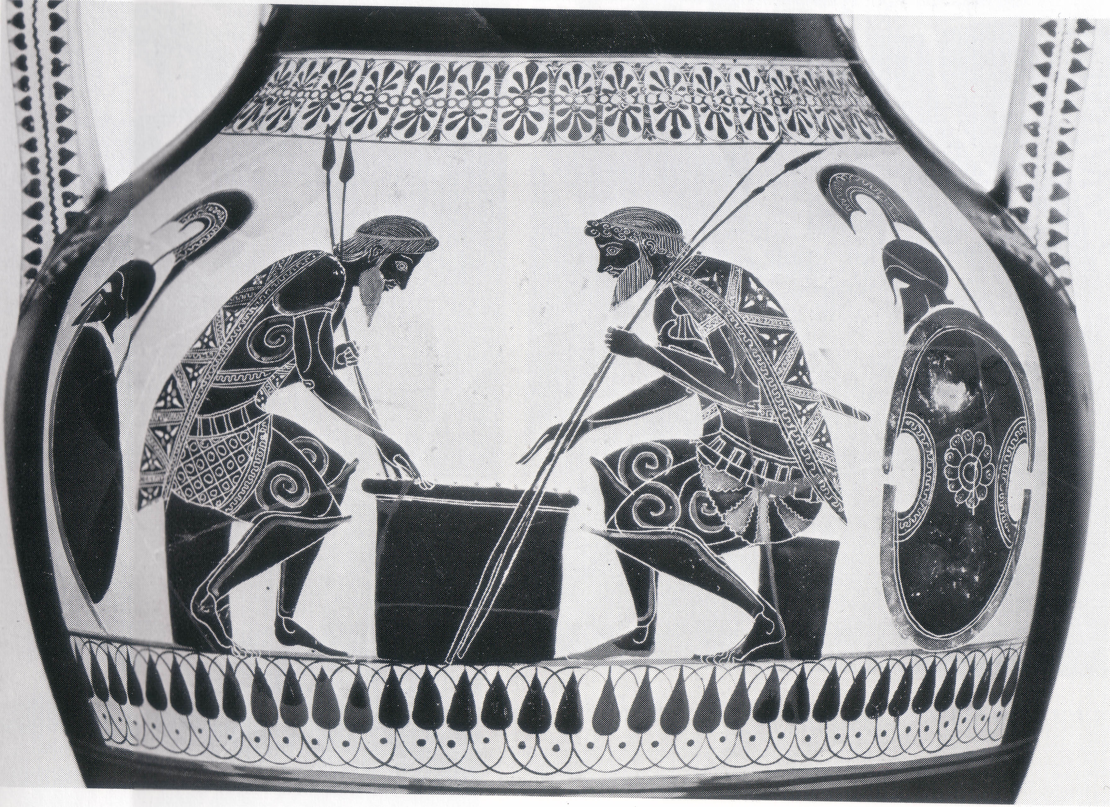
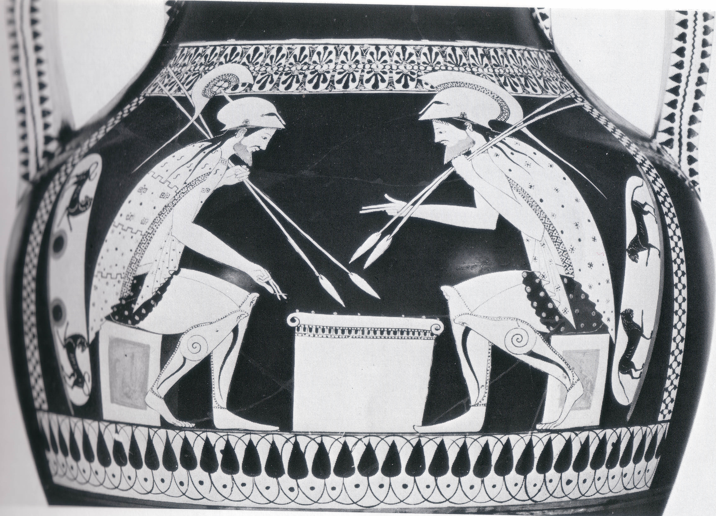
These are the opposite sides of the same amphora.
They both show Achilles and Ajax playing a boardgame.
Spot the difference!
This style is known as a ‘bilingual vase’.
Andokides Painter, Boston (MA), Museum of Fine Arts: 01.8037.

Slide 20
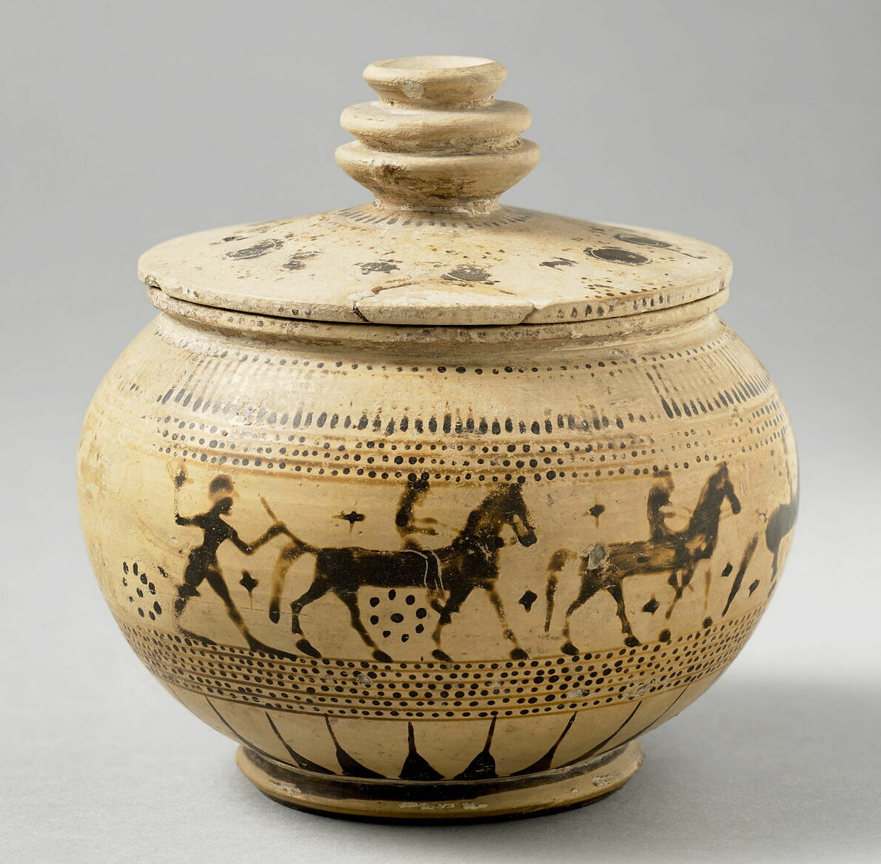
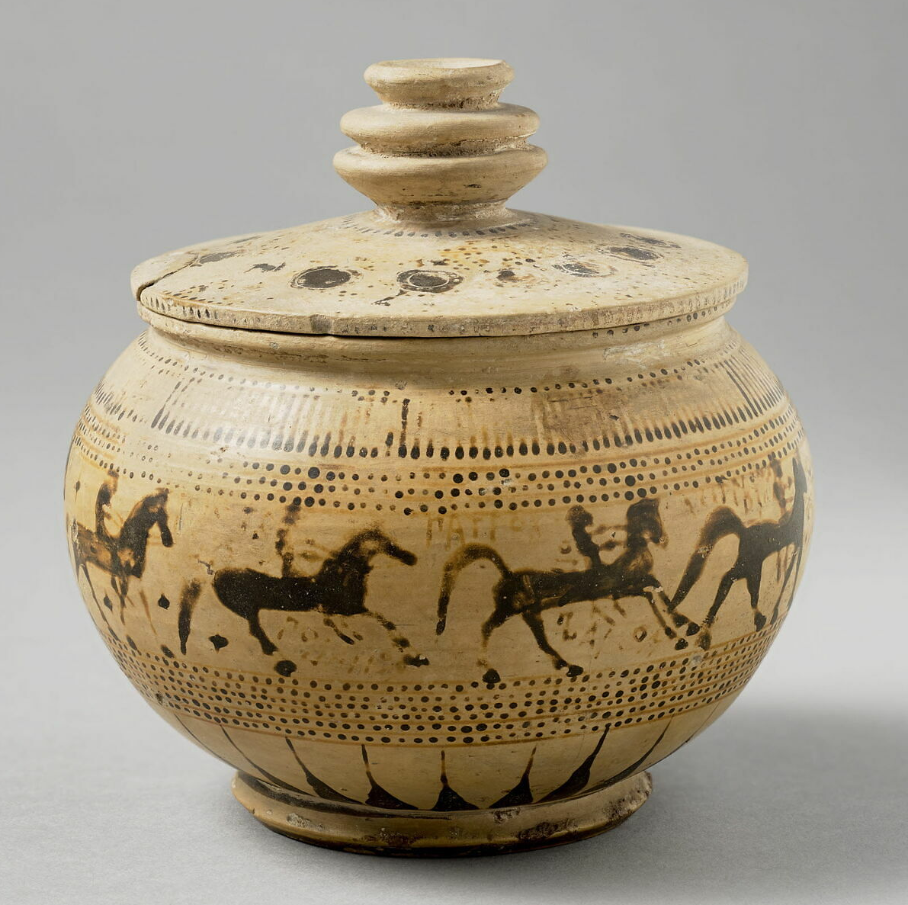
Palamedes on pottery:
Corinthian pyxis with lid, made c.575-550BCE, by Chares.
Louvre Museum, E 609.1
The pot has 13 inscriptions painted in boustrophedon (right to left, then left to right), written in the Corinthian alphabet. They label heroes and horses of the Trojan War and name Chares as potter.
The labelled heroes are: Palamedes; Nestor; Protesilaus; Patroclus; Achilles; Hector; and Memnon.
https://collections.louvre.fr/ark:/53355/cl010250295

Slide 21
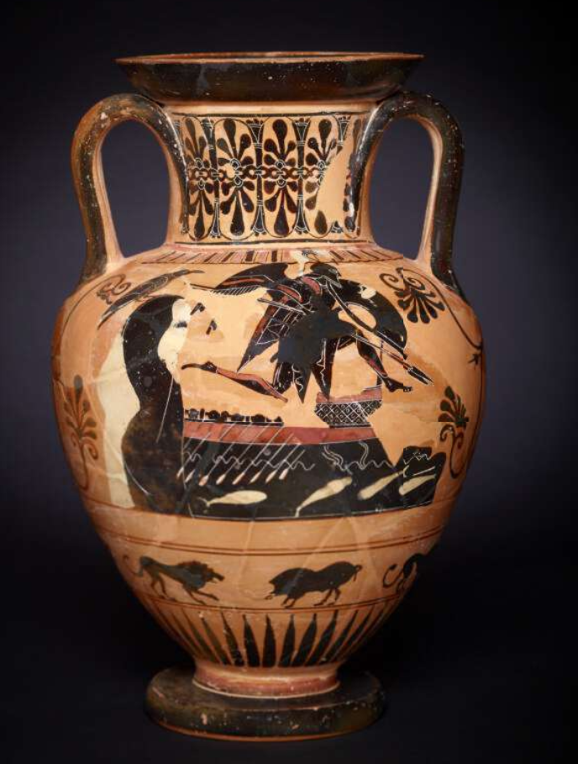
Attic black-figure amphora, c.510-500BCE.
British Museum 1848,0619.2.
https://www.britishmuseum.org/collection/object/G_1848-0619-2
This image is often interpreted as the ghost of Achilles or Patroclus, however, Susan Woodford has argued that it represents Palamedes’ ghost:
‘[This scene] represents the Greek fleet returning from Troy and… the winged warrior is the ghost of Palamedes rushing before it to alert his father to the fact that the moment for revenge is approaching. This explanation would also account for the beetling cliff-a proleptic allusion to the Capherian rocks and the presence of the bird. Birds can appear on vases without carrying any profound meaning, but they can often be interpreted as ill-omened, an indication of doom in the offing.’ p.167.
Woodford, Susan, 1994, ‘Palamedes Seeks Revenge’, Journal of Hellenic Studies, 114, pp. 164-169.
See a larger image on the next slide.

Slide 22
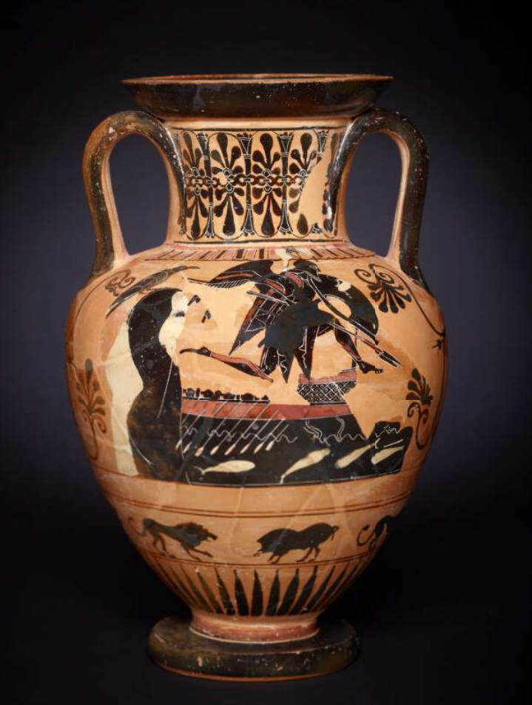
Attic black-figure amphora, c.510-500BCE.
British Museum 1848,0619.2.

Slide 23
The following slides show the outside of the Palamedes cup.
The scene depicted is most likely a dokimasia, a review of the cavalry. Men present themselves and their horses whlie a man stands with a tablet making notes.
The circular shape of the cup presents a very suitable surface for showing a line of horses and men curving around the round shape.

Slide 24
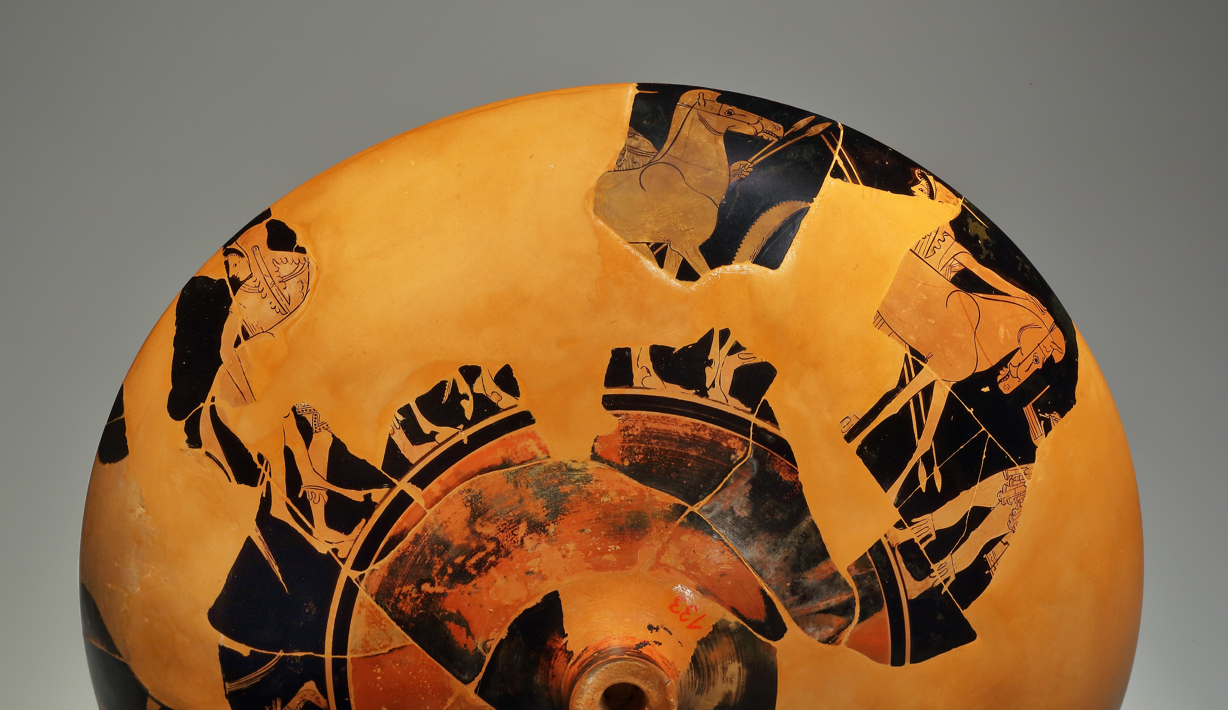
Palamedes cup, red-figure, late 6th century.
Exterior.
Cahn Gallery, 133.
ARV² 1626.115, 1708.

Slide 25
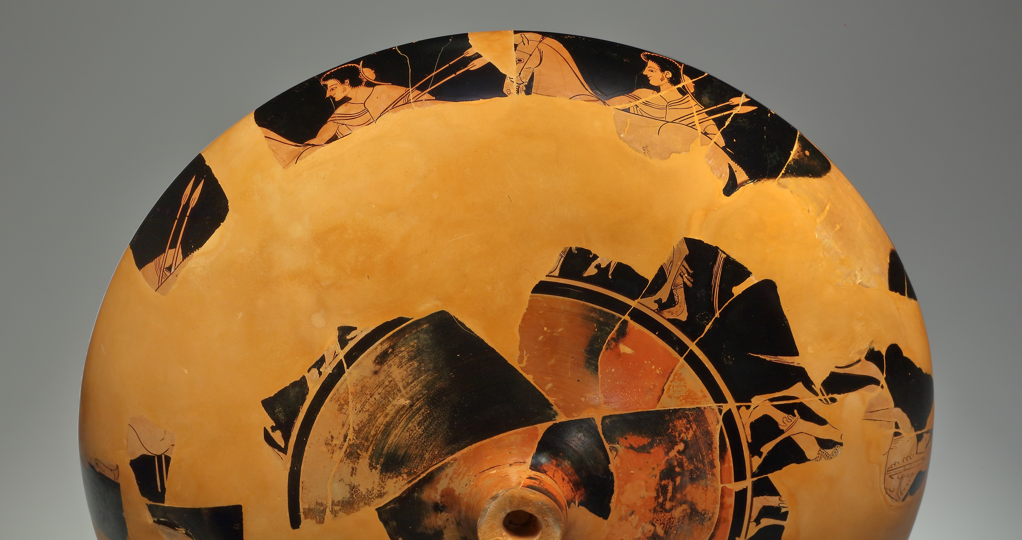

Slide 26
Palamedes cup, red-figure, late 6th century.
Exterior.
Cahn Gallery, 133.
ARV² 1626.115, 1708.
Photos from Cahn, Herbert A., 1973, ‘DOKIMASIA’, Revue Archéologique, Nouvelle Série, Fasc. 1, pp. 3-22.

Slide 27
Palamedes cup, red-figure, late 6th century.
Exterior.
Cahn Gallery, 133.
ARV² 1626.115, 1708.
Photos from Cahn, Herbert A., 1973, ‘DOKIMASIA’, Revue Archéologique, Nouvelle Série, Fasc. 1, pp. 3-22.

Slide 28
Aristotle describes the dokimasia, the inspection that we likely see depicted on the exterior of the cup:
The Boule also inspects the horses, and if anybody having a good horse keeps it in bad condition, it fines him the cost of the feed. Horses that cannot keep up with the squadron or will not stay in line but run off are branded on the jaw with the sign of a wheel, and a horse so treated has failed to pass the inspection.
It also inspects the mounted skirmishers, to see which it considers fit for fighting duty, and any that it votes to reject lose their horse and rank. It also inspects the foot-soldiers that fight in the ranks of the cavalry, and anyone it votes against is stopped from drawing his pay.
Aristotle, Constitution of the Athenians (Ath.Pol.), 49.1. (4th Cent. BCE)

Slide 29
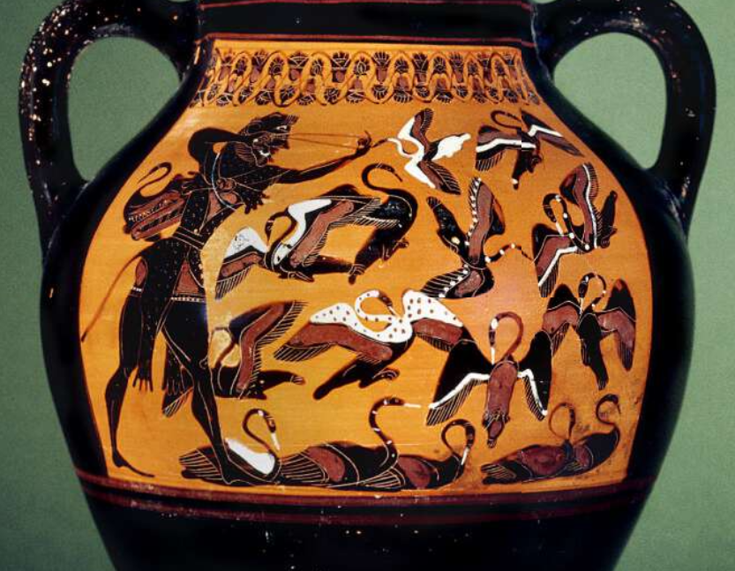
This vase was used as a style guide
for the cranes that appear before
Palamedes.
Black-figure amphora, c.540BCE.
Heracles slaying the Stymphalian birds
British Museum 1843,1103.40
https://www.britishmuseum.org/collection/object/G_1843-1103-40

Slide 30

This PowerPoint was created by Dr Sonya Nevin of the Panoply Vase Animation Project.
It supports the animation Palamedes. Games Master: www.panoply.org.uk/palamedes-games-master
Palamedes. Games Master was made as part of the Locus Ludi project: https://locusludi.ch/
Feel free to use it for educational purposes, including editing the PowerPoint and embedding the animation from YouTube.
Please do not post the PowerPoint online.
The PowerPoint can be downloaded from: www.panoply.org.uk/palamedes-games-master

